Slide 1
INFC 215 Infection Prevention and Control
Donning/Doffing
Procedure/ Surgical Mask with Elastic Ear Loops

Slide 2
Donning
Putting ON

Slide 3
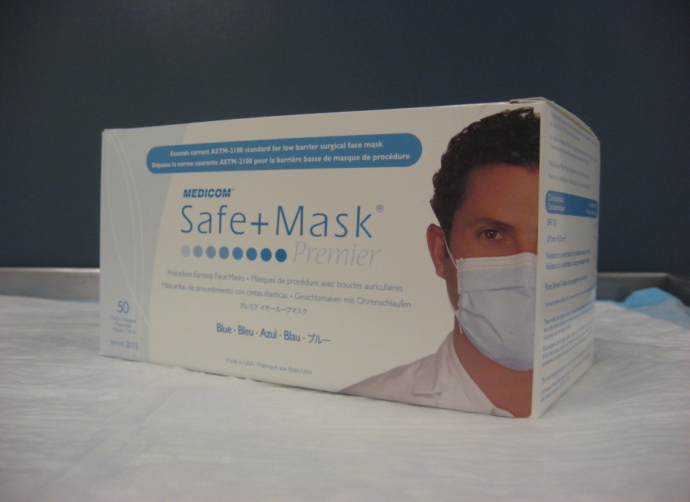
Select procedure / surgical mask
When?
As part of Routine Practice
(if anticipating splashes)
or if patient requires droplet isolation precautions

Slide 4
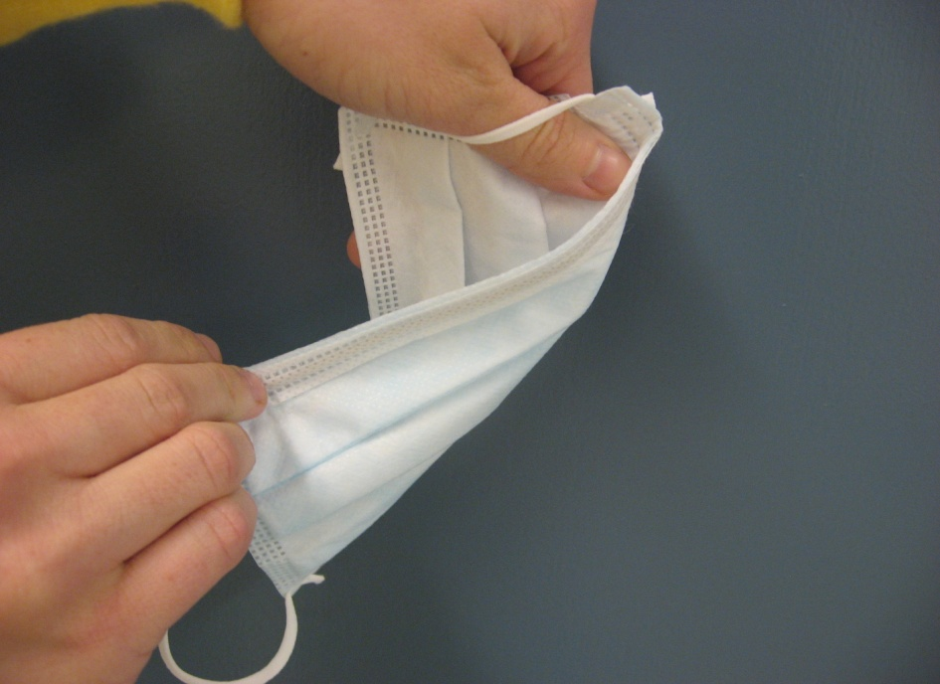
2. Fluid resistant side out
Ensure that the mask is put on with the fluid resistant shield out (not against your face)
The shield is often colored.

Slide 5

3. Place mask over your nose and mouth
The metal strip goes over the nose
Loops go over your ears

Slide 6
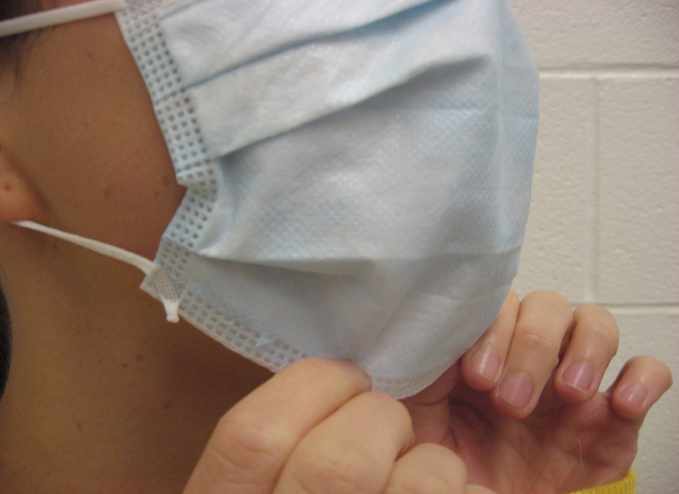
4. Separate folds of the mask
Ensure that your nose and chin are completely covered

Slide 7

5. Ensure a snug fit over your nose and cheeks
Use fingers of both hands to press the metal strip

Slide 8
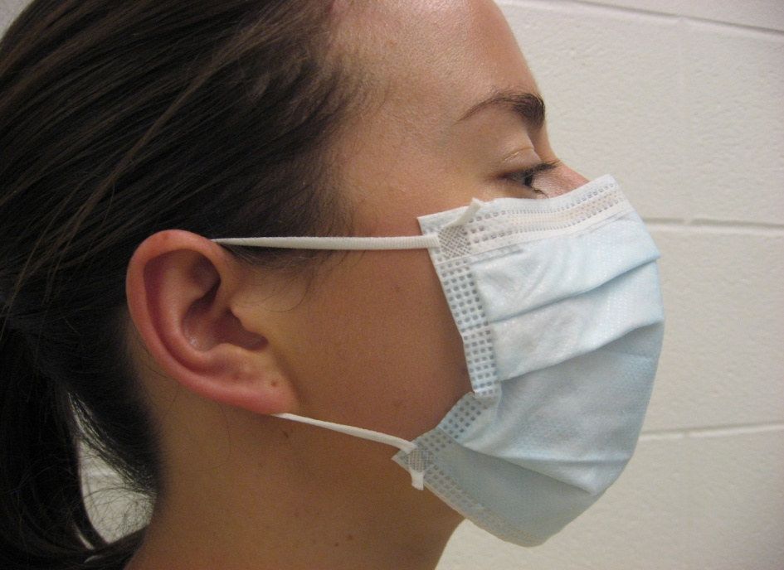
6. Check
Is the mask properly adjusted?

Slide 9
Doffing
Taking OFF

Slide 10
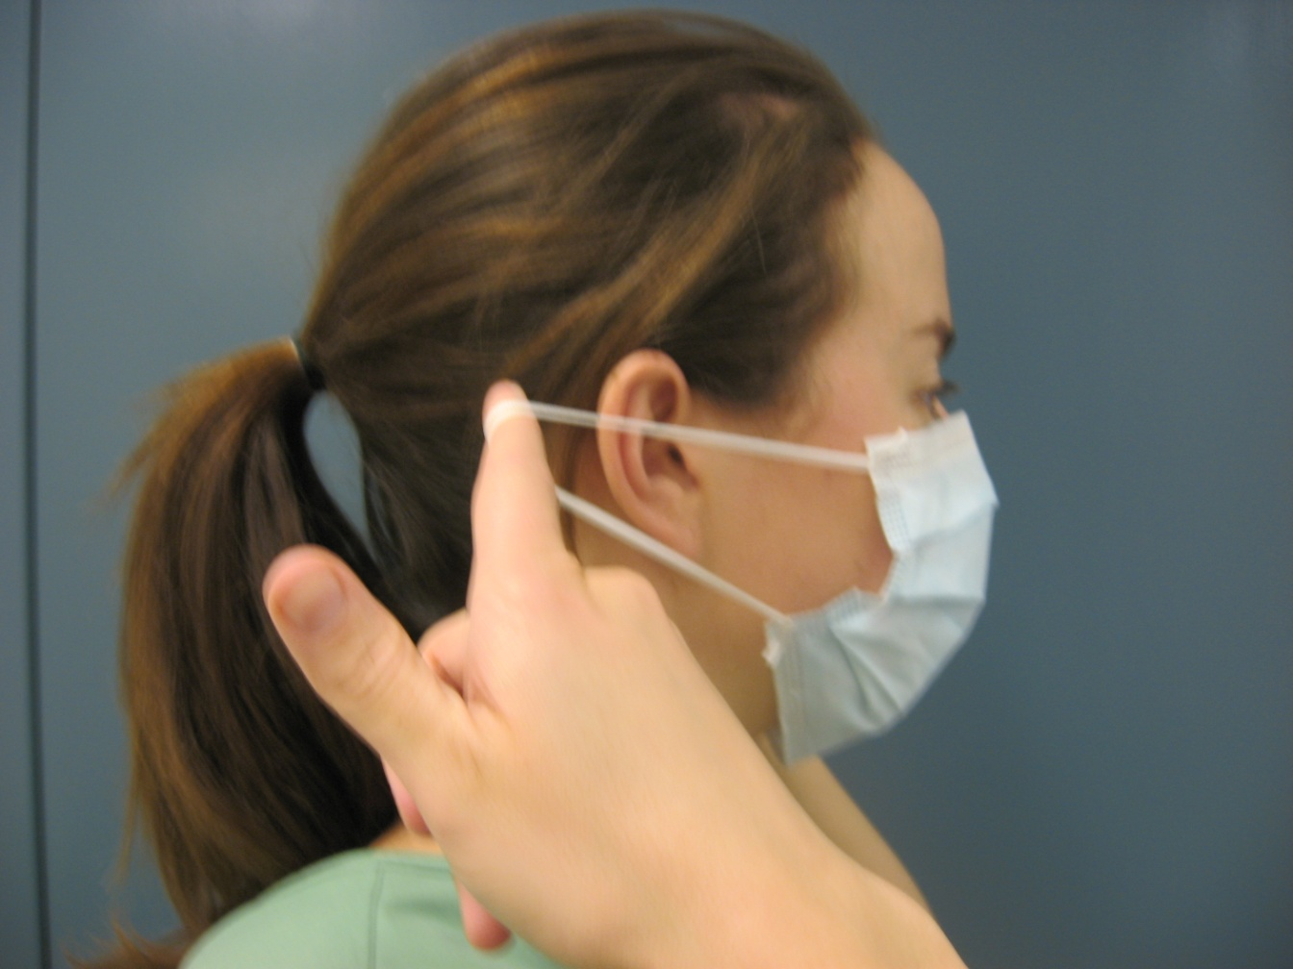
1. Grasp ear loops with clean hands

Slide 11

2. Pull mask away from face

Slide 12
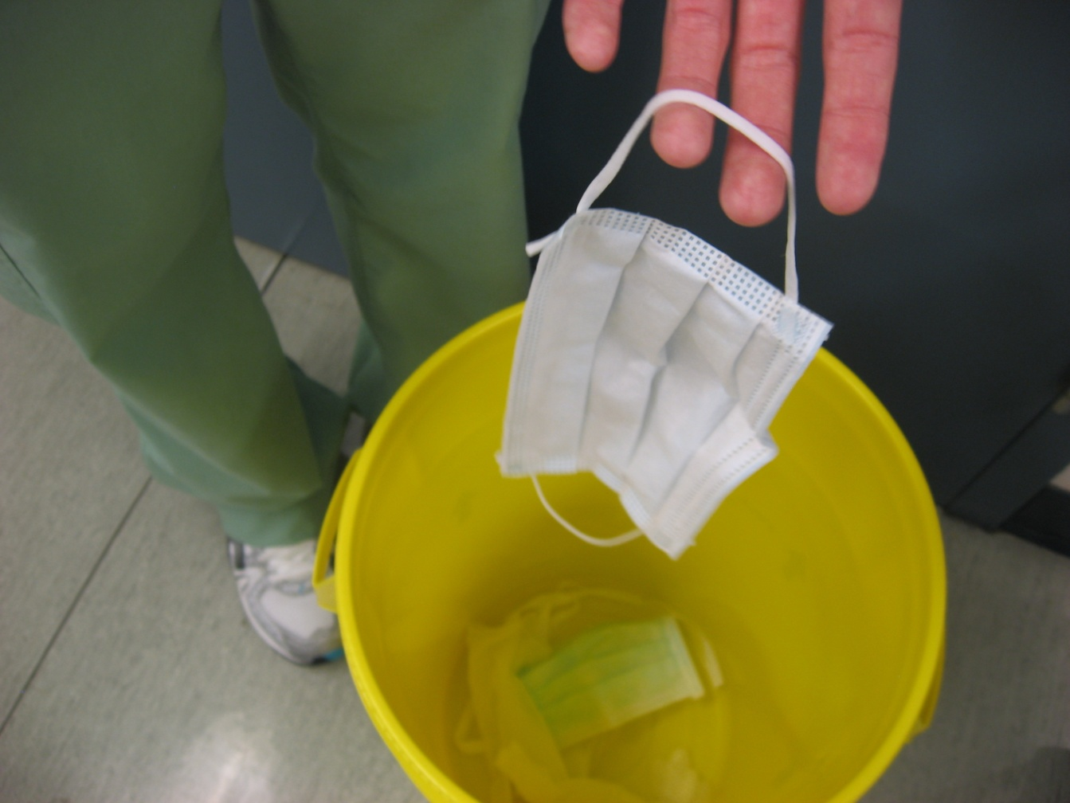
3. Discard into disposal container

