Slide 1


Medical Esthetics
Glands

Slide 2
The endocrine system is a group of specialized glands that affect the growth, development, sexual activities, and state of health in the entire body. Glands are specialized organs that produce chemicals, including hormones, necessary for various body systems to function optimally
Glands That Make Up the Endocrine System

Slide 3
How Is This Important?
The esthetician’s treatment plan can be greatly impacted by the functioning of the client’s endocrine system. Hormonal imbalances can cause hair growth, affect oil production, and increase acne breakouts, melanin production, and skin sensitivity. Uncontrolled diabetes, which is a disease influenced by the production of insulin, affects the nerves, vision, and immune system to name a few. A person with diabetes may have neuropathy and sensation loss in the extremities, for example. If you were to do a paraffin wax treatment and the wax was too hot, the client with diabetes may be unable to sense the burn and alert

Slide 4
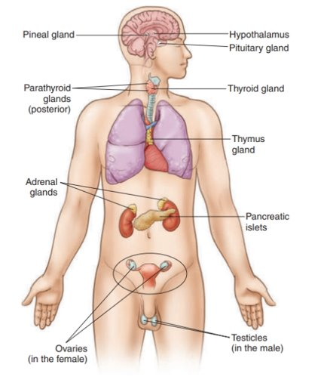

Slide 5
Endocrine Glands
Also known as ductless glands , release secretions called hormones directly into the bloodstream, which in turn influences the welfare of the entire body. Hormones such as insulin, adrenaline, and estrogen stimulate functional activity or secretion in other parts of the body.

Slide 6
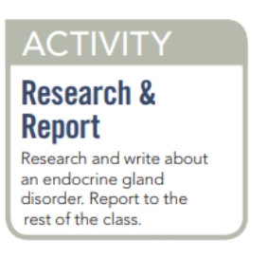

Slide 7

Functions
· The pituitary gland
· The thyroid gland
· The parathyroid glands
· The pancreas
· The adrenal glands
· The ovaries and testes

Slide 8


Slide 9

QUESTIONS?

