Slide 1
MRAD 285:
Radiographic Applied Skills
Mobile Radiography

Slide 2
Mobile Radiography
Mobile radiography equipment has significant limitations as compared with the equipment in the department
Should only be done when:
  Ordered by a physician
  Patient’s condition makes transfer to the department difficult or hazardous
    The patient is too ill or unstable
  Any time a safe patient environment cannot be maintained in the dept
    E.g. a burn victim cannot be examined in the dept because of the risk of infection

Slide 3
Medical Reasons
Some of the medical reasons for mobile radiography include:
  Cardiac or respiratory instabilities
  Metabolic instability
  Hemorrhaging
  Hypothermia
  Burns
  Infectious Diseases

Slide 4
Advantages of Mobile Radiography
Unstable or ill patients can remain in a medically supported environment
  E.g. NICU, ICU, CCU, ER
Physicians and nurses have immediate access to radiographic images
  Increased efficiency of some procedures. i.e line placements – especially with digital units
Patients with infectious diseases can be examined in isolation
  Minimizing risk to others
  Minimize transmission

Slide 5
Disadvantages
Increased risk of radiation exposure
  To general public and hospital workers
Protocols and image quality may be compromised
Errors more easily made
  Patient information, marker placement, patient support equipment
Workload efficiency impacted
  Limited number of mobile units
  Distance between each case – unit to unit
Ergonomically challenging
  Techs need to physically position IR and patient
  Room layout, limited space
  Positioning aids and accessories not available

Slide 6
Most Common Examinations
AP chest – erect, semi – erect and supine
Abdomen – supine or LLD
C-spine – AP and x-table lateral
L-spine – AP and x-table lateral
Post op knee
  AP and/or x-table lateral
Post op Pelvis and Hip - AP
X-table skull

Slide 7
What do these have in common?
  ICU
  NICU
  CCU
  PACU or PAR
  Trauma Bay
  ER
  Orthopedics
  OR
  GI
  All are common areas that dedicated mobile equipment can be found

Slide 8
Postanesthesia Care Unit
Located just outside of surgical suite to allow easy access by surgeons, anesthesiologists and hospital personnel
Can be called “Recovery Room”
Surgical attire is not required for entry
In the PACU, mobile radiographic exams are ordered to:
  Check line placement
  Rule out pneumothorax or atelectasis
  Check orthopedic hardware placement

Slide 9
Neonatal Intensive Care and Newborn Nursery
NICU – is a special unit for the care of babies who are premature, have a low birth weight, or have a health issue
In NICU, mobile exams are often performed on babies in incubators
  Imperative to keep baby warm
  Shielding is essential
    If not direct shielding, shadow shielding
  Gowns and gloves are required when handling these infant patients

Slide 10
NICU
Even though the patient may not be on protective precautions, still important to pay attention to medical asepsis for the infant’s safety
    Disinfect x-ray equipment
      Dedicated mobile
    Hand hygiene
    Gown, gloves
    Shielding
    Markers
    IR – need protective covering

Slide 11
NICU
  Typically the neonate will be imaged within the incubator, a nurse/staff member will assist.
  Sometimes there is a tray built into the incubator for cassettes, otherwise the cassette will need to go under the infant
  If opening the unit to place IR, move quickly to maintain temperature
  Nurse will assist with positioning patient and IR, but the technologist must provide clear instructions
  If it is an open incubator, ensure that the lamp is moved before centering the tube to avoid collision

Slide 12
Intensive Care and Coronary Care Units
ICU and CCU are used to care for very ill patients who require constant monitoring
Chest radiographs are the most common exams requested
Technologists must maneuver around lots of specialized equipment – be careful!
  Cords, catheters, lines, devices (suction, dialysis)
  Space is limited!

Slide 13
Procedure
Notify the nurse in charge, before starting the exam
  Coordinate efforts, seek assistance and confirmation
Provide clear instructions
  Explain what you need, and ask if there is anything that needs to be considered (can they be sat up? Is there anything that needs to be watched?)
Speak to patient, even if they are not responsive
  Assume they can hear you, keep communications professional

Slide 14
Procedure
Space is limited at the bedside, consider how much working space you will need
Move equipment around
Locate cords, tubes, drainage receptacles – be aware of their location
Cover IR – higher possibility of fluids leaking from IV lines, dressing and drainage tubes
Breathing instructions – may need to watch
Radiation protection for yourself and others

Slide 15
Prioritizing Exams
STAT and code blue exams are first priority
then
CCU and ICU and NICU
then
Routine In-patients

Slide 16
Common Accessory Equipment
Lead aprons
Lead blockers
Markers
Grid
Cassettes and covers
Plastic bags
Pillowcases
Tape

Slide 17
Managing a Mobile Examination
Check in at unit’s nursing station to introduce yourself, confirm the request and inquire about the pt’s condition/history
Locate the patient, introduce yourself and conduct a brief survey of the room layout before bringing the mobile into the room
Elicit the help of nursing staff to plan the logistics of equipment set-up and patient management, and to ensure that the examination is conducted in a safe manner

Slide 18
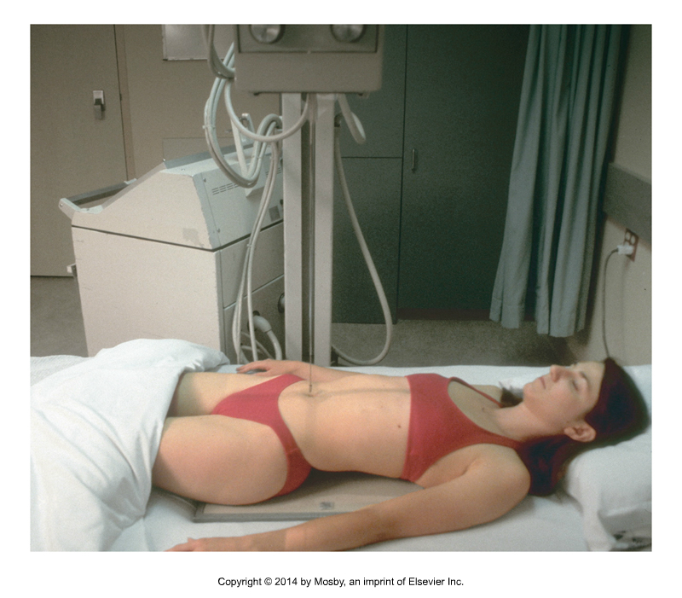
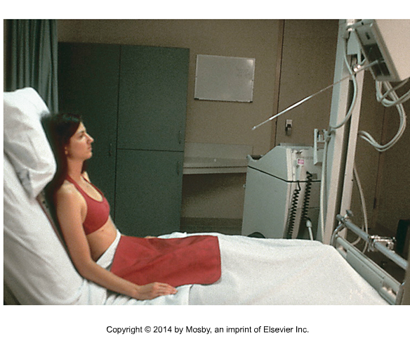
Orienting the machine
Note! - the boom is perpendicular to the edge of the bed
Bontrager 8th ed. fig. 15-49
Note! - the boom is parallel to the foot of the bed
Bontrager 8th Ed. fig. 15-42

Slide 19
Stretcher
Central ray
Boom
Mobile
AP semi erect
Supine
Decubitus/x-table
Decubitus/x-table

Slide 20

Preparing the patient
Always check with nursing staff to determine how much the patient can be moved and/or whether or not they can be raised to a sitting position.
1. If the patient’s hips are not at the same level as the bend in the stretcher, you will need to boost them up with the assistance of nursing staff
2. If the patient is rotated, you will need to correct the rotation. (i.e. place a pillow under the side that is “low”)
3. If the patient is tilted, you will need to prop them up with pillows
Bontrager 8th Fig 15-49

Slide 21
Removing Patient Artifacts
tubes, lines, wires, hoses snaps, bed rails, snaps, towels, pillows, IV bags

Slide 22
Preparations for placing the IR…
Tape markers to the IR in a location that will not interfere with the required anatomy
Slide the IR into a plastic bag or a plastic cassette holder to protect it, and to make it easier to slide between sheets or under the soaker pads
With the help of nursing staff develop a plan for getting the IR in place ergonomically, safely, and efficiently

Slide 23
Technique Considerations
Why is this important?
Mobile equipment does not have AEC
Sometimes the appropriate SID cannot be achieved
What if the SID is shorter/longer? How do we know how to adjust the technique?

Slide 24
Chest technique comparison…
Techniques may vary depending on equipment. For a healthy adult of average build:
PA chest
taken in the dept using DR: 125kV @ 1.6 mAs
AP chest :
Mobile using CR without a grid: 90kV @ 4mAs
Mobile using DR without a grid: 90kV @ 2mAs

Slide 25
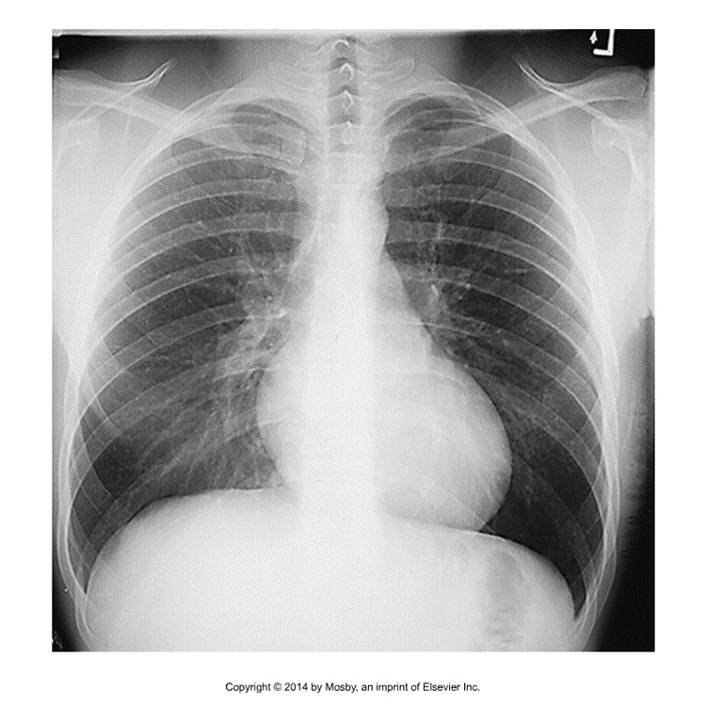
Is my Tube Angle OK?
Remember! The light-field is a perfect rectangle when it is viewed on a surface the CR is perpendicular.
Angled too caudad
Perpendicular to sternum
Angled too cephalad
Bontrager Figure 2-53

Slide 26
Radiation Safety
Before exposing:
Shield the patient
Clear visitors, ambulatory patients, and health care workers from the room
Shield yourself
Move a minimum of 6 feet away from the primary beam
Give the patient final instructions (e.g., breathing)
Call “x-ray” in a voice that can be heard
  Find your x-ray voice

Slide 27
Completing the Exam
Evaluate the image for diagnostic quality
Ensure pertinent information has been annotated on the image, and/or on PACS as per site protocols
  Technique used
  Time
  Tech initials
  Special markers : mobile, supine, x-table

Slide 28
Readings
Bontrager 9th Edition
  Pg 568-569
Ehrlich 9th Edition
  Pg 373-379

