Slide 1
APPH 226:
Timing Circuits, AEC and APR
Objectives: 1.3, 2.4, 5.8, 10.2

Slide 2
Time
Why is exposure time important?
X-ray quantity is directly proportional to the mAs
Directly affects exposure
Controls how long electrons will be crossing over to the anode

Slide 3
Exposure Timers
Timer circuit is a component of the x-ray circuit
  Directly affects the number of x-rays being produced
Purpose: ‘make or break’ the high voltage across the tube
Located on the primary side (lower voltage is easier to control than high voltage)
    All types of timers are controlled by the technologist, except for one specific type, which is automatic

Slide 4
Types of Timing Circuits
Four types of timing circuits:
  Synchronous*
  Electronic *
  mAs*
  AEC**
    *controlled by the technologist
    **automatic

Slide 5
Synchronous Timers
Synchronous motor
  a special type of electric motor which drives a shaft at exactly 60 revolutions per second (rpm)
When used as a timing mechanism in an x-ray unit, the shaft turns a disk which is connected to on/off switches
Exposure time selected will determine the time it takes for the disk to move from the on switch to the off switch
Can recognize an x-ray system that uses this type of timer because of the timing intervals
  The shortest exposure time possible is 1/60 s, and timing intervals increase by multiples thereof (1/30, 1/20 etc)
  Cannot be used for serial exposures, needs to be reset in between

Slide 6
Electronic Timers
Most sophisticated, expensive and accurate
  Almost all modern units will utilize this type
Complex circuitry based on time required to charge a capacitor through a variable resistor
The exposure will terminate as soon as the capacitor receives its pre-programmed charge
  How it works:
    For a 1 second exposure, resistance is increased so it takes 1 second to charge the capacitor
    For a 1 ms exposure, there is almost no resistance so that the capacitor is charged very quickly and the exposure is terminated by the timer
Wide range of time intervals can be selected
Very accurate down to intervals as small as 1ms
Can be used for rapid serial exposures
  Ideal for interventional radiography

Slide 7
mAs Timer
Variation of the electronic timer, but it monitors the current passing through the tube and will terminate the exposure when the set mAs is achieved
Designed to safely provide the highest tube current and shortest exposure for the mAs selected
Located on the secondary circuit (high voltage) side because must monitor the actual tube current
  Found on falling load generator systems

Slide 8
AEC (Automatic Exposure Control)
Device that measures the quantity of radiation reaching the image receptor
Automatically terminates the exposure as soon as the IR has received the required amount of radiation
  Controls this by breaking the timer circuit
Serves the same role as an exposure timer
  Only factor it controls is time
Operates differently, instead of the technologist pre-setting the time, it uses the patient’s body part as the variable to determine when the exposure should be terminated
  Technologist sets which ‘cell’ is active

Slide 9
Purpose of AEC
Eliminate the ‘guessing’ for technical factors
Setting a manual technique requires technologist to:
  Select exposure time that they think will produce sufficient radiographic density
  Measure the thickness of the patient and ‘guess’ the technique required
  ‘guess’ at the density of the tissues within the body

Slide 10
Types of AEC
Two types of AEC devices:
  Photodiode / Phototimer
  Ionization Chamber
    Main difference between the two types is the location of the device in relation to the IR, one is exit type, and one is entrance type

Slide 11
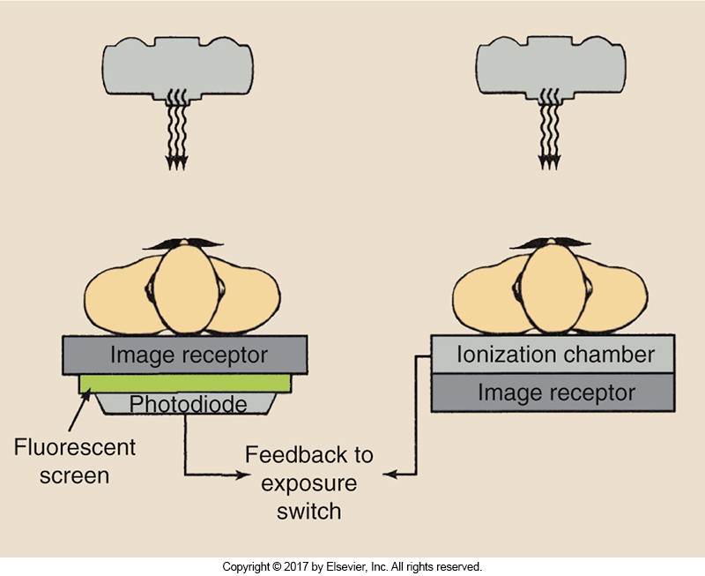
Photodiode / Phototimer
Positioned as exit type of device
Behind IR
Photodiode converts light to electrical energy
Once certain charge has been reached, exposure is terminated
Becoming obsolete
Bushong Fig 5-10

Slide 12
Ionization Chambers
Most commonly used today in modern imaging systems
Located between patient and the IR
Flat parallel plate ionization chamber
  Radiolucent – does not interfere with image
X-ray beam travels through the patient and tabletop before striking the chamber
Entrance type – IR positioned after the ion chamber

Slide 13
Ionization Chambers
Chamber is a hollow cell containing air
Air inside the cell becomes ionized as it is struck by radiation – creates an electrical charge
Ionization is directly proportional to the amount of radiation received
When predetermined charge has been reached, exposure will terminate
Bushong Fig 5-10

Slide 14
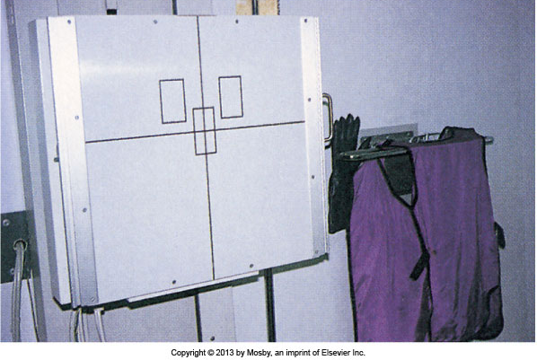
AEC Selection
Different configurations
  Usually have 3 detectors/cells/chambers
  Center
  Left and Right
    Slightly higher than the center cell, and off centered to each side

Slide 15
Choosing the Correct Configuration
Various combinations of the AEC chambers can be selected
  Can select any one cell, combination or all three
APR can also select configuration
When more than one cell is selected, the average signal from all cells is used
This can be over-ridden if needed
  i.e. AP Pelvis with metal hip replacement

Slide 16
Back Up Timer
Protects the patient from overexposure
  Due to equipment failure, or technologist error
SC 35 states that the mAs cannot exceed 600 mAs for one single exposure
Usually set to 1.5 times the expected length of exposure
  Maximum time is 6 seconds
Often it is automatically done when APR is used

Slide 17
AEC operation
When AEC is first installed, it must be calibrated
Exposures are taken using test tools, and AEC is adjusted until the intensities on the IR are optimal
Typically this is done by the service engineers

Slide 18
Density Control
Regulates the radiographic density of the image
Selection of 7 density steps
  -3, -2, -1, 0, 1, 2, 3
Each one is calibrated to increase/decrease the preset density of the image receptor by 0.1
  About a 25% change in exposure from step to step
Can be used to accommodate patient condition or over-ride AEC sensitivity issues
  Not used to compensate for part thickness

Slide 19
Utilizing AEC
Technologist needs to select:
  kVp
  mA
  Set backup timer
  Select which chambers to use
  Density control
  Or select appropriate APR (anatomically programmed radiography)

Slide 20
APR - Anatomically Programmed Radiography
Refers to radiographic system that allows user to select a body part, and a preprogrammed set of exposure factors will be displayed for it
Technique chart stored in the computer
  kVp
  AEC
    Cell selection
  mAs (if AEC is not selected)
  Focal Spot Size

Slide 21
APR – Anatomically Programmed Radiography
Controlled by computer circuit/chip that has been programmed with different exposure factors for specific position/projections of anatomic parts
Once the part and position/projection has been selected, the technologist can make adjustments to the displayed exposure factors if they need to
APR and AEC are not related, but often used in conjunction
  i.e… an APR setting may utilize AEC

Slide 22
Positioning with AEC
Technical factors are taken care of with AEC, but that doesn’t mean all the work is done
Positioning is critical to utilizing AEC properly
Specific body part must be placed over the cell for appropriate exposure
  If not, can result in over or under exposure
Improper centering is the most common reason for repeats with AEC

Slide 23
Collimation and AEC
AEC cannot tell the difference between useful beam and scatter radiation
If the field size is too big
  Too much scatter will cause the AEC to shut off prematurely
If the field size is too small
  AEC cell will take longer to receive enough radiation to end exposure
If the field size is too small to cover the entire cell
  AEC should not be used and a manual technique should be set

Slide 24
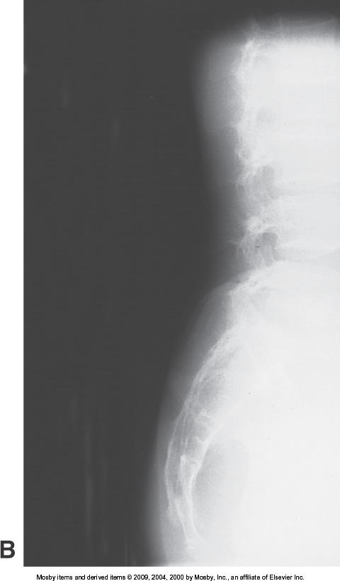
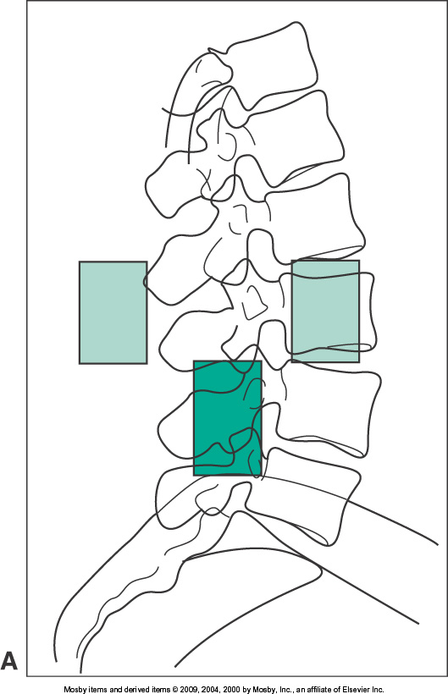
Positioning with AEC

Slide 25
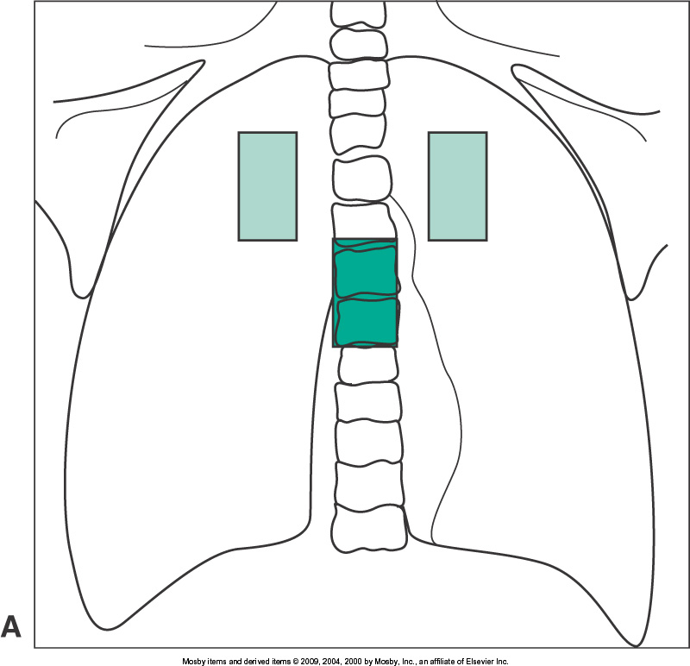
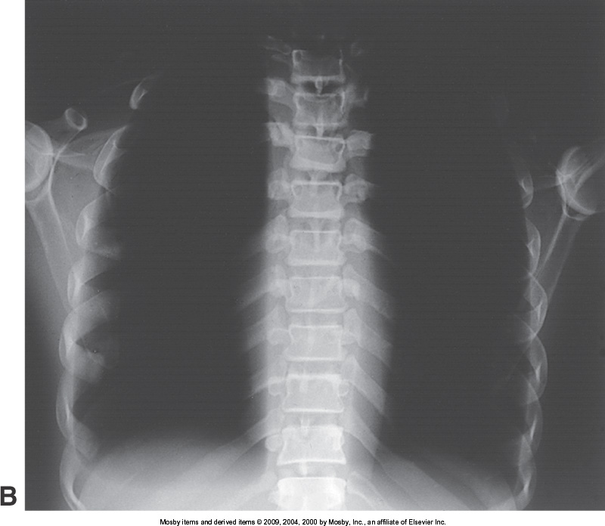
Cell Selection
Crucial to the exposure
Improper cell selection can also result in over or under exposure
  i.e. What needs to be visualized.. Bone? Air? Soft Tissue? Is there a surgical implant?

Slide 26
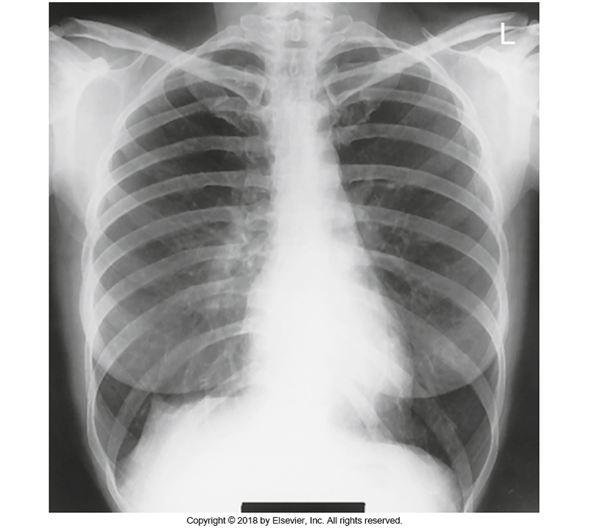
Cell Selection
Appropriate cell selection will produce optimal image quality

Slide 27
Optimal Use of AEC
Appropriate kVp selected for the area of interest
  Based on contrast characteristics and penetrability of beam
Precise centering
Appropriate selection of cell
Appropriate collimation to area of interest
Positioning is critical to optimal utilization of AEC

Slide 28
Readings
Bushong: Radiologic Science for Technologists 11th Ed
  Pg 90-92
  Pg 256-258

