Slide 1

ANPH 202
Blood

Slide 2
Formed Elements of Blood
Types
  RBCs (erythrocytes)
  WBCs (leukocytes)
    Granular leukocytes—neutrophils, eosinophils, and basophils
    Agranular leukocytes—lymphocytes and monocytes
    Platelets; also called thrombocytes
2

Slide 3
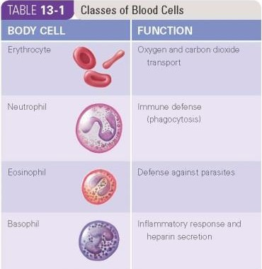

Slide 4
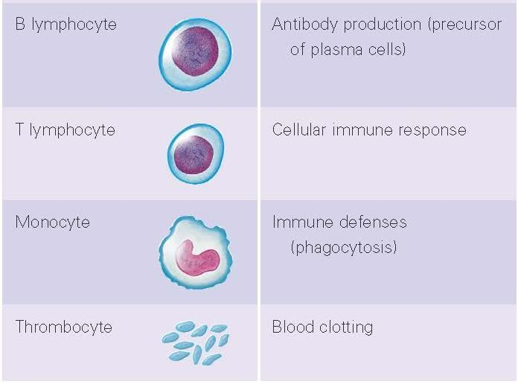

Slide 5
Red Blood Cells (Erythrocytes or RBCs)
Excellent example of how structural adaptation affects biologic function
  Tough and flexible plasma membrane deforms easily allowing RBCs to pass through small- diameter capillaries
  Biconcave disk (thin center and thicker edges) results in large cellular surface area
  Absence of nucleus and cytoplasmic organelles limits life span to about 120 days but provides more cellular space for red pigment called hemoglobin (Hb)
5

Slide 6
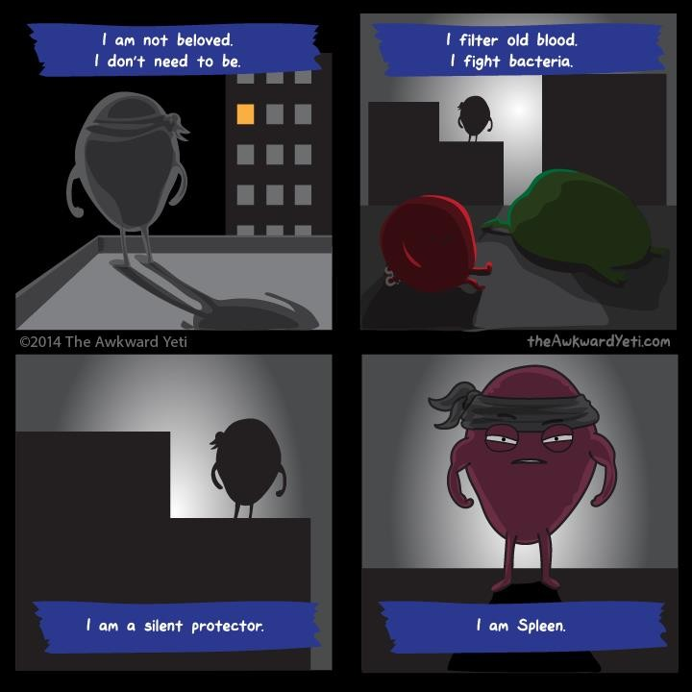

Slide 7
Leukocytes or White Blood Cells (WBCs)
Categorized by presence of granules (granulocytes) or absence of granules (agranulocytes)
WBC count—normal range is 5000 to 10,000/mm³ of blood
Leukopenia—abnormally low WBC count (below 5000/mm³ of blood)

Slide 8
Leukocyte Types and Functions
Granulocytes—neutrophils; eosinophils; basophils
  Neutrophils
    Most numerous type of phagocyte
    Numbers increase in bacterial infections
  Eosinophils
    Weak phagocyte
    Active against parasites and parasitic worms
    Involved in allergic reactions

Slide 9
Leukocyte Types and Functions, Cont'd.
Basophils
Related to mast cells in tissue spaces
Both mast cells and basophils secrete histamine (related to inflammation)
Basophils also secrete heparin (an anticoagulant)

Slide 10
Agranular Leukocytes
Agranulocytes—monocytes in peripheral blood (macrophages in tissues); lymphocytes—B lymphocytes (plasma cells) and T lymphocytes
  Monocytes
    Largest leukocyte
    Aggressive phagocyte—capable of engulfing larger bacteria and cancer cells
    Develop into much larger cells called macrophages after leaving blood to enter tissue
spaces

Slide 11
Agranulocytes
Lymphocytes
  B lymphocytes involved in immunity against disease by secretion of antibodies
  Mature B lymphocytes called plasma cells
  T lymphocytes involved in direct attack on bacteria or cancer cells (not
antibody production)

Slide 12
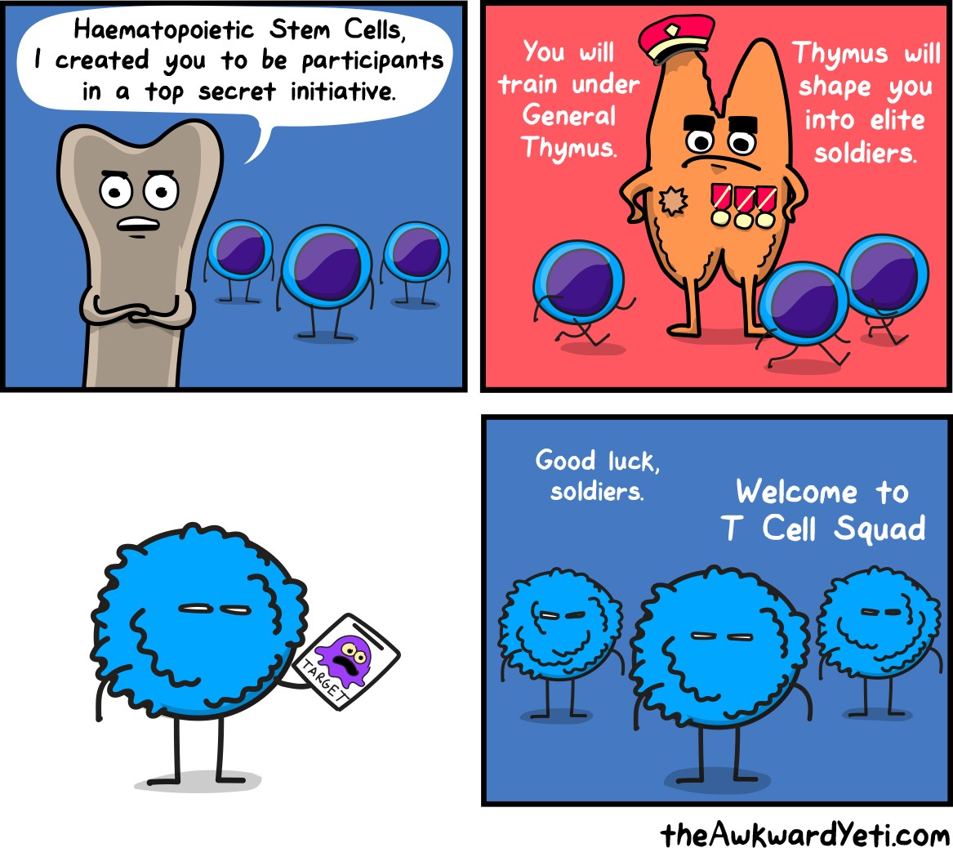

Slide 13
White Blood Cell Disorders
Two major types of WBC cancers or neoplasms
  Lymphoid neoplasms—result from B and T lymphocyte precursor cells or their descendent cell types
  Myeloid neoplasms—result from malignant transformation of precursor cells of granulocytic WBCs, monocytes, RBCs, and platelets

Slide 14
Multiple Myeloma
Cancer of B lymphocytes called plasma cells
Most deadly blood cancer in people older than age 65
Causes bone marrow dysfunction and production of defective antibodies

Slide 15
Multiple Myeloma, Cont'd.
Characterized by:
  Destruction and fracture of bones
  Recurrent infections and anemia
Treatment includes chemotherapy, drug and antibody therapy, and marrow and stem cell transplantation

Slide 16
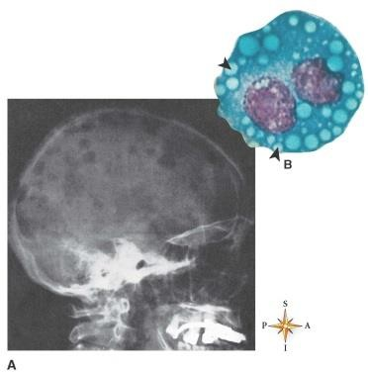
Multiple Myeloma
From Kumar V: Robbins basic pathology, ed 9, Philadelphia, 2013, Saunders.

Slide 17
Leukemia
Leukemias—WBC-related blood cancers
  Characterized by marked leukocytosis
  Identified as:
    Acute—rapid development of symptoms
    Chronic—slow development of symptoms
    Lymphocytic—affects lymphocytes
    Myeloid—affects granular leukocytes as they develop in the red bone marrow

Slide 18
Common Types of Leukemia
Chronic lymphocytic leukemia (CLL)
  Average age of onset is 65; rare before age 30
  More common in men than in women
  Often diagnosed unexpectedly in routine physical exams with discovery of marked B lymphocytic leukocytosis
  Generally mild symptoms include anemia, fatigue, and enlarged—often painless—lymph nodes
  Most patients live many years following diagnosis
  Treatment of severe cases involves chemotherapy and irradiation

Slide 19
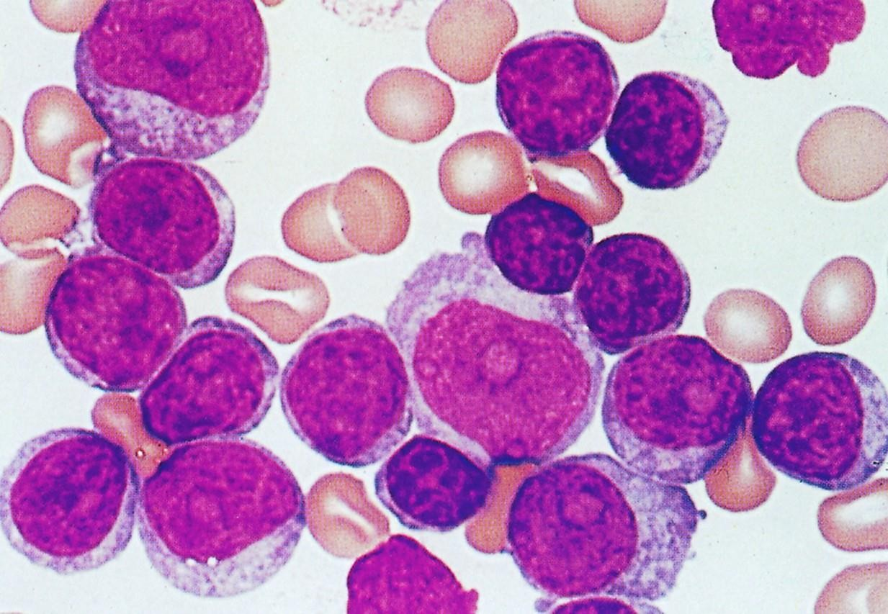
Chronic Lymphocytic Leukemia (CLL)
Courtesy Dr. JV Melo.

Slide 20
Acute Lymphocytic Leukemia (ALL)
Primarily a disease of children between 3 and 7 years of age; 80% of children who develop leukemia have this form of the disease
Highly curable in children but less so in adults
Onset is sudden—marked by fever, leukocytosis, bone pain, and increases in infections
Lymph node, spleen, and liver enlargement is common
Treatment includes chemotherapy, irradiation, and bone marrow or stem cell transplantation

Slide 21
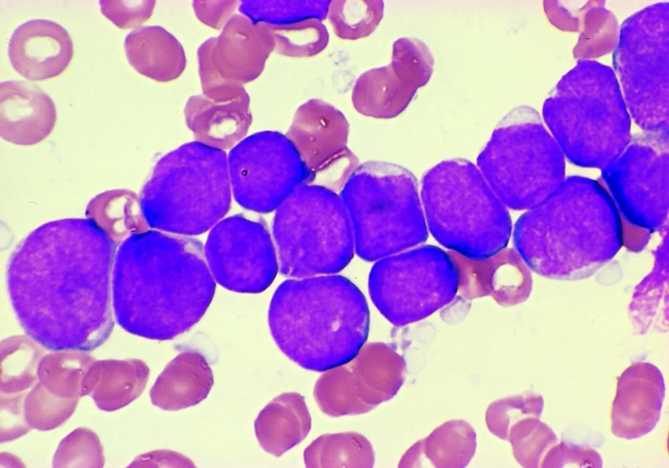
Acute Lymphocytic Leukemia (ALL)
Courtesy of Dr. Robert W McKenna, Department of Pathology, University of Texas Southwestern Medical School, Dallas, TX. IN Kumar V et al: Robbins basic pathology, ed 9, Philadelphia, 2013, Saunders.

Slide 22
Chronic Myeloid Leukemia (CML)
Accounts for about 20% of all cases of leukemia
Occurs most often in adults between 25 and 60 years of age
Caused by cancerous transformation of granulocytic precursor cells in the bone marrow
Onset and progression of disease is slow with symptoms of fatigue, weight loss, and weakness

Slide 23
Chronic Myeloid Leukemia (CML), Cont'd.
Diagnosis often made by discovery of marked granulocytic leukocytosis and extreme spleen enlargement
Treatment by new “designer drug” Gleevec or bone marrow transplants is curative in over 70% of cases

Slide 24
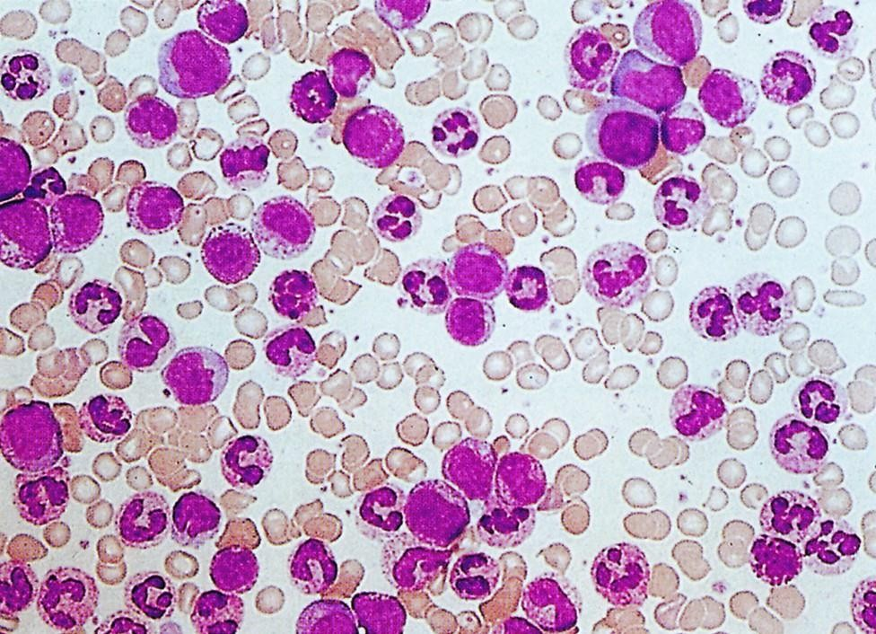
Chronic Myeloid Leukemia (CML)
From Hoffbrand AV, Pettit JE: Clinical haematology illustrated, Edinburgh/London, 1987, Churchill Livingstone/Gower Medical Publisher.

Slide 25
Acute Myeloid Leukemia (AML)
Accounts for 80% of all cases of acute leukemia in adults and 20% of acute leukemia in children
Characterized by sudden onset and rapid progression
Symptoms include leukocytosis, fatigue, bone and joint pain, spongy bleeding gums,
anemia, and recurrent infections
Prognosis is poor with only about 50% of children and 30% of adults achieving long- term survival
Bone marrow and stem cell transplantation has increased cure rates in selected patients

Slide 26
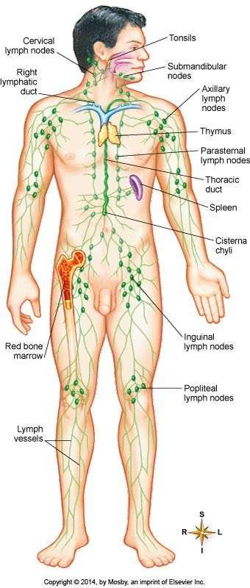
Lymphatic and immune systems
Organs of the lymphatic system include:
lymph vessels
lymph nodes
tonsils
thymus gland (stores T-cell lymphocytes for immune processes)
Spleen (cleans defective cells from blood, stores platelets and WBC’s)
Red bone marrow- produces blood stem cells of all types (in adults red bone marrow is found in the axial skeleton, shoulders and pelvic girdles
Patton and thibodeau 7th ed. Fig. 16-1

Slide 27
The lymphatic system has two main functions:
it maintains blood volume
it controls the processes of adaptive immunity.

Slide 28
The lymphatic system maintains blood volume by collecting blood plasma that has been left in the interstitial spaces by circulatory processes
The collected fluid is known as “lymph”

Slide 29
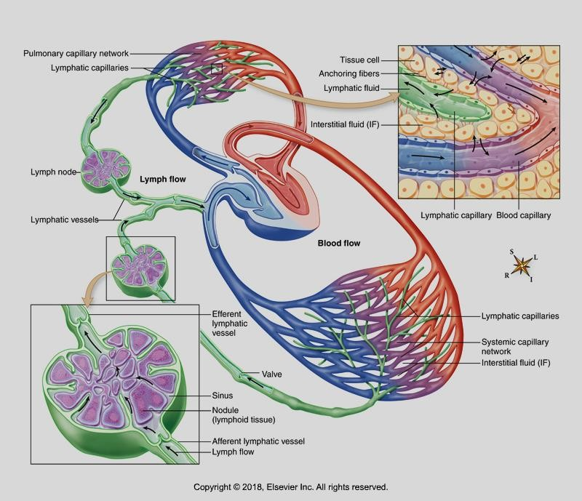
On its way back to the heart the lymph is filtered by the lymph nodes i.e. bacteria, cancer cells, viral agents, and damaged cells are removed through the process of phagocytosis.
Patton and Thibodeau 16-2

Slide 30
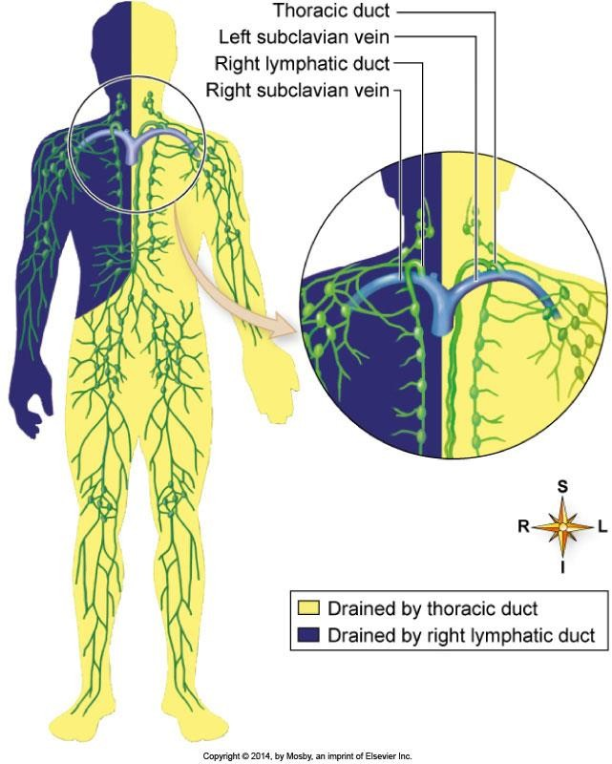
The lymph is collected into two ducts, which ultimately dump their contents into the superior vena cava, which directs the fluid into the right atrium of the heart
Patton and Thibodeau 7th ed. Fig. 16-1

Slide 31
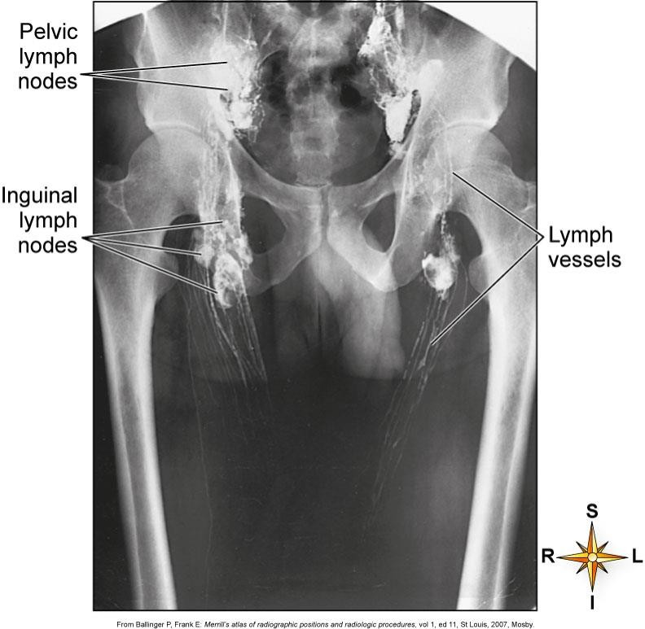
Lymphangiogram
Patton and Thibodeau 7th ed. fig. 16-7

Slide 32
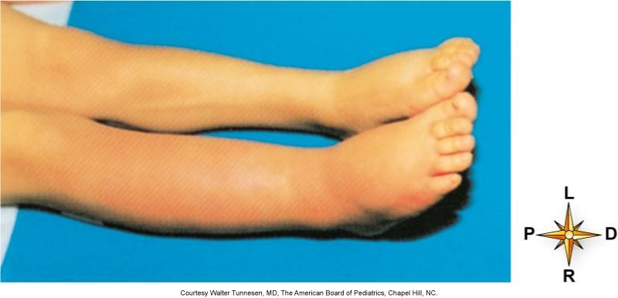
Lymphedema is an accumulation of lymph in the tissues, caused by a congenital abnormality, an injury, a blockage, or an infection/inflammation of the lymph vessels
Patton and Thibodeau 7th ed. Fig. 16-3

Slide 33
The Lymphatic System
Besides collecting lymph, the lymphatic system produces lymphocytes for the immune system. All lymphocytes originate from primitive stem cells in the red bone marrow, and are not considered to be “mature” until they are “immune-competent” and “self –recognizing”. Respectively, this means that
they have been “trained” to respond to one specific antigen, and that they
recognize when a cell is part of “self” or “you”.
There are many types of lymphocytes but they fall into one of three
categories: B, T, and NK (natural killer cells)
B lymphocytes mature in the red bone marrow and T lymphocytes mature in the thymus, an organ that is located in the mediastinum just superior to your heart. These locations are known as primary lymphoid organs

Slide 34
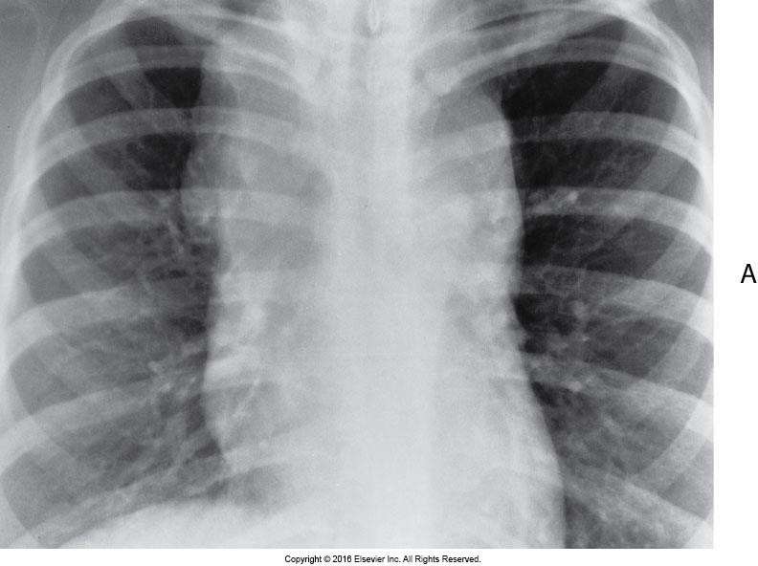
Lymphoma

Slide 35
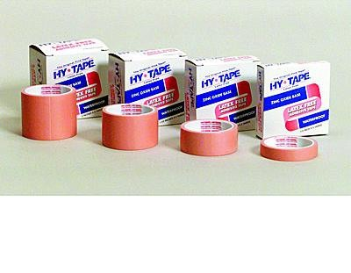
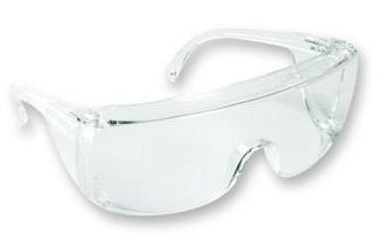


The immune system
1st line of defense is maintaining intact skin and mucous membranes
www.medicalforyouonline.com

Slide 36
2nd line of defense – inflammation (non-specific immunity)
A break in that first line of defense like a cut activates the second line of defense
Prevents the spread of disease, or further damage to tissues
Disposes of any dead tissue and pathogens
Initiates tissue repair

Slide 37
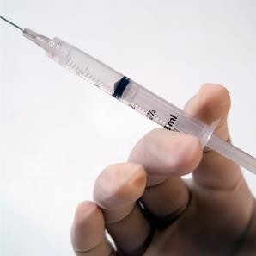
3rd line of defense-specific (adaptive) immunity
May be naturally or artificially acquired

Slide 38


