Slide 1


Type of Lasers Used in Esthetics

Slide 2
There are many Lasers In the Industry
Medical Estheticians work with the following
Hair removal
Skin Resurface
Varicose veins (under doctor's license and supervision)
Nail Fungus
Tattoo Removal
Skin Tightening
Fat Reduction, cellulite reduction
Collagen and tightening procedures
Other non Laser
RF
IPL
LED
Photodynamic Therapies
And many more

Slide 3
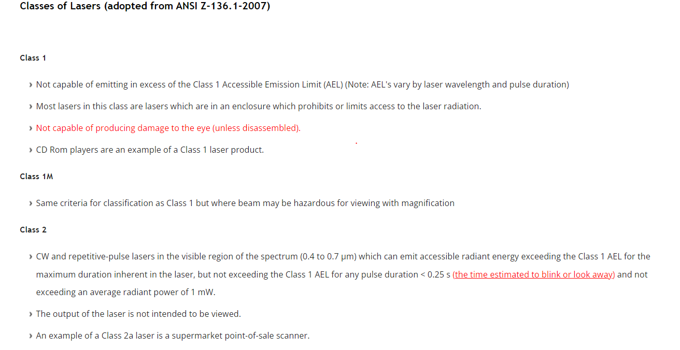

Slide 4

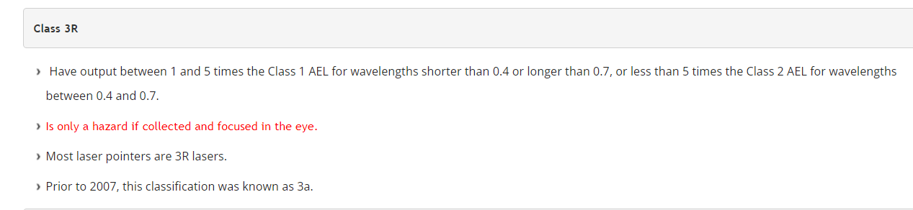
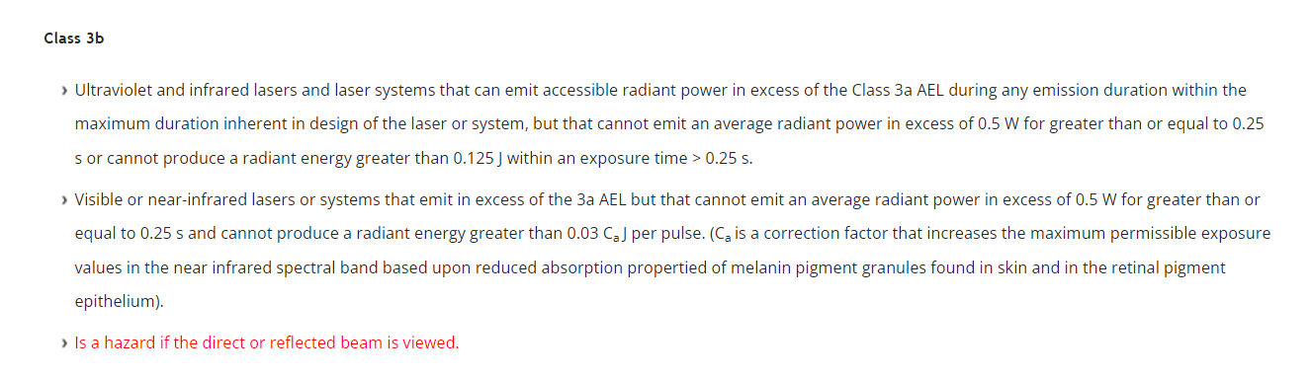

Slide 5
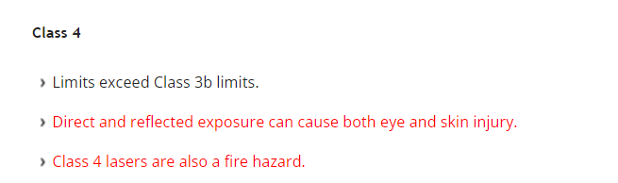


Slide 6
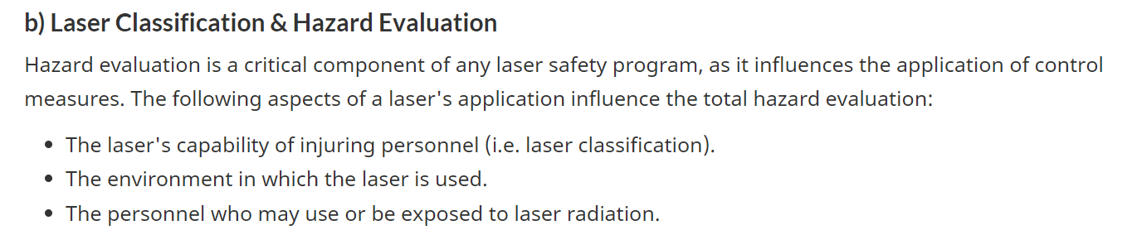

Slide 7
Laser classification is based upon the laser's capability to injure personnel and falls under seven general categories: 1, 1M, 2, 2M, 3R, 3B and 4.
As mentioned before, lasers used for hair removal are mainly classified as Class 3B or Class 4.
Class 3B hair removal devices are medium-powered lasers that can emit sufficient infrared radiation to be hazardous to unprotected eyes, both by direct or reflected viewing. Skin will not be injured by unfocused or unmagnified Class 3B laser beams.
Class 4 hair removal devices are high-powered lasers that emit sufficient infrared radiation to be hazardous to unprotected eyes, both by direct or reflected viewing. In some cases, diffusely reflected beams off matt surfaces can also be hazardous to the eyes. Skin can be injured by the direct beam and fires can be started if flammable or combustible materials in the immediate area are exposed.

Slide 8

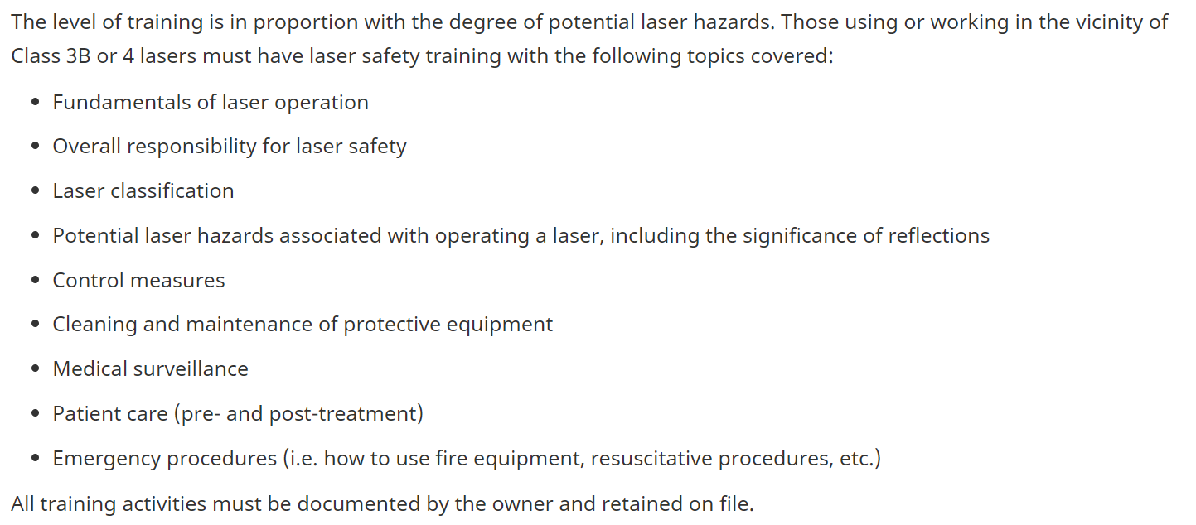

Slide 9
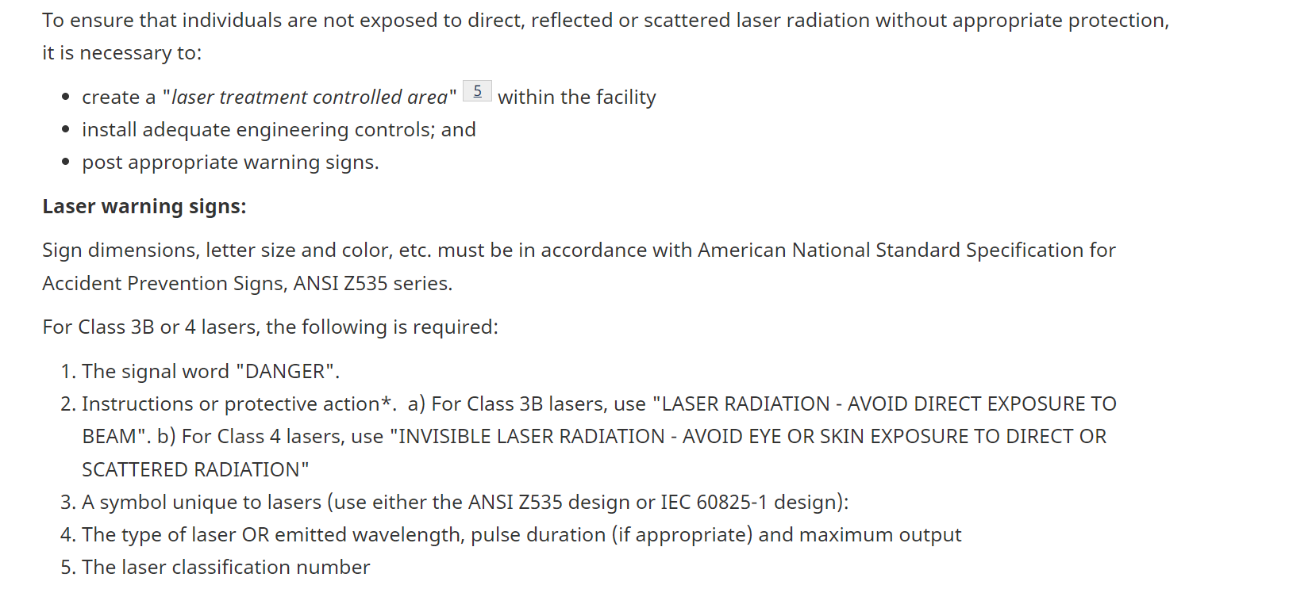

Slide 10
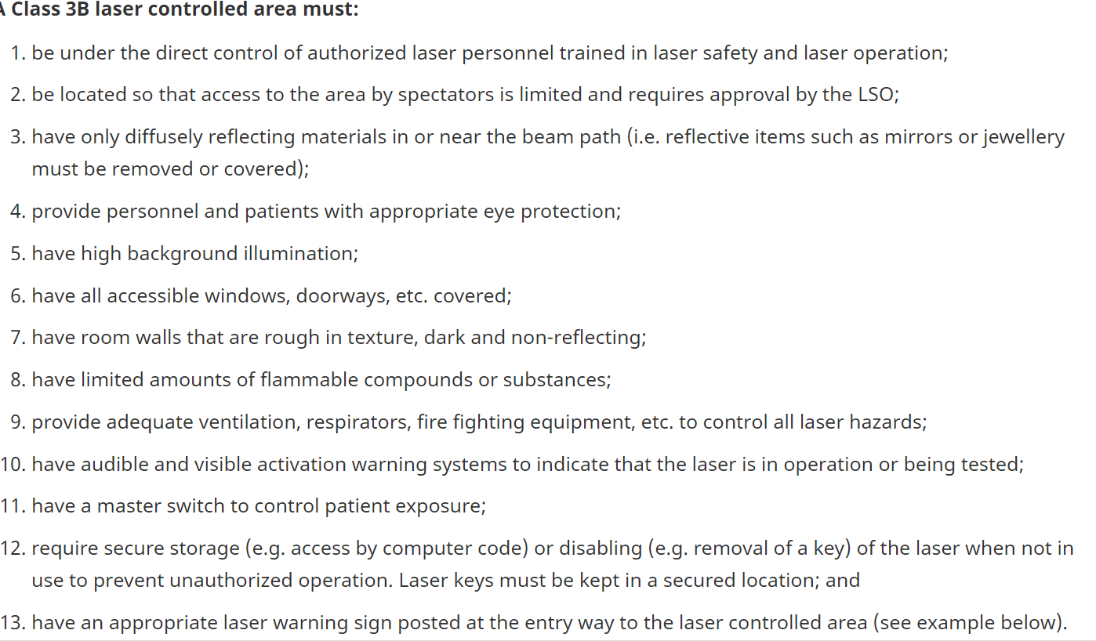

Slide 11
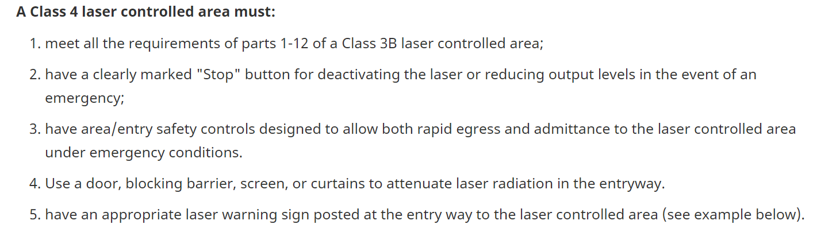

Slide 12
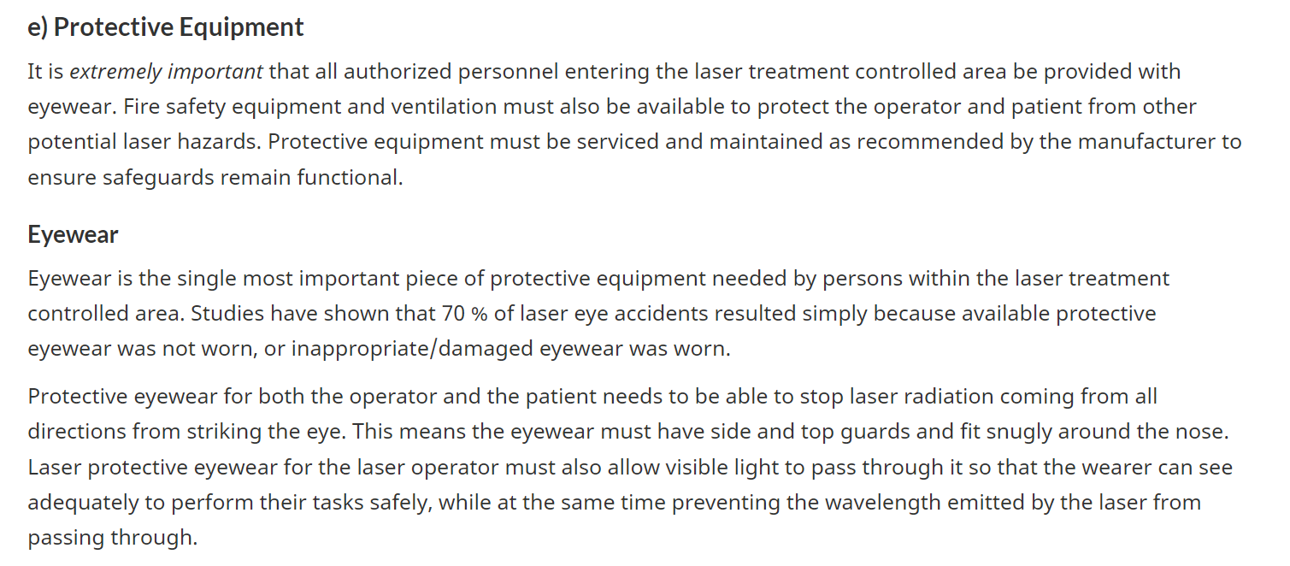

Slide 13
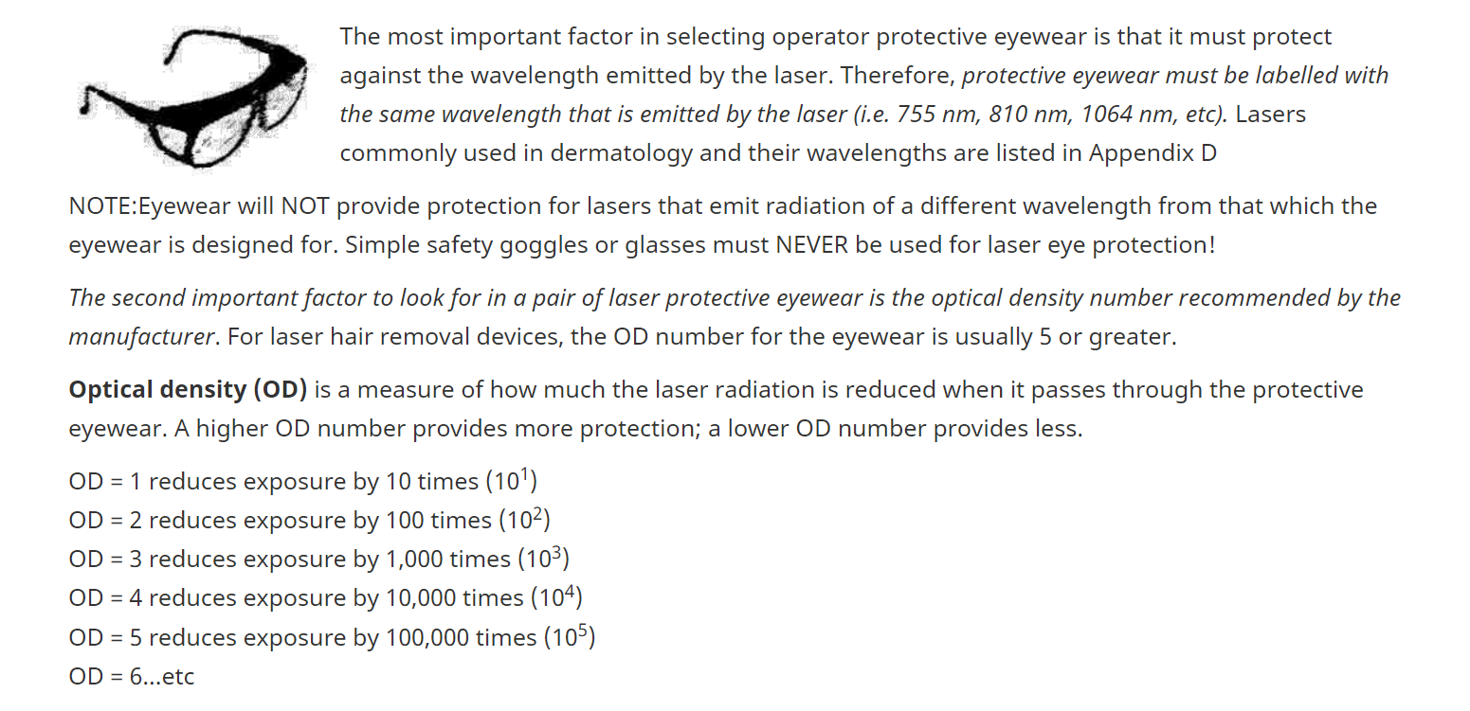

Slide 14
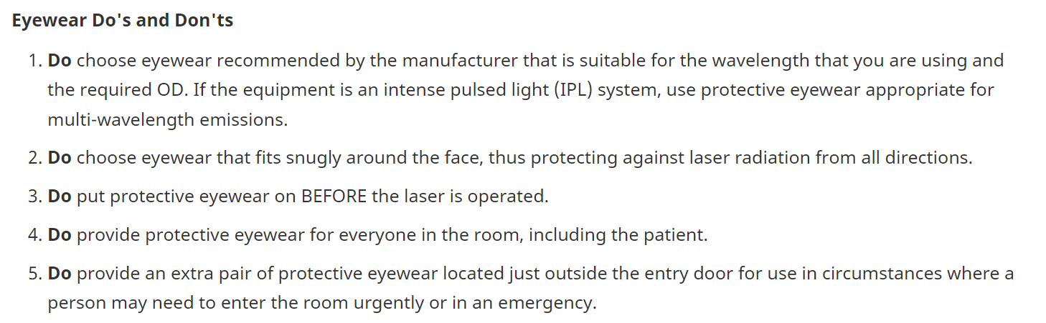

Slide 15
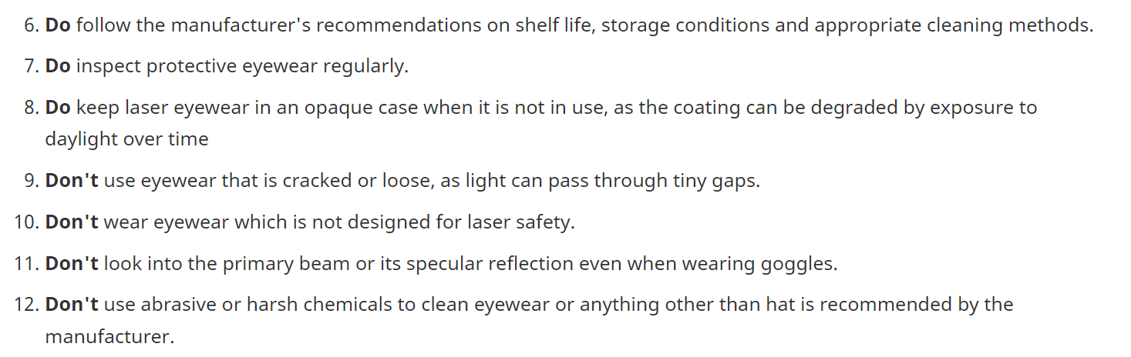

Slide 17

QUESTIONS?

