Slide 1
MRAD 204:
Radiographic Technique 1
Outcome 6-10:
Image Critique – Ankle, Calcaneus, & Foot

Slide 2
Affiliated Readings
Bontrager Reading
Pgs: 232→242
Emphasis on the “pink box” Evaluation Criteria

Slide 3
Overview
Image Critique – Ankle
Image Critique – Calcaneus
Image Critique – Foot
Tips & Tricks

Slide 4
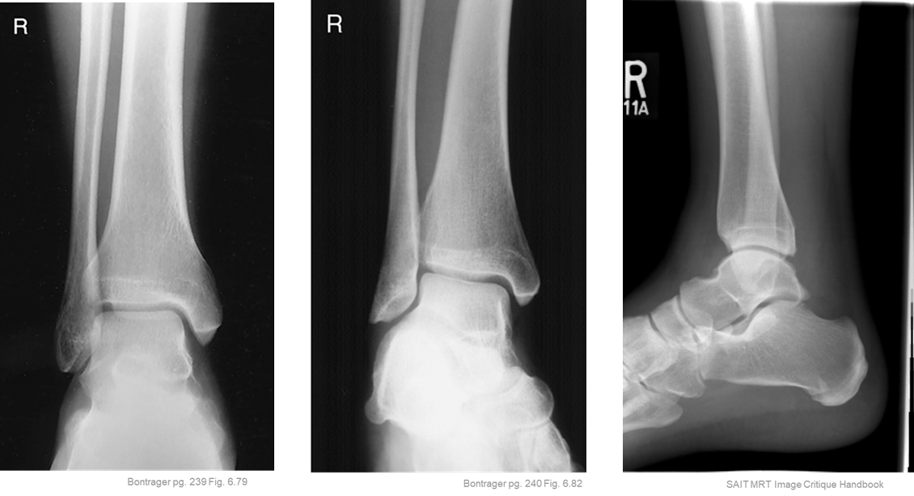
Image Critique – Routine Ankle
Lateral projection must also display the entire calcaneus, navicular and base of 5th metatarsal
Anatomy
Ideally, routine Ankle radiographs should display:
Entire Ankle Joint
Talus
Distal ¹/₃rd of tibia & fibula
Lateral & medial malleoli

Slide 5

Image Critique – Routine Ankle
R
Exposure & Technique
R
All Routine Ankle radiographs should display:
kVp range of 60→75
Optimal density and contrast:
  no motion (i.e. blur)
  soft tissue margins visible
  clear bony trabecular markings

Slide 6
Image Critique – Routine Ankle
Marker Placement &/or artifacts
Marker placement: not obscuring soft-tissue anatomy
AP & Mortise = Lateral side
Lateral = Anterior side (“walking” on the foot)
R
No removable artifacts are visible

Slide 7
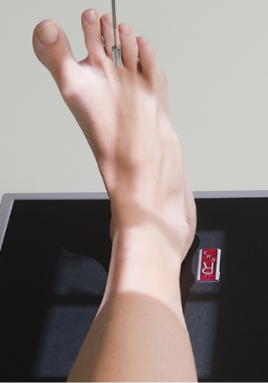
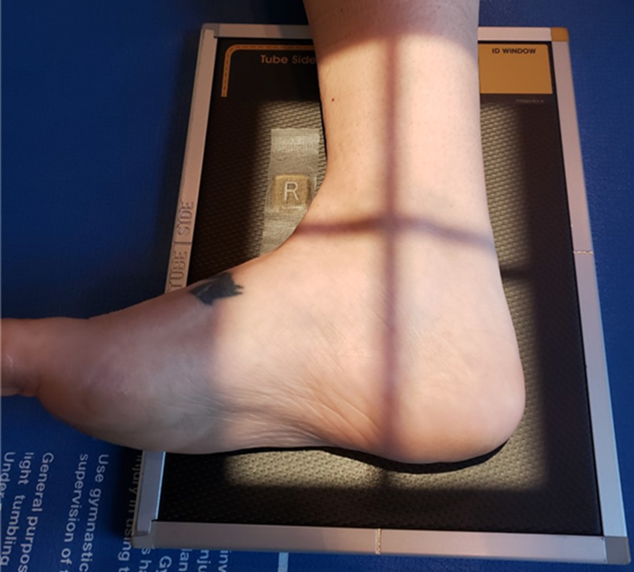
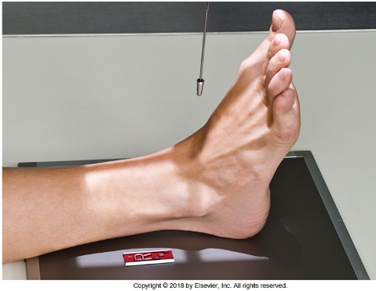
Image Critique – Routine Ankle
Four sided collimation centered over the Tibiotalar joint (aka. ankle joint)
Bontrager pg. 239 & 240 Fig. 6.78 & 6.81
CR & Collimation
Note: Ankle joint is NOT the center of required anatomy

Slide 8
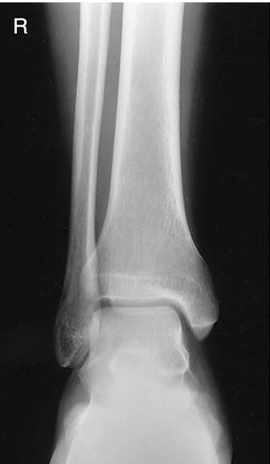
Image Critique – AP Ankle
Position
@ 60 kVp
Distal Tib/Fib parallel to length of IR
Open tibiotalar joint
Open medial mortise joint
Closed lateral mortise joint
  Slight superimposition of distal tibia, fibula, and talus
Bontrager pg. 239 Fig. 6.79

Slide 9
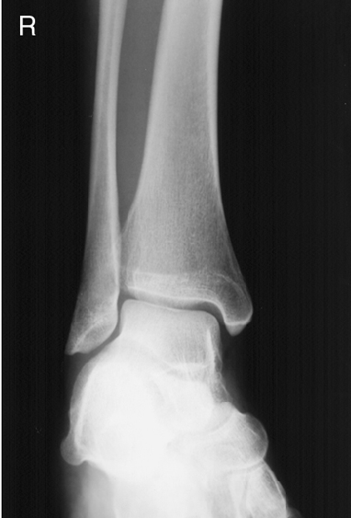
Image Critique – AP Mortise Ankle
Position
@ 60 kVp
Open medial mortise joint
Open lateral mortise joint
Malleoli in profile
Slight superimposition of distal tibiofibular joint
Bontrager pg. 240 Fig. 6.82

Slide 10
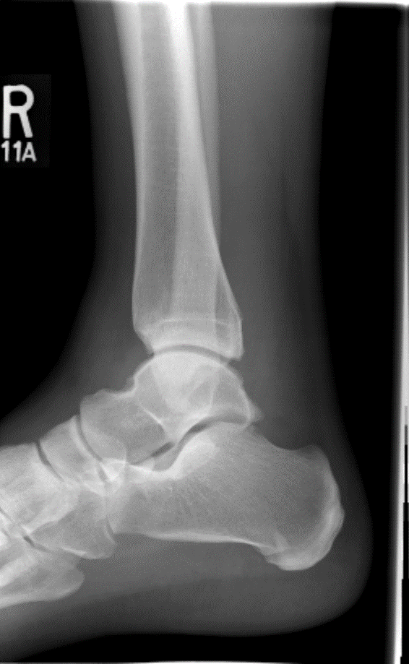

Image Critique – Lateral Ankle
Position
@ 60 kVp
Talus and calcaneus in profile
Distal fibula superimposed over posterior ½ of tibia
Open tibiotalar joint
  Superimposed talar domes

Slide 11
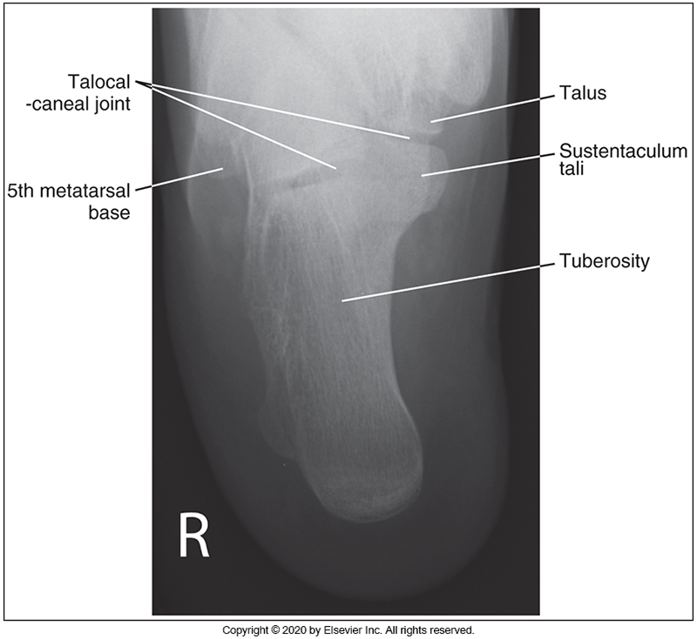
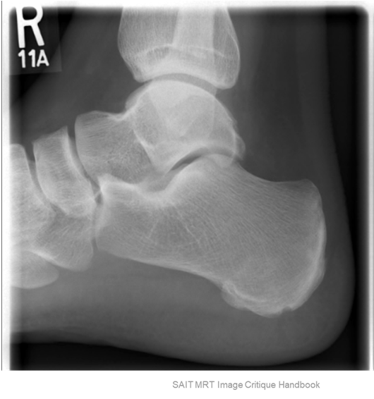
Image Critique – Routine Calcaneus
Anatomy
Lateral projection must also display ~1 inch of distal Tib/fib, and navicular
McQuillen Martensen 5th Ed. pg. 334 Fig. 6.68
Ideally, routine Os Calcis radiographs should display:
Base of 5th metatarsal
Entire Calcaneus
Talocalcaneal joint
Soft-tissues

Slide 12
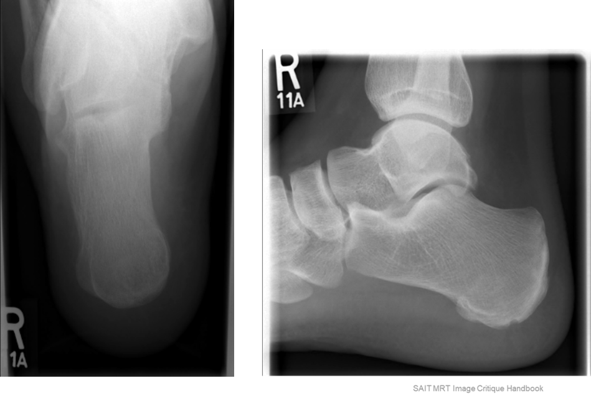
Image Critique – Routine Calcaneus
Exposure & Technique
BOTH routine Os Calcis radiographs should display:
kVp range of 60→75 (Axial = 65-75; Lateral = 60-75)
Optimal density and contrast:
  no motion (i.e. blur)
  soft tissue margins visible
  clear bony trabecular markings

Slide 13
Image Critique – Routine Calcaneus
Marker Placement &/or artifacts
Marker placement, not obscuring soft-tissue:
Plantodorsal (axial) projection: lateral edge of light-field
Lateral projection: anterior, “inferior” edge of light field
No removable artifacts are visible

Slide 14
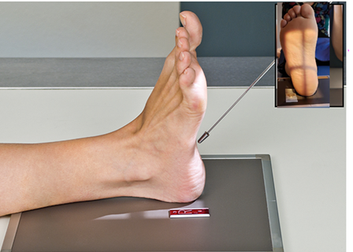
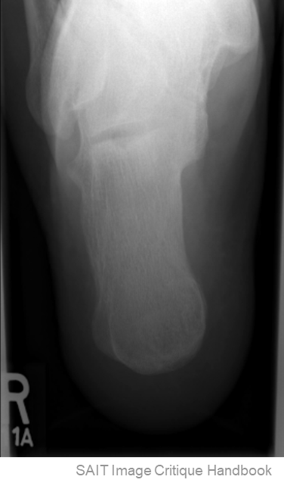

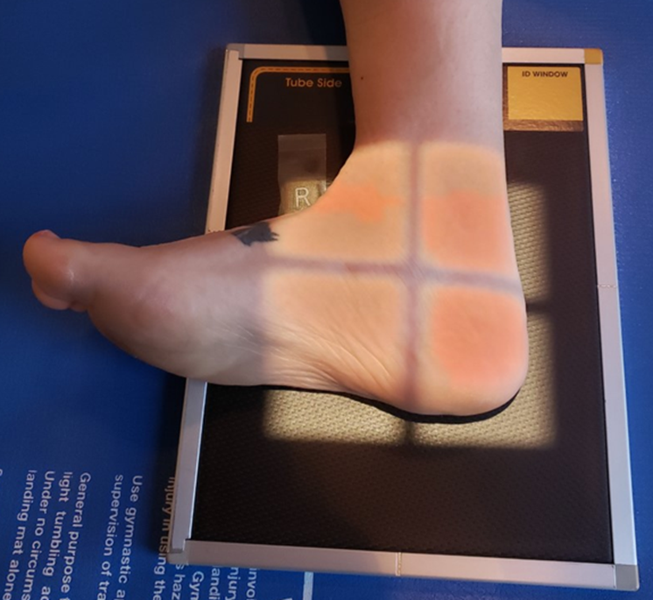
Image Critique – Routine Calcaneus
CR & Collimation
Note: when viewing the plantar surface, the CR is centered around the level of the 5th metatarsal base
Four sided collimation
Note: CR is centered around subtalar joint (~1 inch distal to medial malleolus)

Slide 15

Image Critique – Axial Calcaneus
Position
@ 65 kVp
Sustentaculum tali in profile
Open subtalar (aka. talocalcaneal) joint space
No distortion of the calcaneal tuberosity
R

Slide 16
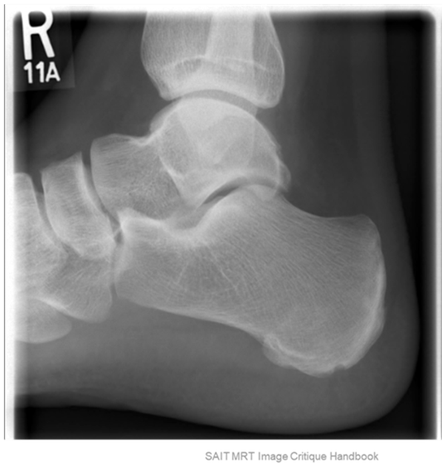
Image Critique – Lateral Calcaneus
Position
@ 60 kVp
Calcaneus in profile
Open tibiotalar, talocalcaneal, calcaneal cuboid, and talonavicular joint
Superimposed talar domes
R

Slide 17
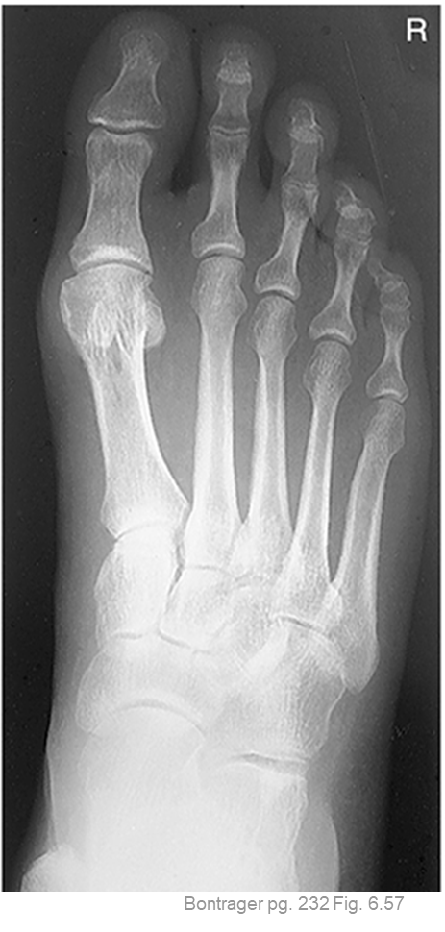
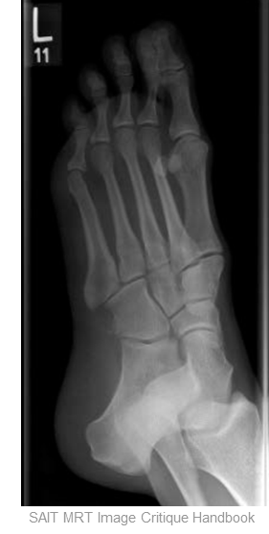
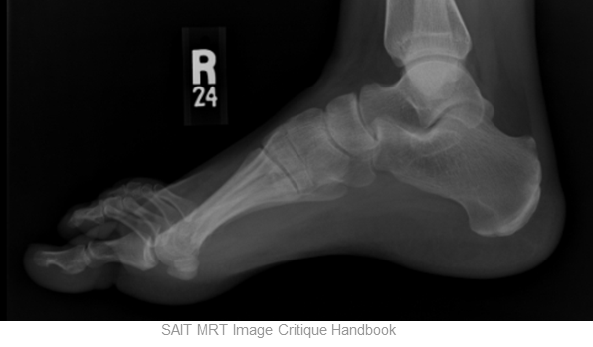
Image Critique – Routine Foot
AP (axial) projection is only required to display all anatomy anterior to the talus
Anatomy
Lateral projection must also display ~1 inch of distal tib/fib
Ideally, routine Foot radiographs should display:
Entire Foot
Soft-tissues

Slide 18
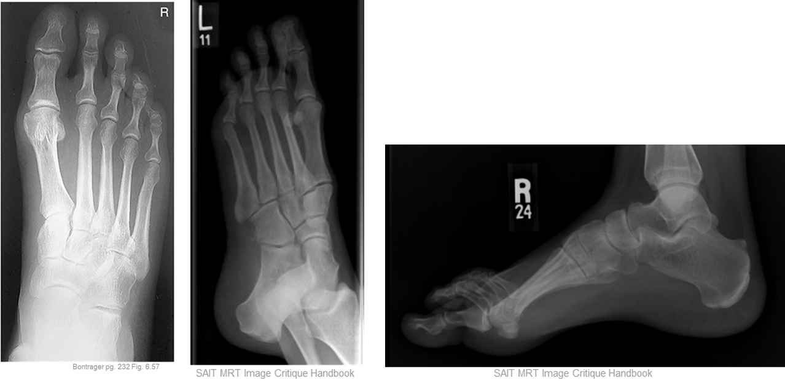
Image Critique – Routine Foot
Exposure & Technique
ALL routine Foot radiographs should display:
kVp range of 55→70 (AP = 55-65; Oblique & Lateral = 60-70)
Optimal density and contrast:
  no motion (i.e. blur)
  soft tissue margins visible
  clear bony trabecular markings

Slide 19
Image Critique – Routine Foot
Marker Placement &/or artifacts
Marker placement, not obscuring soft-tissue:
AP & Oblique projections: lateral “superior” edge of light-field
Lateral projection: anterior, “superior” edge of light field
No removable artifacts are visible

Slide 20
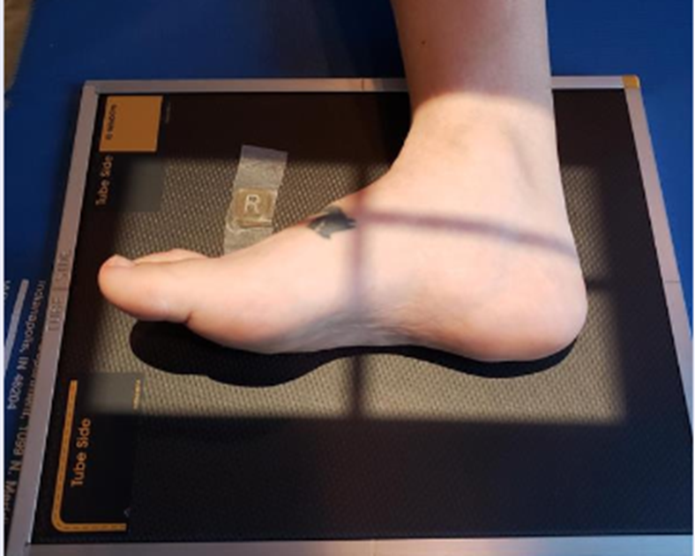
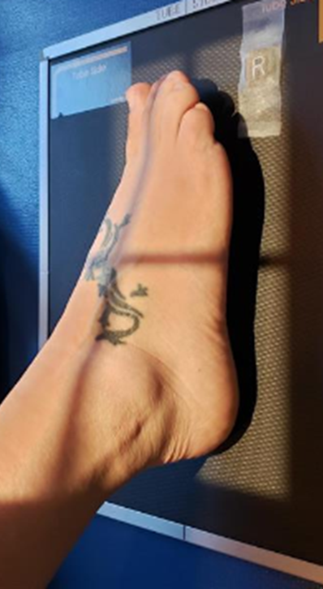
Image Critique – Routine Foot
Four sided collimation, centered around base of 3rd metatarsal
CR & Collimation
Note: CR is centered more distally as less anatomy is included radiographically

Slide 21
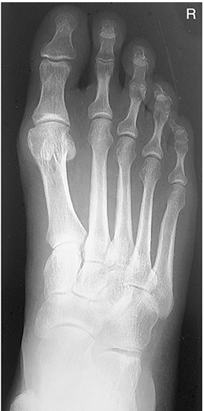
Image Critique – AP Foot
@ 55 kVp
Position
Equal distance between 2nd→5th metatarsal bodies
  *Overlap of bases
1st & 2nd metatarsal bases generally separated
Intertarsal joint space between 1st & 2nd cuneiforms
R
Bontrager pg. 232 Fig. 6.57

Slide 22
Image Critique – AP Oblique Foot
@ 60 kVp
Position
3rd→5th metatarsals free of superimposition
  No overlap of bases
1st & 2nd metatarsal bases overlapped
Base of 5th metatarsal in profile
Open joint spaces around cuboid and sinus tarsi
SAIT MRT Image Critique Handbook

Slide 23
Image Critique – Lateral Foot
Metatarsal heads superimposed
Open tibiotalar joint
Distal fibula superimposed by posterior ½ of tibia
R
Position
@ 60 kVp
SAIT MRT Image Critique Handbook

Slide 24
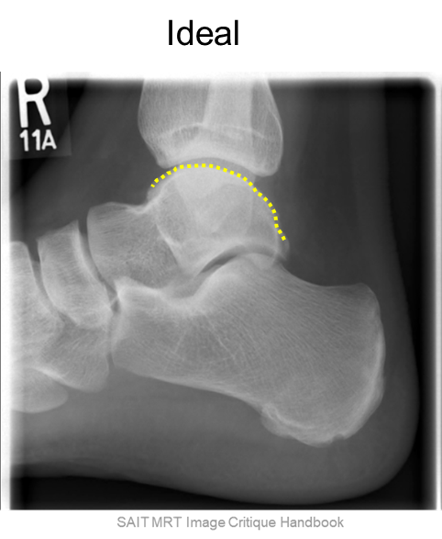
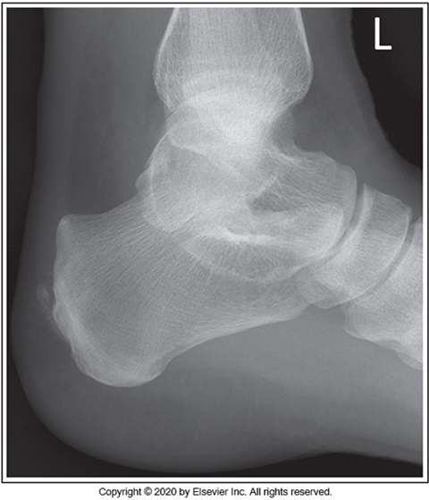
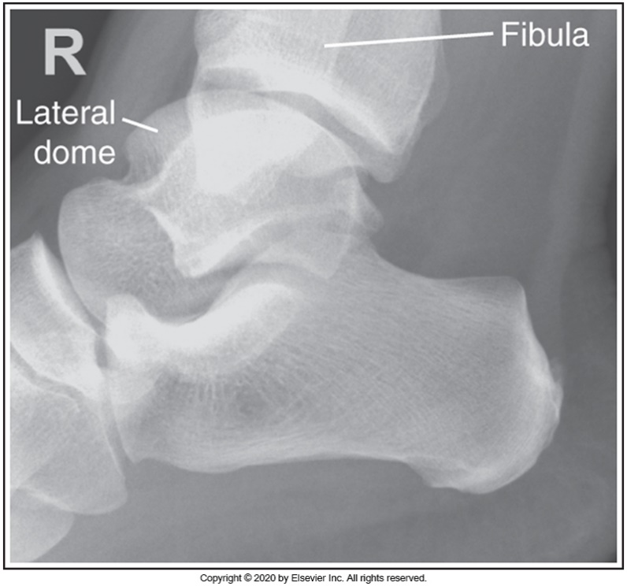
Tips & Tricks – Lateral Projections
Assess the level of superimposition of the talar domes:
Anterior/posterior misalignment and superior/inferior misalignment
McQuillen Martensen 5th Ed. pg. 340 Fig. 6.82
McQuillen Martensen 5th Ed. pg. 340 Fig. 6.85

Slide 25
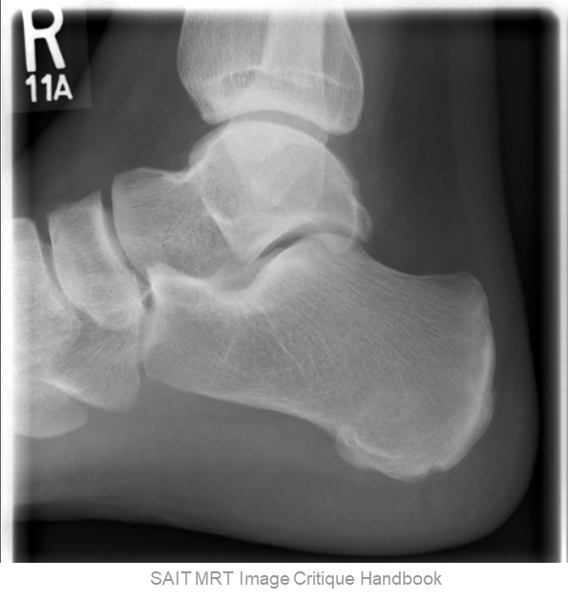
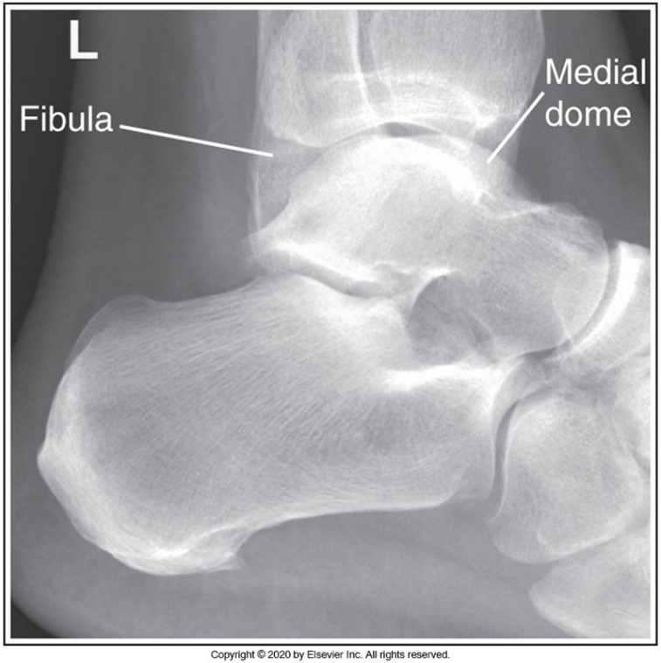
Tips & Tricks – Lateral Projections
Assess the position of the fibula in relation to the tibia:
Fibula should be aligned to the posterior ½ of the Tibia
Check if the fibula is more anterior or posterior
Ideal
McQuillen Martensen 5th Ed. pg. 340 Fig. 6.85
McQuillen Martensen 5th Ed. pg. 340 Fig. 6.84

Slide 26
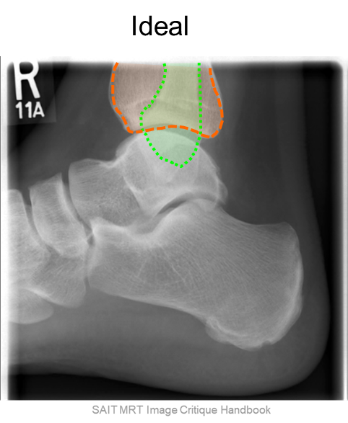
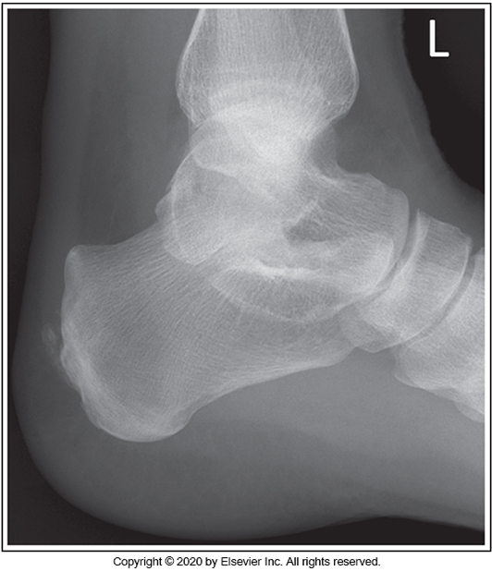
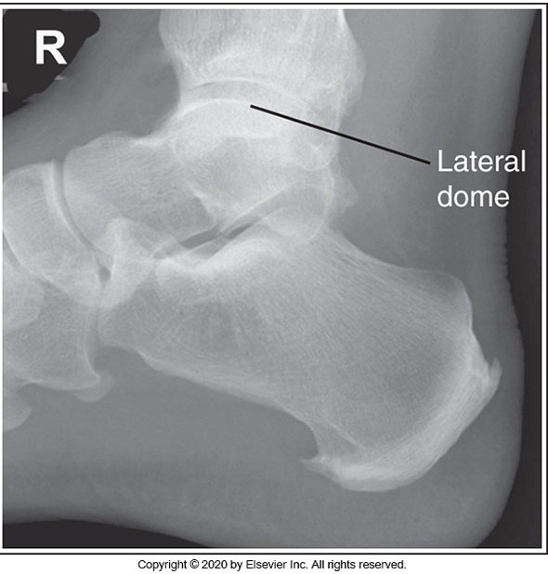
Tips & Tricks – Lateral Projections
Assess the position of the fibula in relation to the tibia:
Fibula should be ~½ inch inferior to the Tibia
Check if the fibula is more inferior or superior
McQuillen Martensen 5th Ed. pg. 340 Fig. 6.82
McQuillen Martensen 5th Ed. pg. 340 Fig. 6.83

Slide 27
Tips & Tricks – Lateral Projections
About ½ of the cuboid should be free of superimposition:
  Check if the cuboid is superimposed
McQuillen Martensen 5th Ed. pg. 340 Fig. 6.82
McQuillen Martensen 5th Ed. pg. 340 Fig. 6.83

