Slide 1
MRAD 204:
Radiographic Technique 1
Outcome 1-5:
Anatomy of the Humerus and Elbow
MRT Program
Anderson College

Slide 2
Affiliated Readings
Module 3
Bontrager
Pgs: 131, 135 & 178

Slide 3
Overview
Humerus
Proximal humerus
Distal humerus
Elbow joint

Slide 4
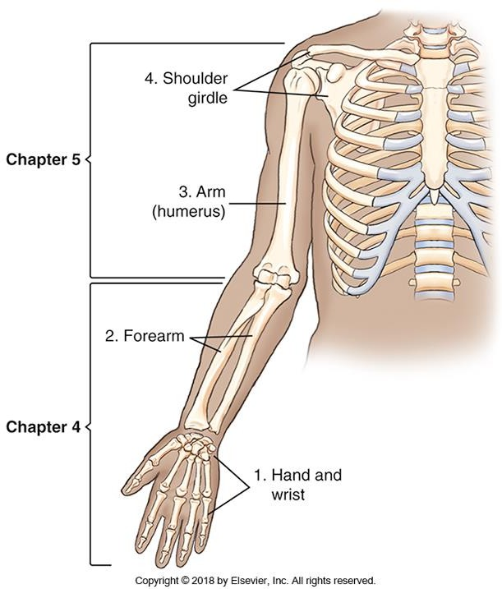
Humerus
The humerus is the only bone in the upper arm (aka. brachium)
The proximal end of the humerus helps to form the shoulder joint
The distal end of the humerus helps to form the elbow joint
Bontrager 9th Ed. pg. 132 Fig. 4.13

Slide 5
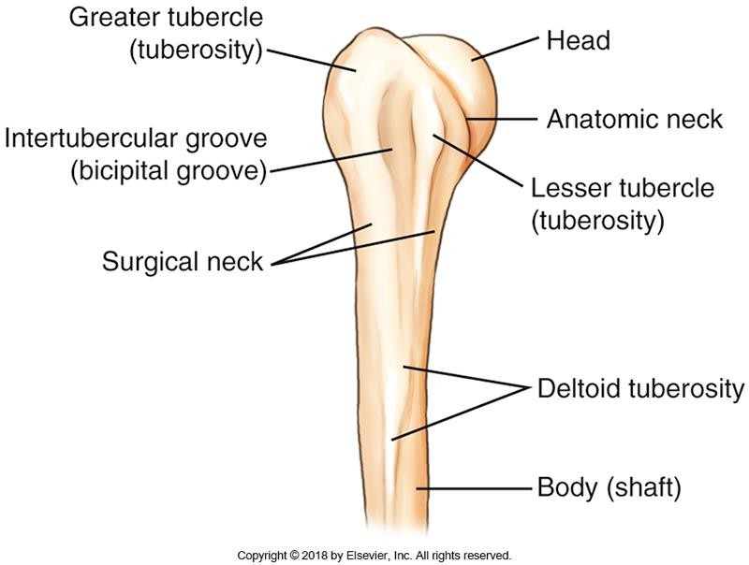
Proximal Humerus
Teach yourself to recognize the following parts of the proximal humerus:
Head
Anatomic neck
Surgical neck
Greater tubercle (tuberosity)
Lesser tubercle (tuberosity)
Intertubercular sulcus
Deltoid tuberosity
Bontrager pg. 178 Fig. 5.2

Slide 6
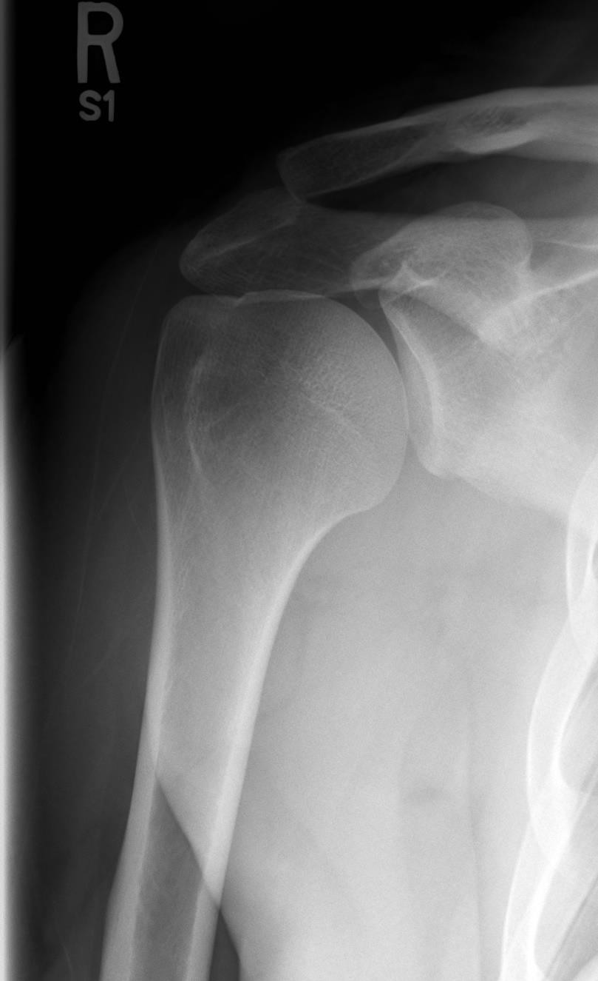
Proximal Humerus
Bontrager pg. 178 Fig. 5.2
SAIT imaging library

Slide 7
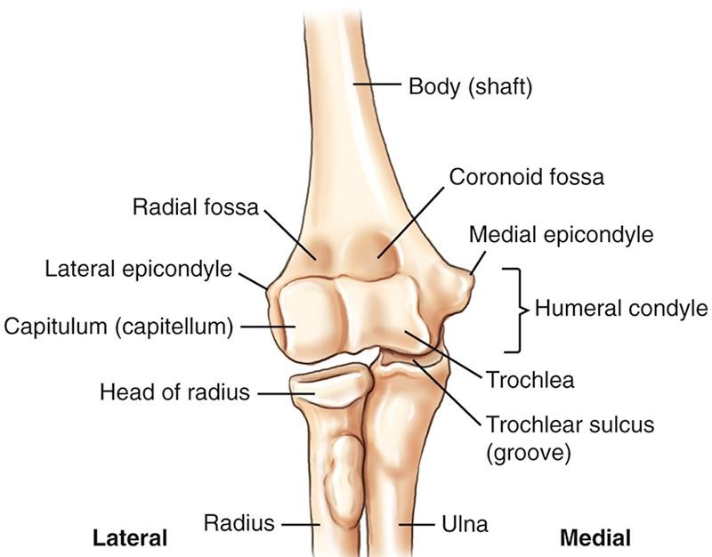
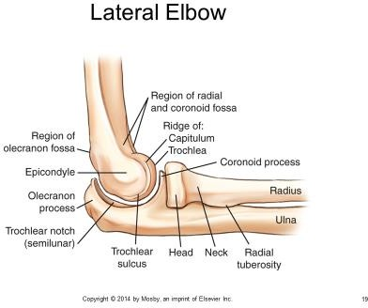
Distal Humerus
Teach yourself to recognize the following
parts of the distal humerus:
Humeral condyles
Trochlea
Trochlear sulcus (trochlear groove)
Capitulum
Medial & lateral epicondyles
Coronoid fossa
Radial fossa
Olecranon fossa
Bontrager pg. 131 Fig. 4.16 & 4.17

Slide 8
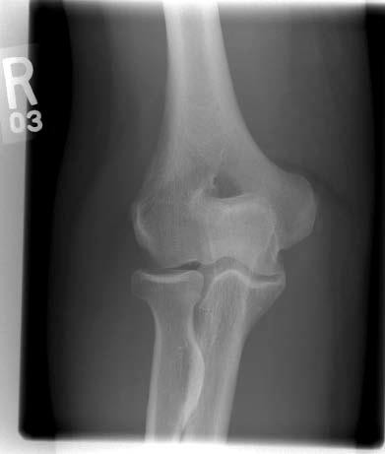
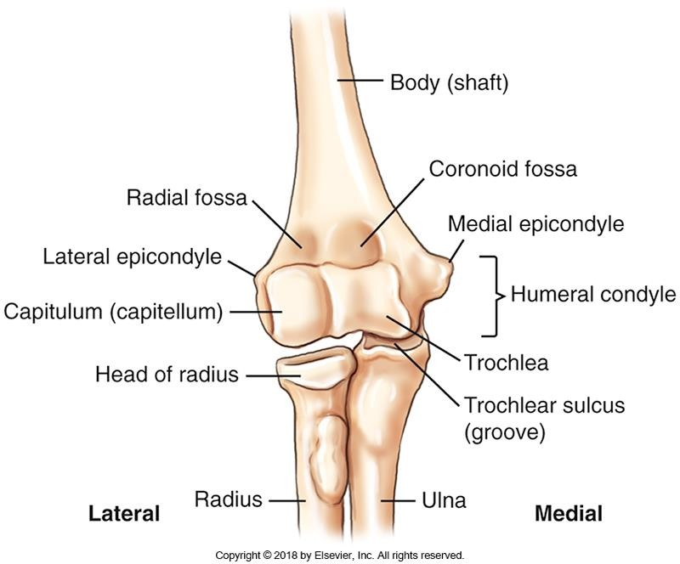
Distal Humerus
Bontrager pg. 131 Fig. 4.16
SAIT Image Critique Handbook

Slide 9
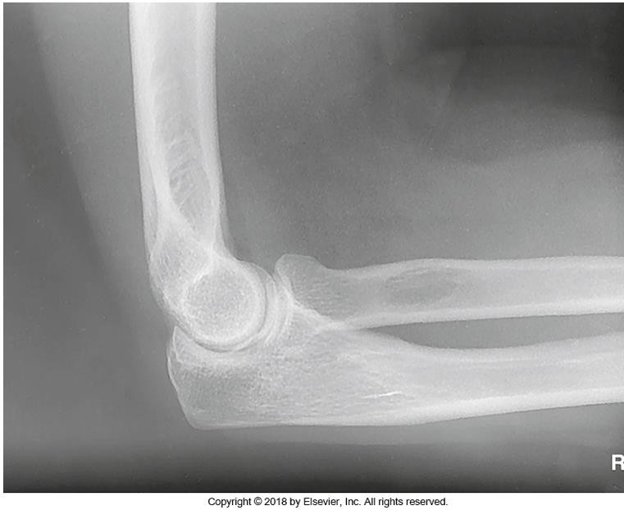
Distal Humerus
Bontrager pg. 131 Fig. 4.17
Bontrager pg. 170 Fig. 4.142

Slide 10
Elbow Joint
Has three articulations:
Between the radius &
capitulum
Between the ulna &
trochlea
Proximal radioulnar joint
Bontrager pg. 131 Fig. 4.16

Slide 11
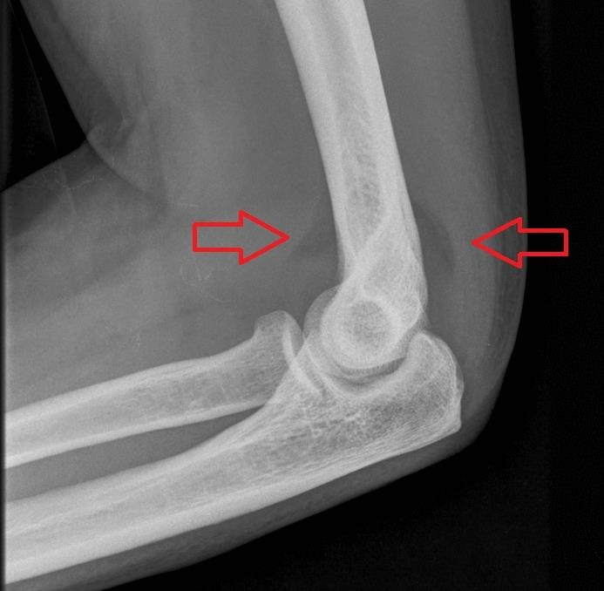
Elbow Joint – Fat Pads
Radiolucent densities (i.e. appear slightly darker than surrounding soft tissue) may be the only indication of disease, significant injury, or fracture within a joint region
Anterior fat pad: trauma or infection
Posterior fat pad: joint pathologic process (or elbow flexed less than 90º)
Supinator fat stripe: radial head or neck fractures
By RSatUSZ - Own work, CC BY-SA 3.0, https://commons.wikimedia.org/w/index.php?curid=17008808

Slide 12
Helpful Resources
http://www.wikiradiography.net/page/The+Lateral+Elbow
  Lateral elbow positioning errors
http://www.startradiology.com/internships/general-surgery/elbow/x- elbow/
  If you run your cursor over the elbow images, the anatomy is outlined for you

