Slide 1
MRAD 204:
Radiographic Technique 1
Outcome 6-10:
Image Critique – Femur and Knee

Slide 2
Affiliated Readings
Bontrager
Pgs: 246→250
Pgs: 278→280
Emphasis on the “pink box” Evaluation Criteria

Slide 3
Overview
Image Critique – Femur
Image Critique – Knee
Tips & Tricks

Slide 4

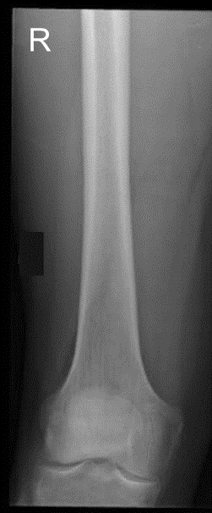
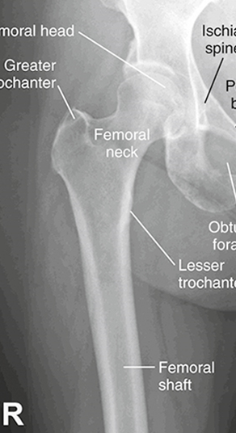
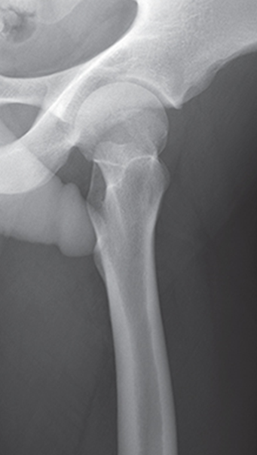
Image Critique – Femur
SAIT Image Critique Handbook
R
Anatomy
McQuillen Martensen 5th Ed. Pg.423 Fig. 6.270
McQuillen Martensen 5th Ed. Pg.415 Fig. 6.256
R
R
Ideally, routine Femur radiographs should display:
Entire Femur
At least 1-inch of proximal tib/fib
Entire Hip & Knee joint

Slide 5
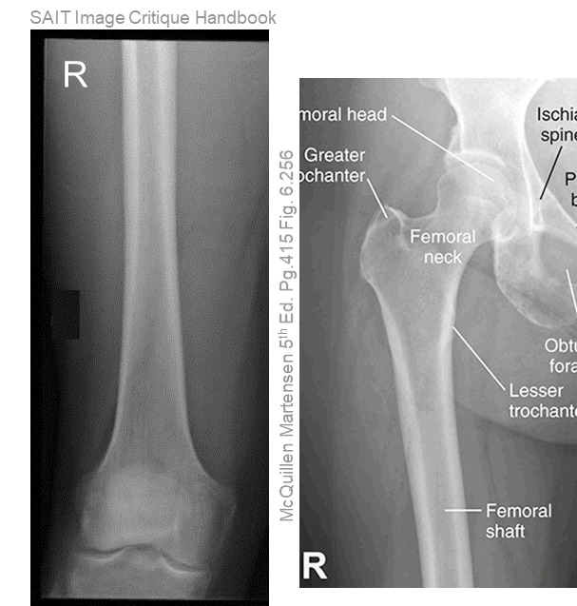
Image Critique – Femur
Exposure & Technique
R
Routine AP Pelvic radiographs should display:
R
kVp range of 75→85
Optimal density and contrast:
  no motion (i.e. blur)
  soft tissue margins visible
  clear bony trabecular markings

Slide 6
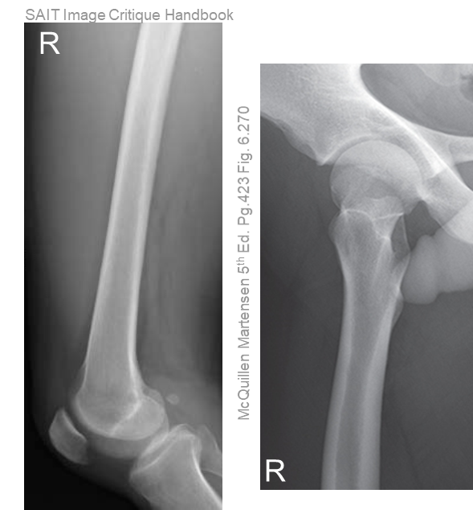
Image Critique – Femur
Marker Placement &/or artifacts
Marker placement: in the same anatomical location on both images in each projection, not obscuring bony anatomy
No removable artifacts are visible
If unmoved between the two images of the AP projection:
If unmoved between the two images of the Lateral projection:
Marker will display in the: superior anterior edge of the proximal image & inferior anterior edge of the distal image
Marker will display in the: superior lateral edge of the proximal image & inferior lateral edge of the distal image
R

Slide 7
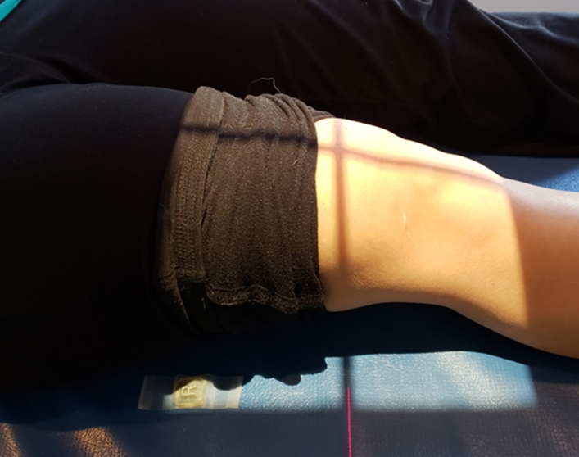
Image Critique – AP Distal Femur
CR & Collimation
Four sided collimation with lengthwise crosshair centered over the femoral body
Notes:
Soft-tissues not required in their entirety; only bony anatomy is of interest

Slide 8
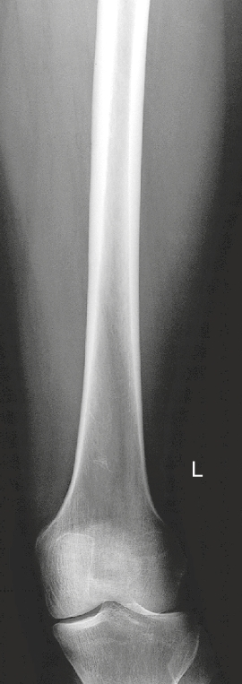
Image Critique – AP Distal Femur
Position
@ 75 kVp
Femoral & tibial condyles symmetric in size and shape
Patella slightly closer to medial side of femur
Medial half of fibular head superimposed by tibia
Femur parallel to collimated light-field
*Knee joint not fully opened due to beam divergence
Bontrager pg. 278 Fig. 7.37

Slide 9
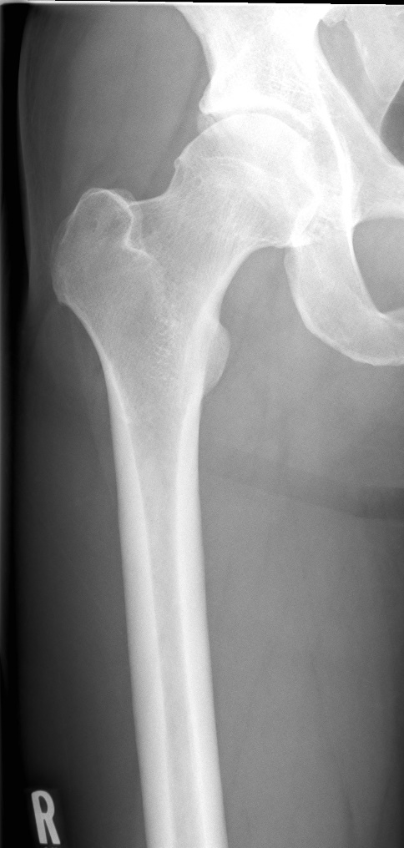
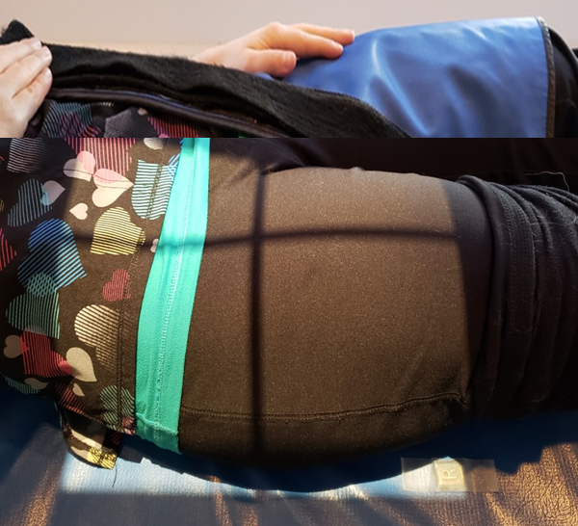
Image Critique – AP Proximal Femur
CR & Collimation
R
Four sided collimation with lengthwise crosshair centered around the femoral body
Notes:
symphysis pubis not required
CR centering (proximal/distal) is dependent on the field size used
When only 1/3rd of the proximal femur is included, the CR should be near the femoral neck
SAIT Image Library & SAIT Campus 2021

Slide 10
Image Critique – AP Proximal Femur
Position
@ 75 kVp
Femoral head seen through the acetabulum
Femoral neck in profile
Greater trochanter in profile
Lesser trochanters barely seen (or not seen at all) on the medial side
Femur parallel to collimated light-field
SAIT Image Library

Slide 11
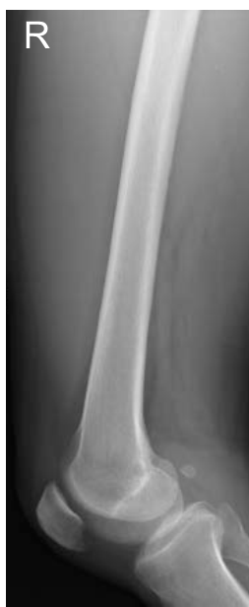
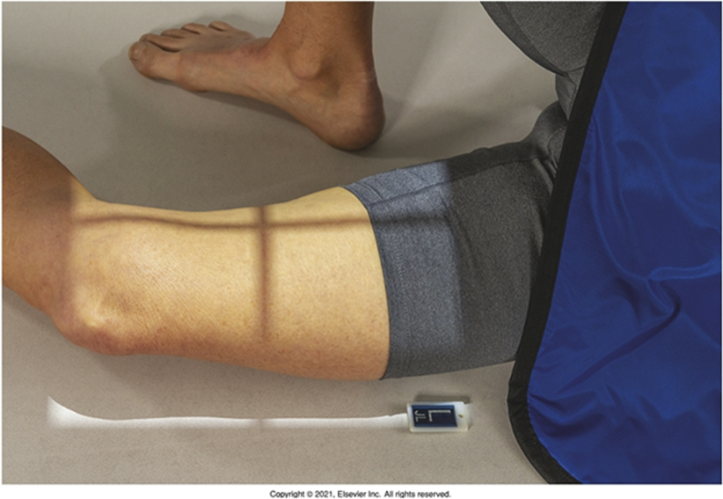
Image Critique – Lateral Distal Femur
CR & Collimation
R
Four sided collimation with lengthwise crosshair centered over the medial epicondyle of the femur
Notes:
Soft-tissues not required in their entirety; only bony anatomy is of interest
Bontrager pg. 279 Fig. 7.38

Slide 12
Image Critique – Lateral Distal Femur
Position
@ 75 kVp
Open patellofemoral joint space
*Closed knee joint, due to beam divergence
Aka. Inferior margins of femur not superimposed
Anterior margins of condyles superimposed
Distal margins of condyles not superimposed

Slide 13
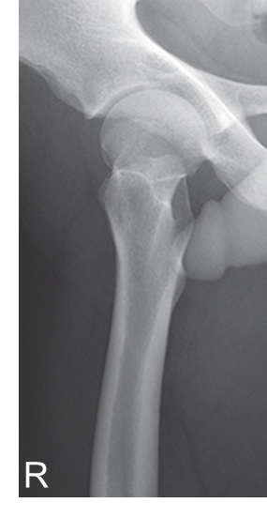
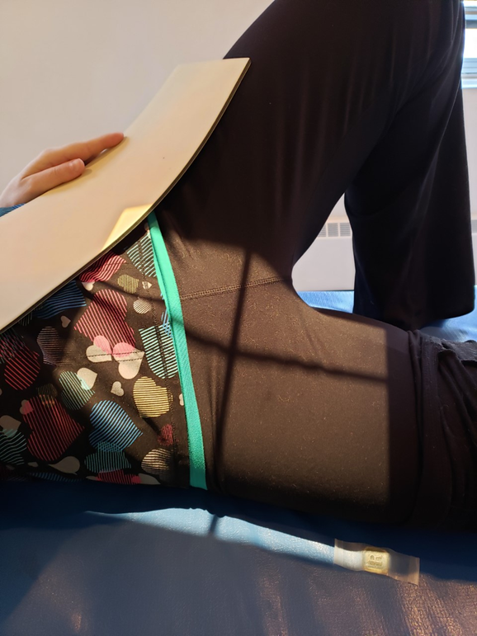
Image Critique - Lateral Proximal Femur
CR & Collimation
R
Four sided collimation with lengthwise crosshair centered around the femoral body
Notes:
CR centering (proximal/distal) is dependent on the field size used
When only 1/3rd of the proximal femur is included, the CR should be near the femoral neck
McQuillen Martensen 5th Ed. Pg.423 Fig. 6.270

Slide 14

Image Critique - Lateral Proximal Femur
Position
@ 75 kVp
Head of femur in the acetabulum
Femoral neck foreshortened and superimposed by the greater trochanter
Only a small part of lesser trochanter visible on the medial side
Femur parallel to collimated light-field
McQuillen Martensen 5th Ed. Pg.423 Fig. 6.270

Slide 15
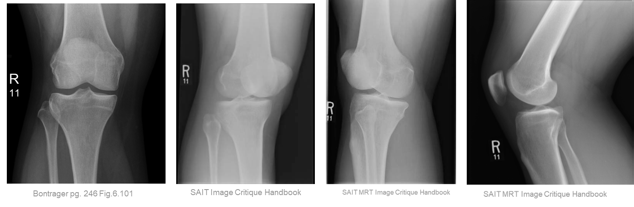
Image Critique – Routine Knee
Anatomy
R
Ideally, all routine Knee radiographs should display:
Entire patella
Distal femur
1/4 of proximal tib/fib

Slide 16
Image Critique – Routine Knee
Exposure & Technique
ALL routine hip radiographs should display:
Optimal density and contrast:
  no motion (i.e. blur)
  soft tissue margins visible
  clear bony trabecular markings
kVp range of 65→80

Slide 17
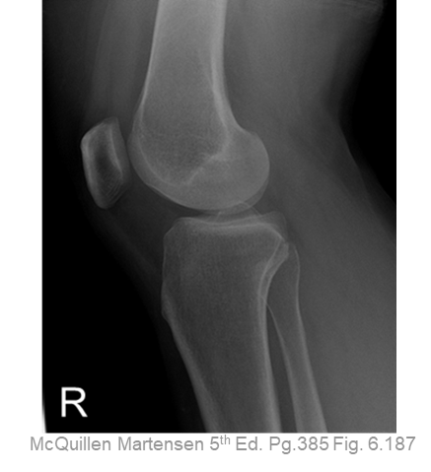
Image Critique – Routine Knee
Marker Placement &/or artifacts
Marker placement, not obscuring soft-tissue:
AP, & Oblique projections: lateral edge of light-field
Lateral projection: anterior, inferior edge of light field
No removable artifacts are visible

Slide 18
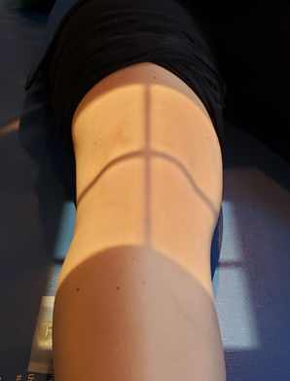
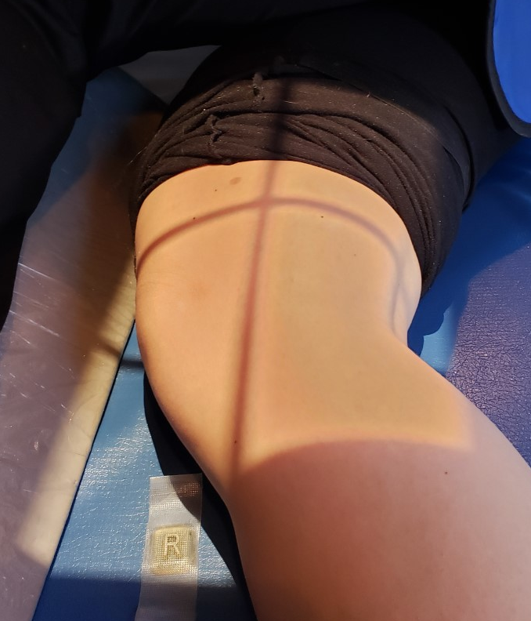
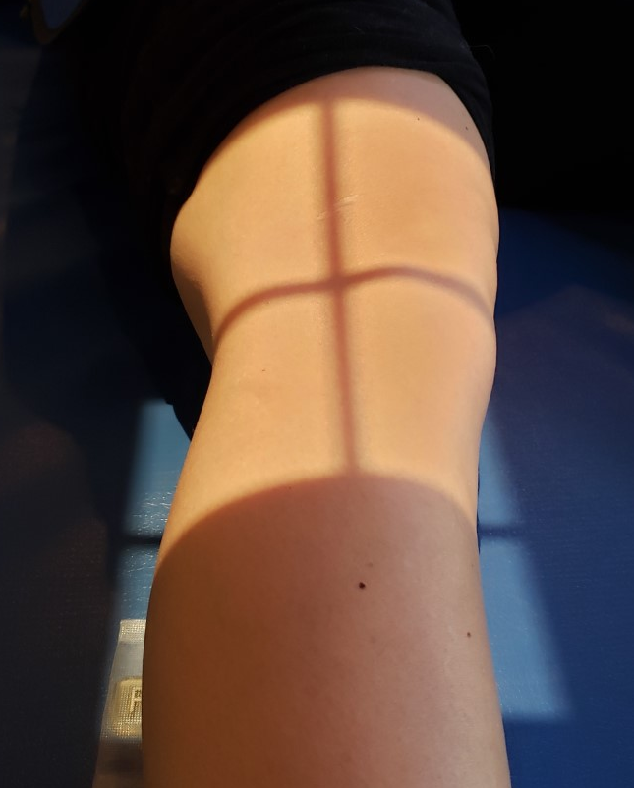
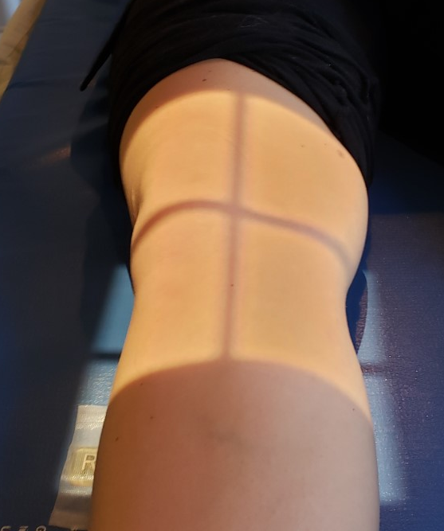

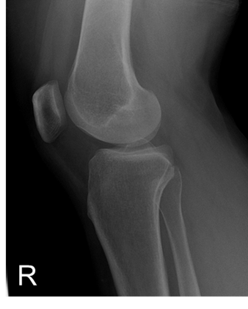
Image Critique – Routine Knee
Four sided collimation centered to mid-knee joint
CR & Collimation
McQuillen Martensen 5th Ed. Pg.385 Fig. 6.187

Slide 19
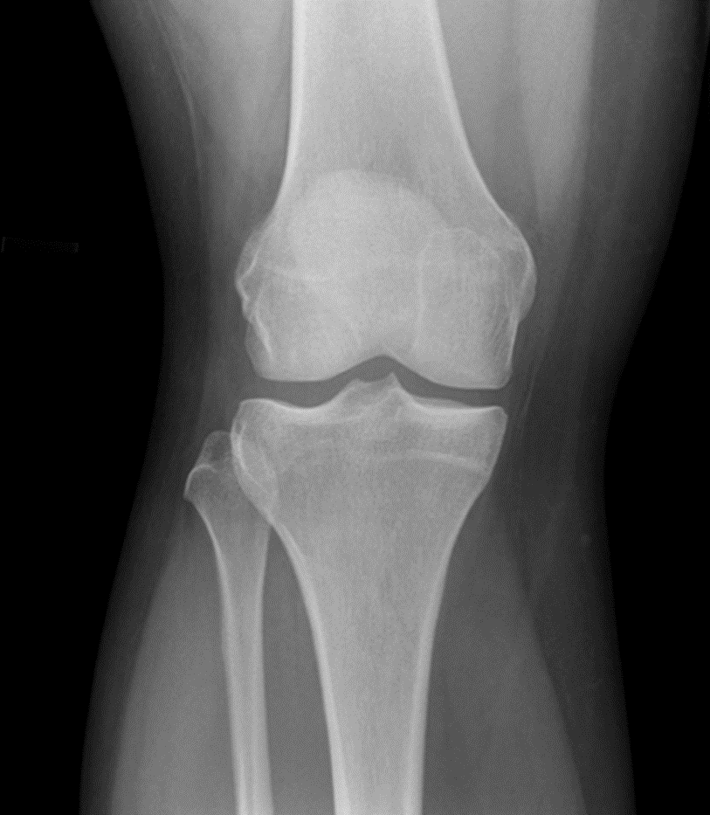
Image Critique – AP Knee
Position
Open femorotibial joint space
Tibial plateaus seen with only minimal surface area
Intercondylar eminence centered at mid-femur (“side-side”)
Symmetric femoral and tibial condyles
~ ½ fibular head superimposed by tibia
@ 65 kVp
R
Bontrager pg. 246 Fig. 6.101

Slide 20
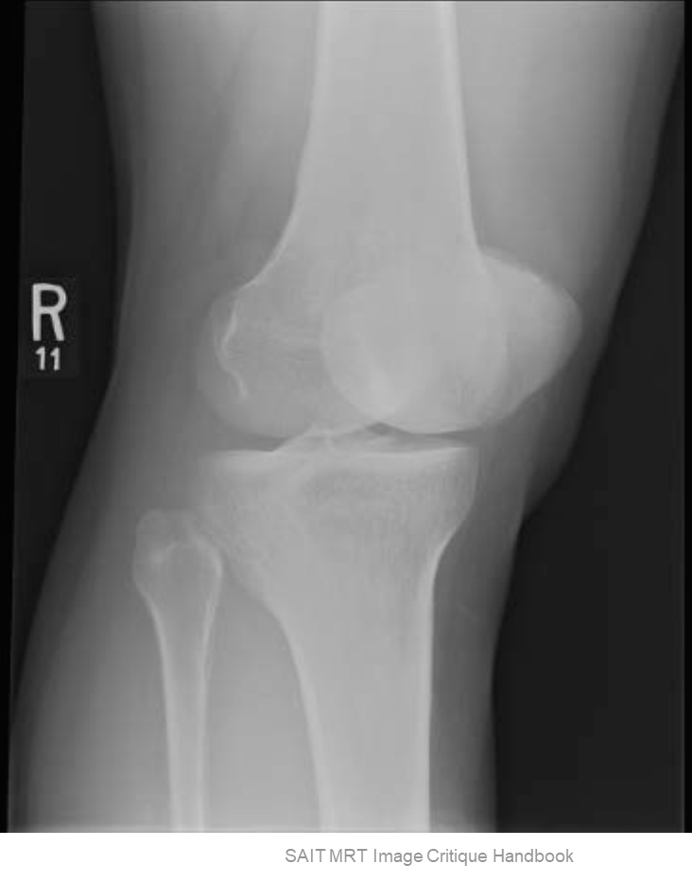
Image Critique: AP Internal Oblique Knee
Position
@ 65 kVp
~½ patella superimposing medial condyle of femur, and ~½ free of superimposition
Open proximal tibiofibular joint
  Aka. head and neck of fibula free of superimposition
Lateral condyle of femur & tibia in profile
R

Slide 21
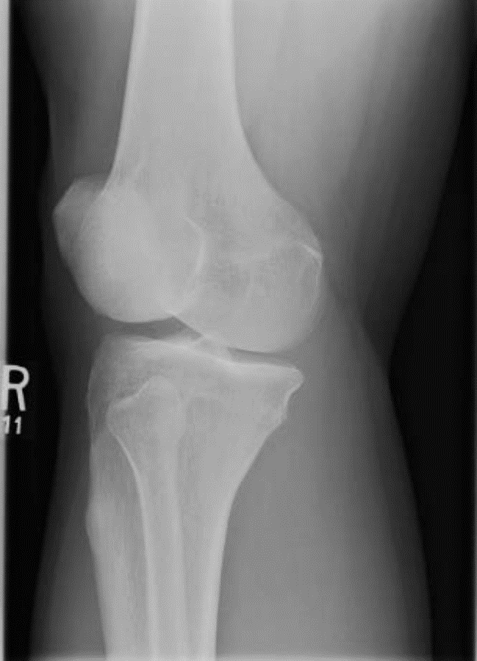
Image Critique: AP External Oblique Knee
Position
@ 65 kVp
~½ patella superimposing lateral condyle of femur, and ~½ free of superimposition
Proximal fibula superimposing lateral half of tibia
  Fibular head aligned with “anterior edge” of tibia
Medial condyle of femur & tibia in profile
R
SAIT MRT Image Critique Handbook

Slide 22
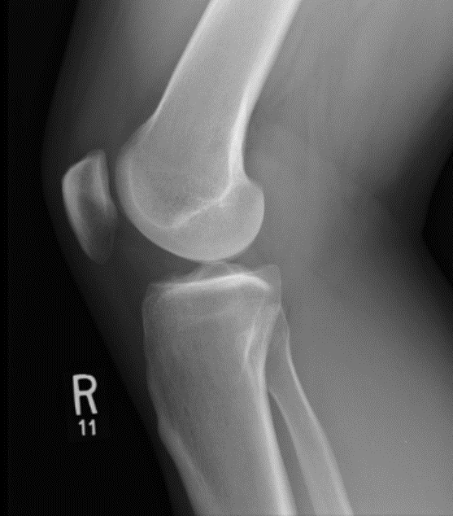
Image Critique – Lateral Knee
Note: Femur should be parallel to collimated light-field
Position
Note: This image used to demonstrate all other “ideal” positioning criteria
@ 65 kVp
McQuillen Martensen 5th Ed. pg. 385 Fig. 6.187
Patella in profile
Posterior and distal margins of femoral condyles directly superimposed
Open Patellofemoral joint
Proximal tibiofibular joint slightly superimposed by posterior half of proximal tibia
R
SAIT MRT Image Critique Handbook

Slide 23
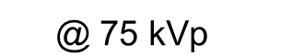
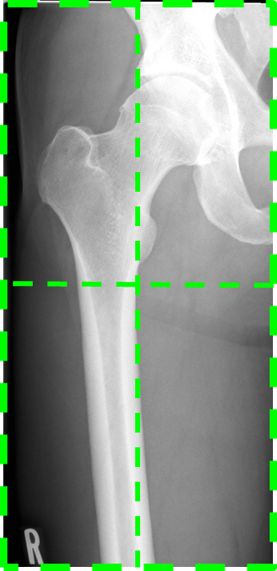
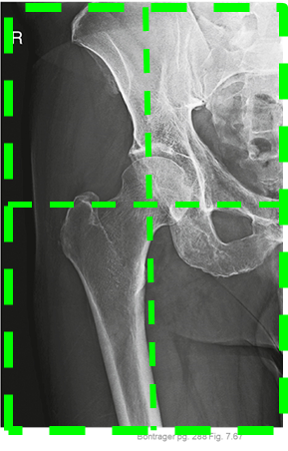
Tips & Tricks – Femur Projections
Proximal AP Femur Image:
Critique same way you would critique AP Hip, EXCEPT:
  “Symph” not required
  Femur requires a lower technique
  *If proximal femur is site of injury, the CR will not be centered over femoral neck
@ 80 kVp
AP Proximal Femur
AP Hip
SAIT Image Library
Bontrager pg. 288 Fig. 7.67

Slide 24
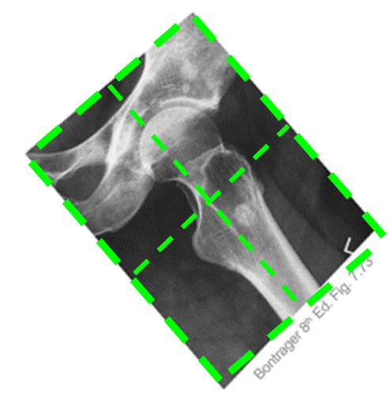
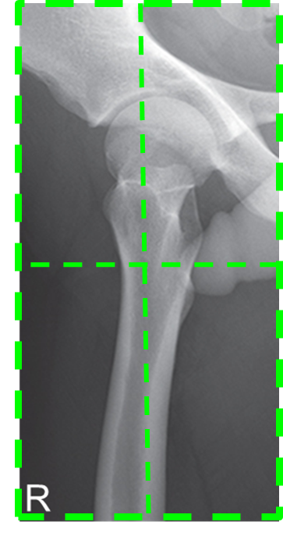
Tips & Tricks – Femur Projections
Proximal Lateral Femur Image:
Critique same way you would critique Lateral Hip, EXCEPT:
  Only a small part of the lesser trochanter will be visible medially
  Femur requires a lower technique
  Femur must be parallel to edge of IR (i.e. no collimator tilt)
  *If proximal femur is site of injury, the CR will not be centered over femoral neck
@ 80 kVp
Lateral Hip
Lateral Proximal Femur

Slide 25
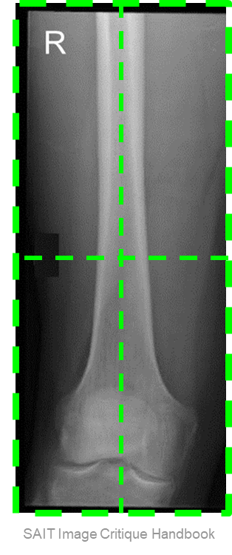
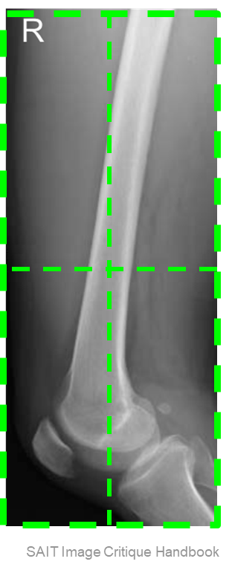
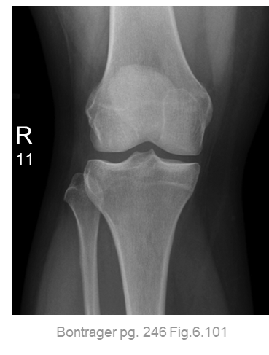

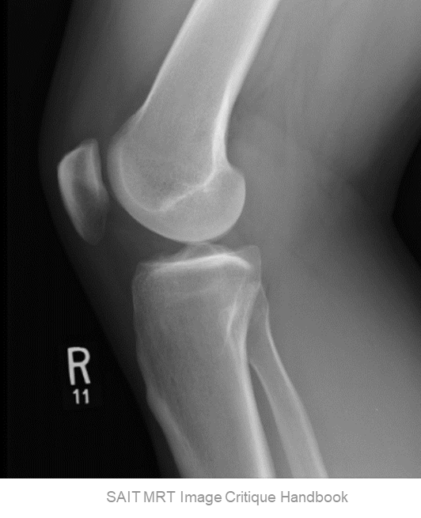
Tips & Tricks – Femur Projections
Distal Femur Images:
Critique same way you would critique AP & Lateral Knee projections EXCEPT:
  Femur requires a higher technique
  Knee joint will be superimposed in femur projections
  Lateral distal Femur: Femoral condyles will not be superimposed
@ 65 kVp
@ 65 kVp
AP distal Femur
Lateral distal Femur
AP Knee
Lateral Knee

Slide 26
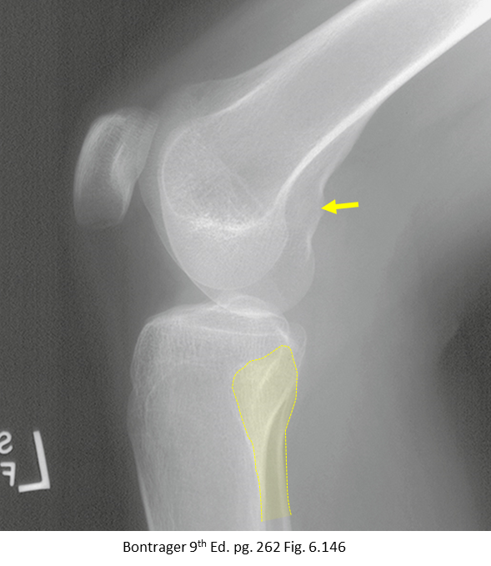
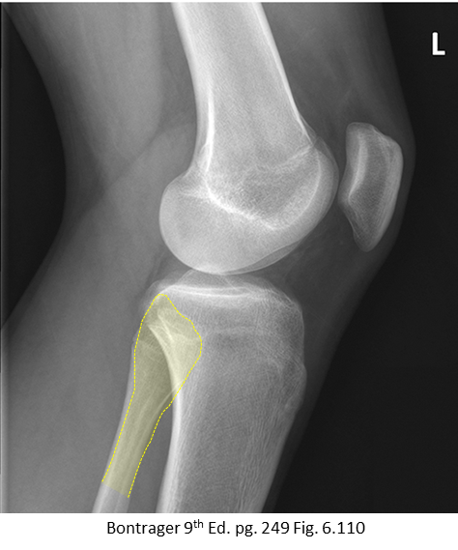
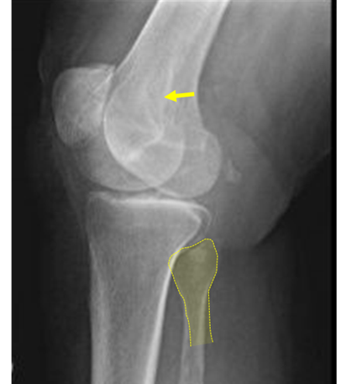
Tips & Tricks: Lateral Knee Projections
Evaluate the Fibula & Adductor tubercle:
Adductor tubercle (yellow arrow): is it superimposed (on top of another structure)
Superimposition of fibula = under-rotation
Superimposition of fibula = over-rotation
https://i.pinimg.com/736x/3b/d5/83/3bd5833938cc85d55028ec1dbb9fb27e.jpg

Slide 27
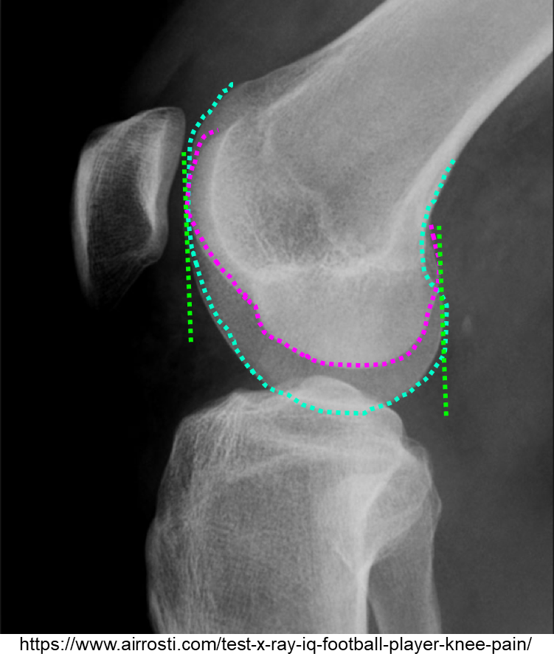
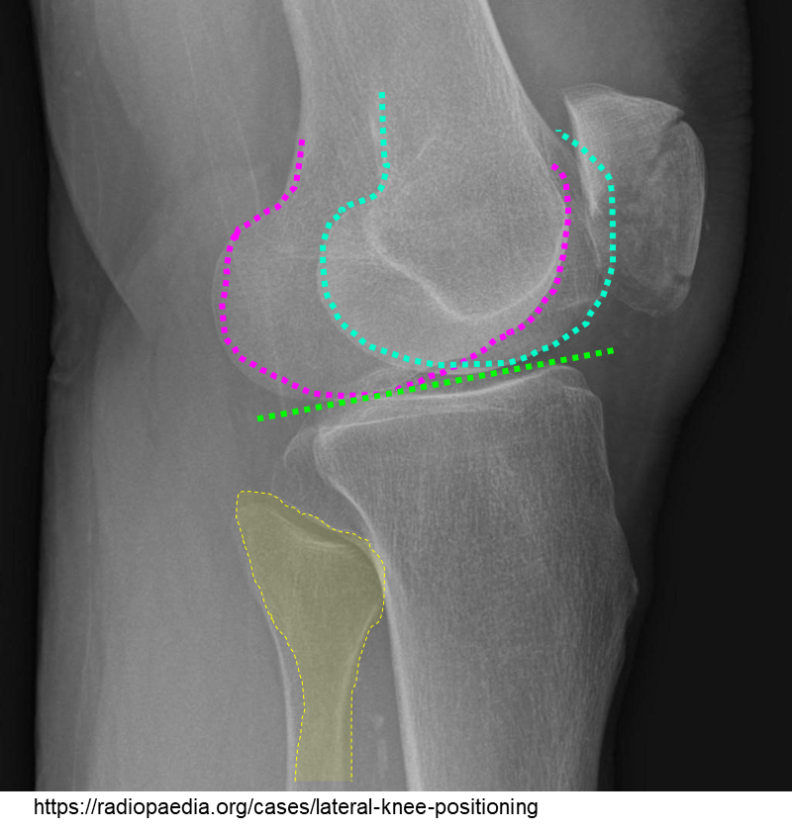
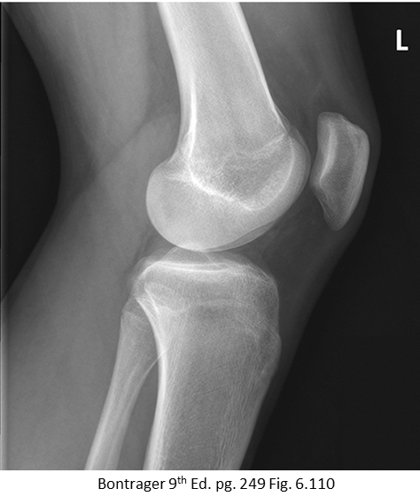
Tips & Tricks: Lateral Knee Projections
If CR centering is accurate, but femoral condyles are:
NOT Superimposed inferiorly
NOT Superimposed anteriorly

Slide 28
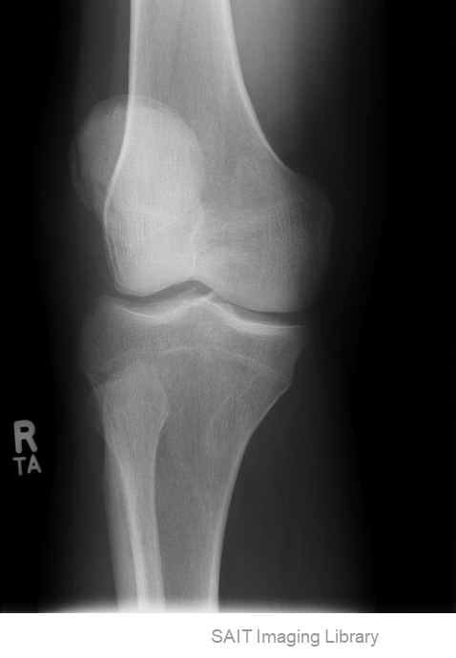
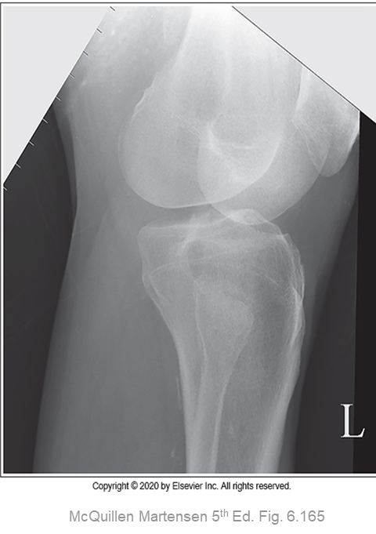
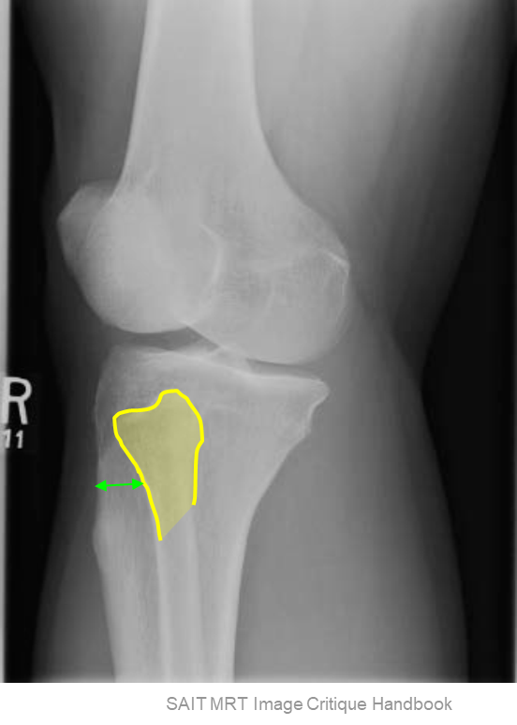
Tips & Tricks: External Oblique Knee
Look at the overall appearance of the femoral condyles, patella, & the position of the fibular head in relation to the tibia:
Internal rotation will demonstrate head of fibula closer to the lateral side of the tibia

Slide 29
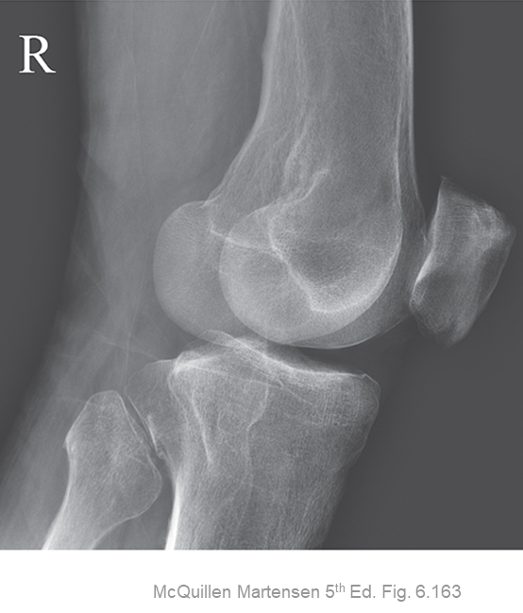
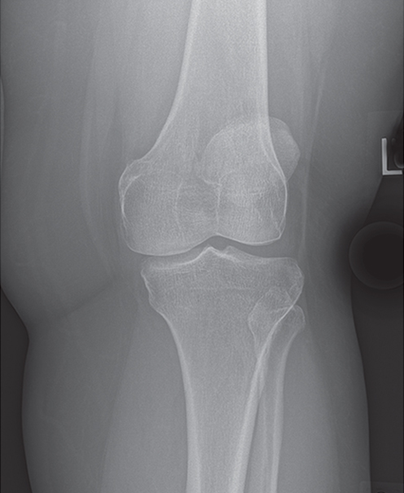
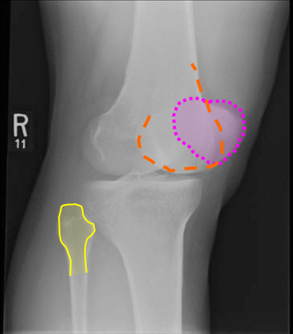
Tips & Tricks: Internal Oblique Knee
Look at the overall appearance of the femoral condyles, patella, & the position of the fibular head in relation to the tibia:
External rotation will demonstrate superimposition of the fibular head
SAIT MRT Image Critique Handbook
McQuillen Martensen 5th Ed. Fig. 6.162

