Slide 1
MRAD 256
Radiographic Technique 2
Positioning of the skull

Slide 2
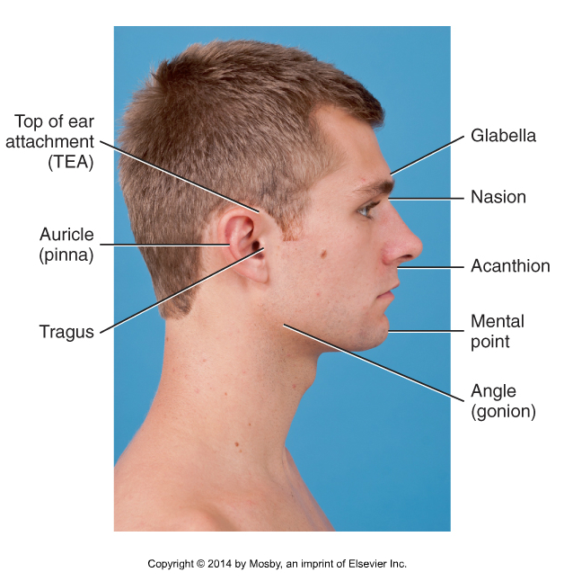
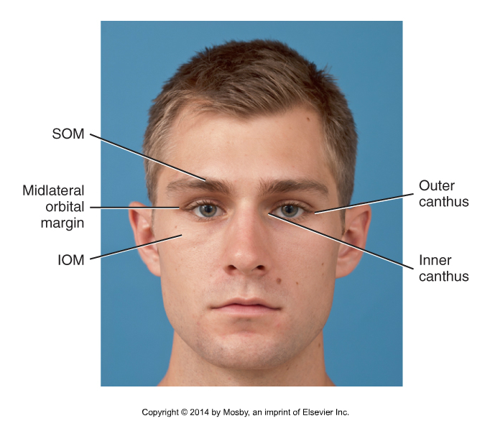
External Landmarks
Bontrager 11-88, 11-89

Slide 3
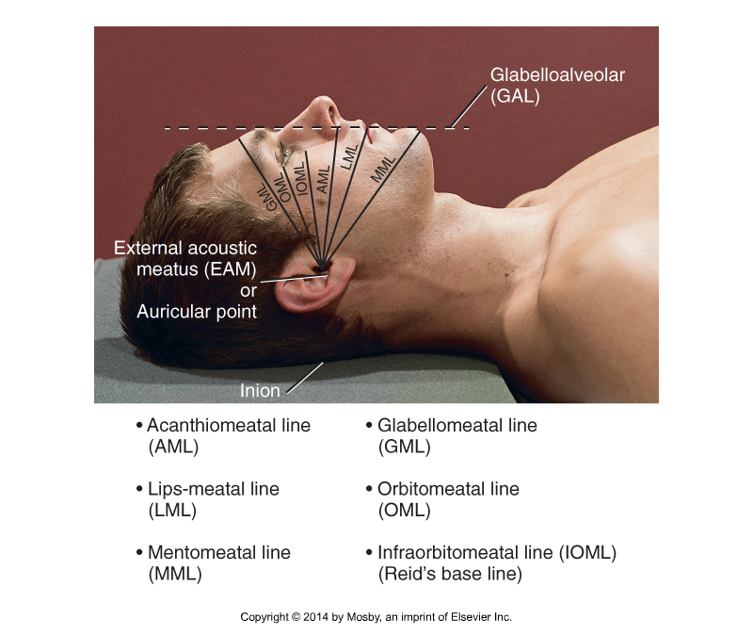
Positioning lines
Bontrager 11-90

Slide 4
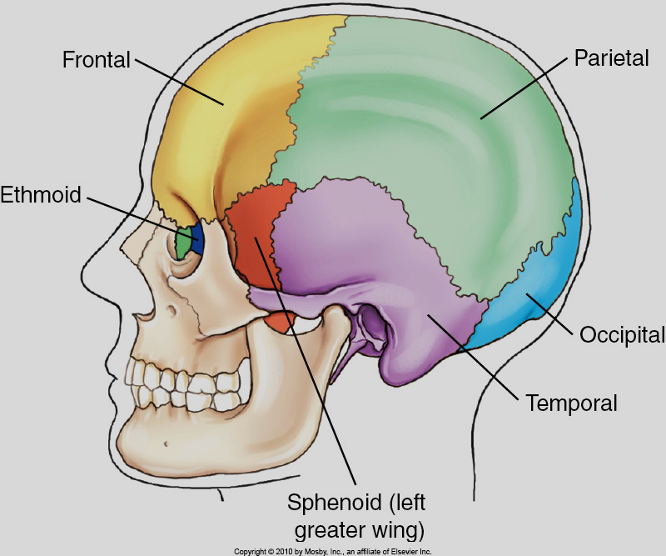
Required anatomy
Skull
Bontrager 11-4

Slide 5
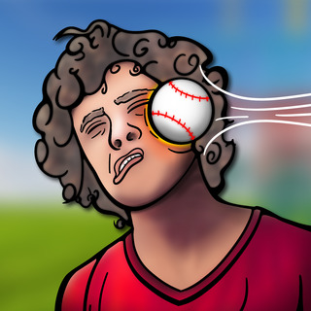
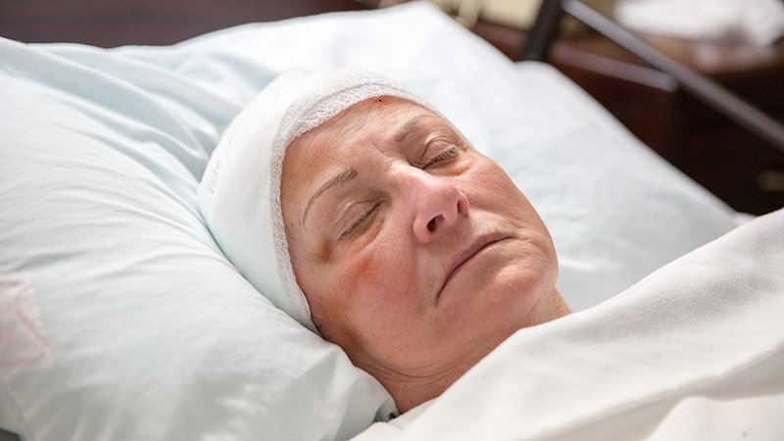
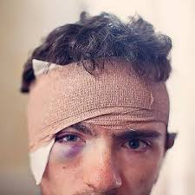
What are some patient care considerations for skull positioning?

Slide 6


Slide 7



Slide 8
Routine skull protocol
Caldwell (PA 15°Axial)
Towne’s (AP 30° Axial)
Lateral (Right or Left)
Field size is always 24x30cm to start
SID is always 110cm

Slide 9
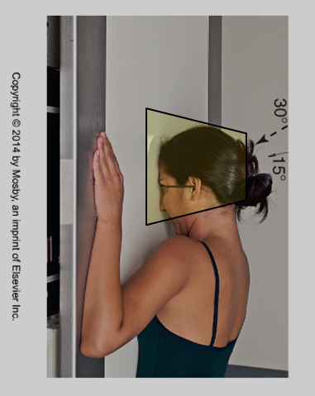
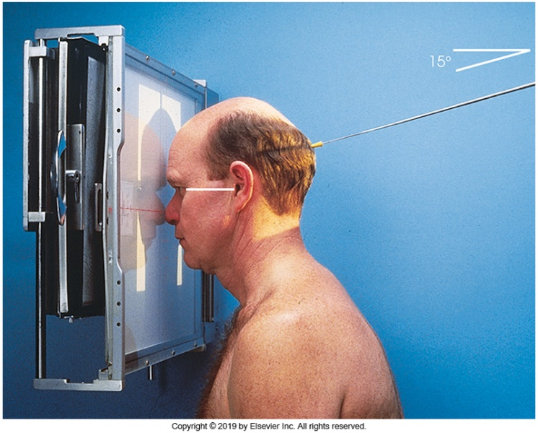
Caldwell (PA 15 °Axial)
Angle CR 15 degrees caudad (to throw the petrous ridges inferiorly)
Ask patient to place forehead and nose on detector, then adjust flexion to place the OML ┴ to IR
Adjust height of the CR so that it exits at or near the level of the nasion
Check for rotation and tilt, and collimate to anatomy of interest (mastoid tip to skull vertex)
Bontrager 11-110
Merrill’s 11-57

Slide 10
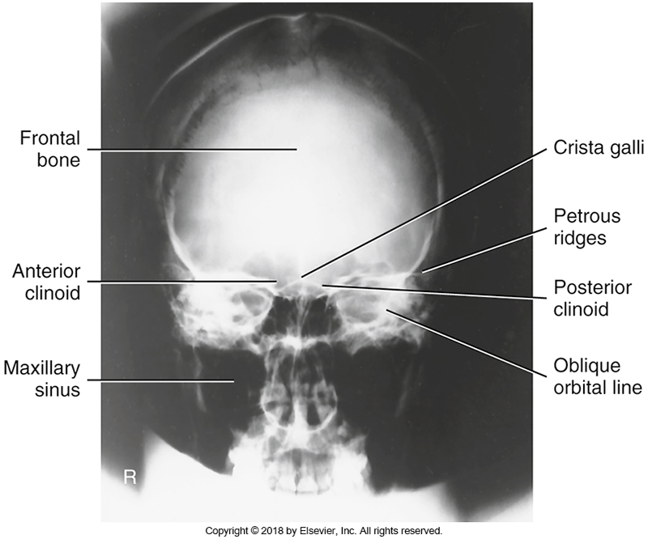
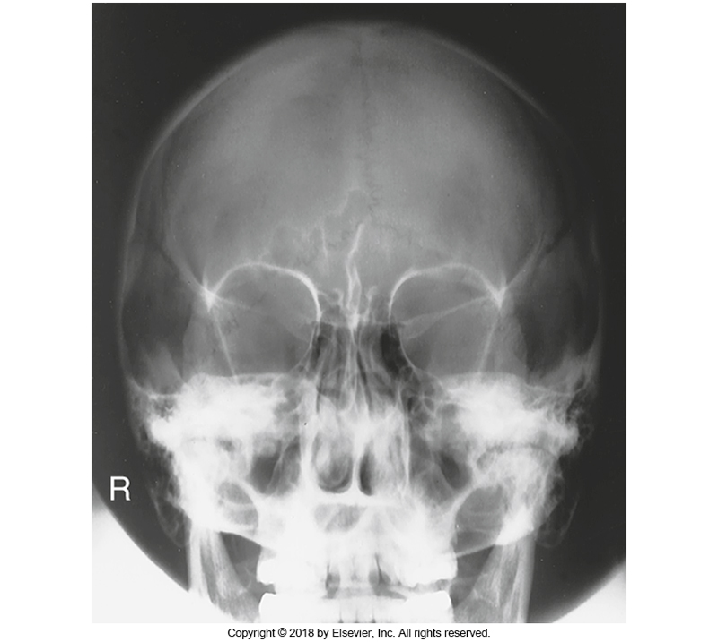
The 15º caudad angle is used to throw the petrous ridges inferiorly
Bontrager 11-115 (0º caudad to OML)
Bontrager 1-111 (15º caudad to OML)
Notes:
Superior orbital fissures= orbits with no petrous ridges

Slide 11
Evaluation criteria
  Entire perimeter of skull is visualized
  Petrous ridges in lower third of the orbits
  Anterior ethmoidal air cells visualized
  No rotation or tilt
Bontrager 11-115

Slide 12
Reverse caldwell (AP 15 °Axial)
OML is still placed perpendicular to the IR
CR angle is 15° cephalad to throw the orbits superiorly with respect to the petrous ridges
CR enters at or near the nasion

Slide 13
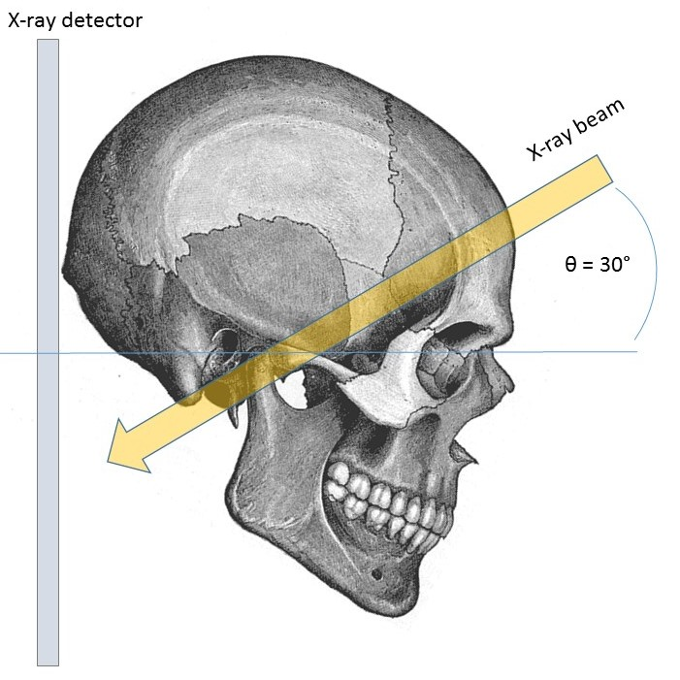
Towne (AP 30-37º Axial)
CR 30º caudad to OML, or CR 37º caudad to IOML
CR enters 6-8cm above glabella (near hairline) and exits inion
May need to place a sponge behind the patient’s head to help them maintain enough flexion
Check for rotation and tilt

Slide 14
Both the neck flexion and caudad tube angle serve the same purpose:
To move the dorsum sellae more inferiorly within the foramen magnum
To move the facial bones inferiorly off of the occipital bone

Slide 15
Towne view of skull
Case courtesy of Dr Matt A. Morgan, Radiopaedia.org, rID: 37238

Slide 16
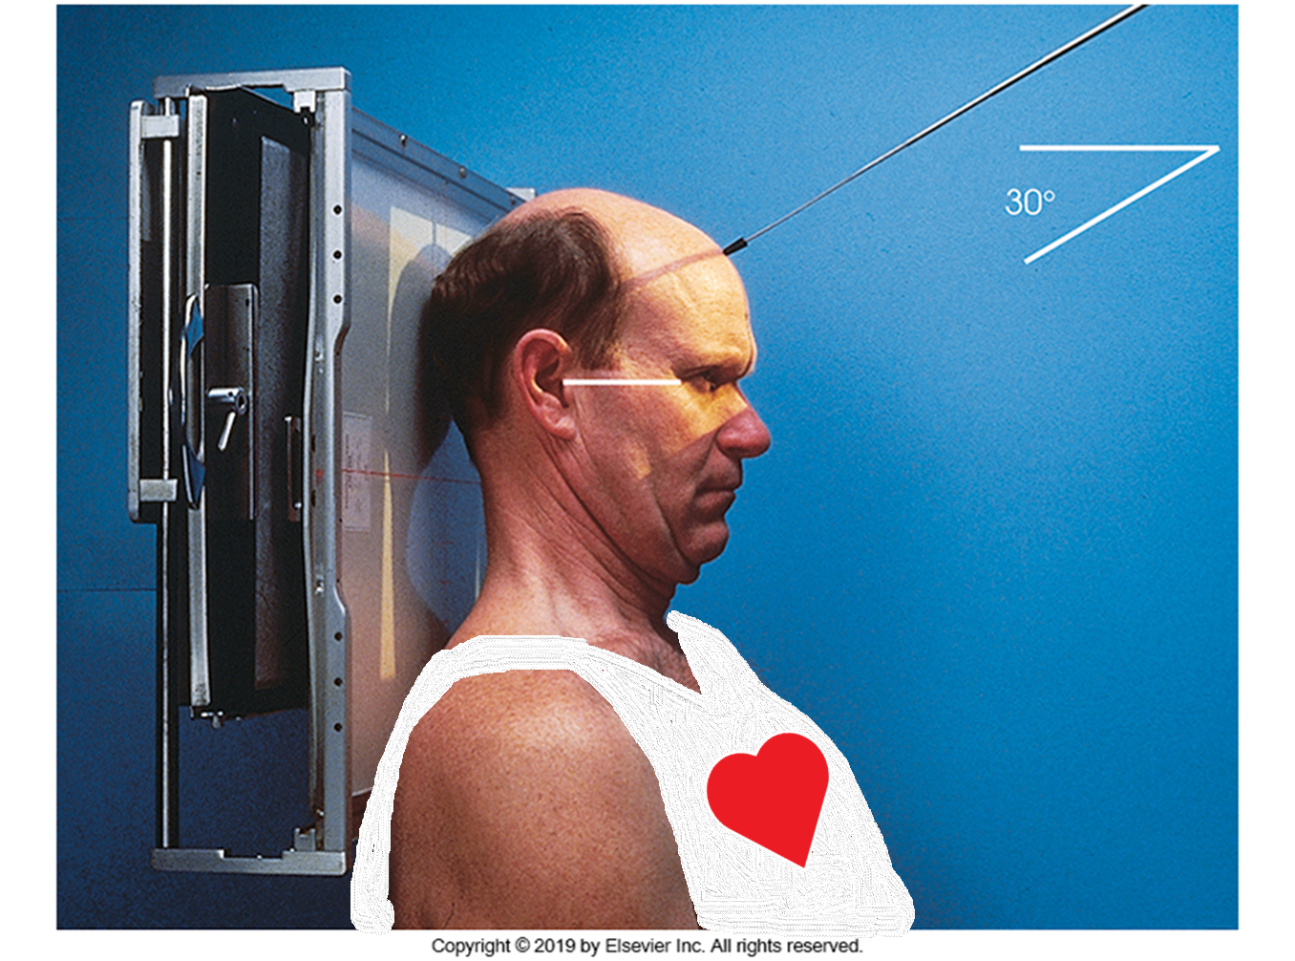

Slide 17
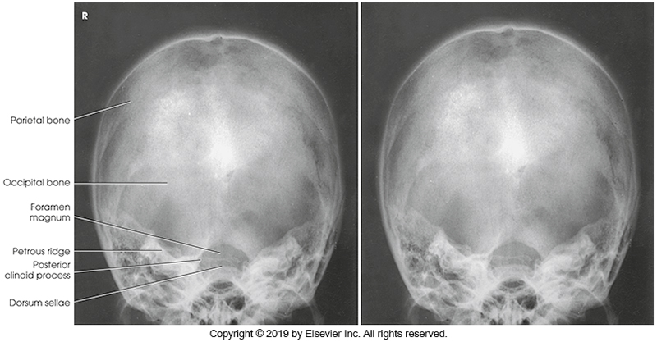
Evaluation criteria
  Occipital bone and the posterior portion of the parietal bones
  Dorsum sellae/posterior clinoid processes are in the foramen magnum.
  Symmetric petrous ridges

Slide 18
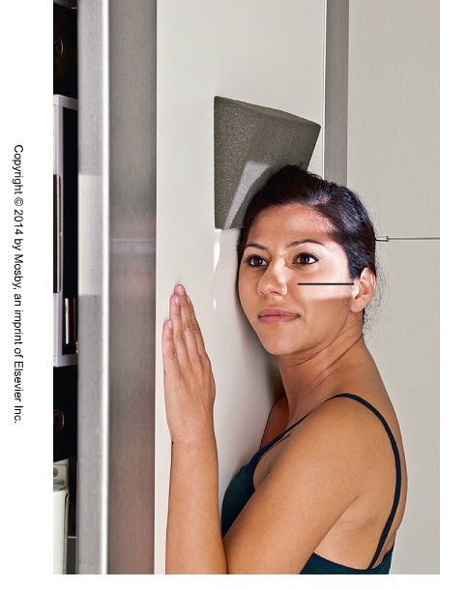
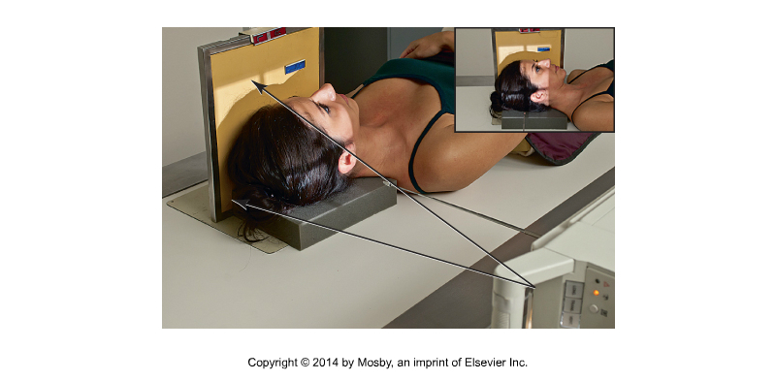
Lateral
Place midsagittal plane parallel to the plane of IR
Place IOML perpendicular to the front edge of the IR
Place interpupillary line perpendicular to the IR
Adjust CR to enter approximately 5 cm above EAM
Cone to include cranium
Turned to look like the wall stand
Bontrager 11-107

Slide 19
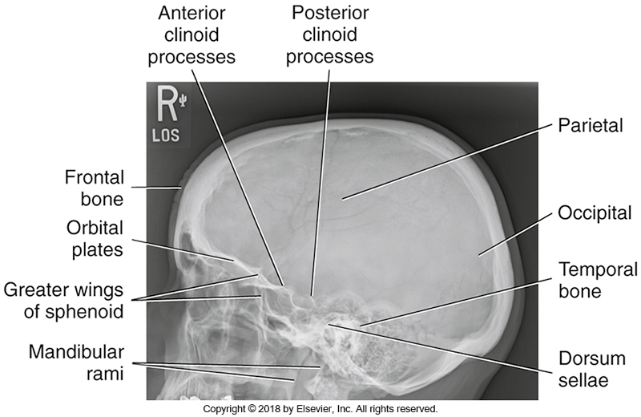
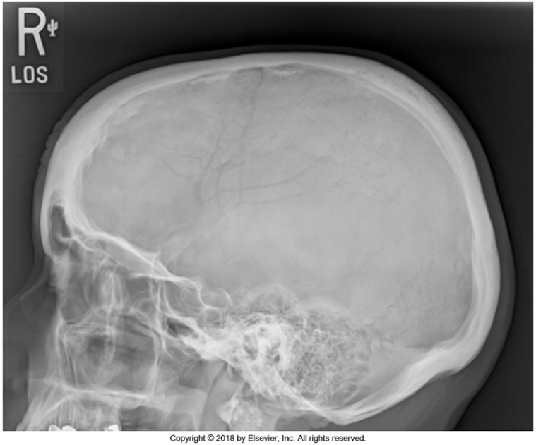
Evaluation criteria
  Sella turcica and dorsum sellae, anterior and posterior clinoid processes are seen
  Superimposed orbital roofs
  Superimposed mastoids, EAM’s and TMJ’s
  No overlap of c-spine, or mandible over skull

Slide 20
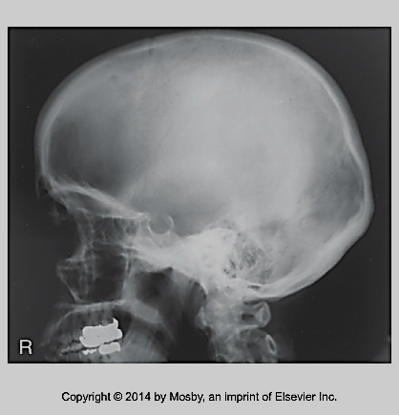
How to evaluate “tilt”
TILT
Bontrager 11-108

Slide 21
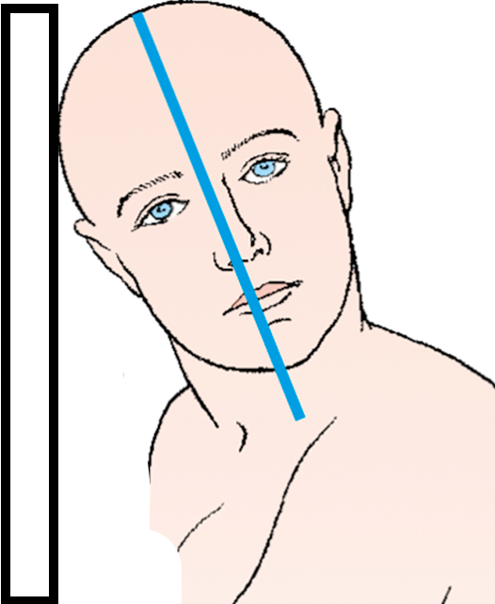
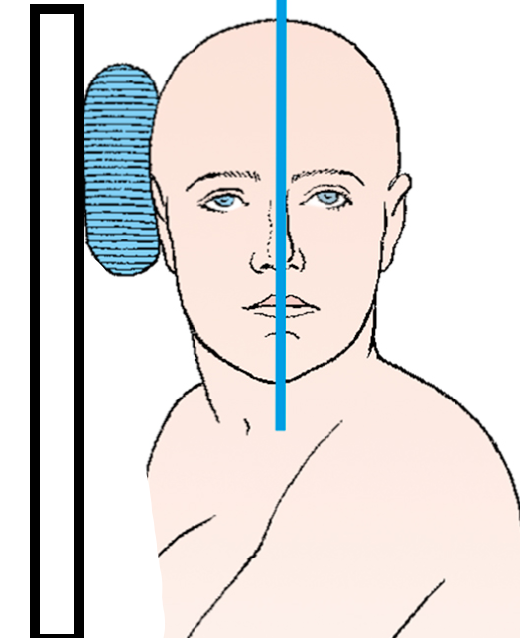
How to correct “tilt”

Slide 22
How to evaluate “rotation”
Rotation
How to evaluate “rotation”
How to evaluate “rotation”
Bontrager 11-108

