Slide 1


Medical Esthetics
The Nervous System

Slide 2
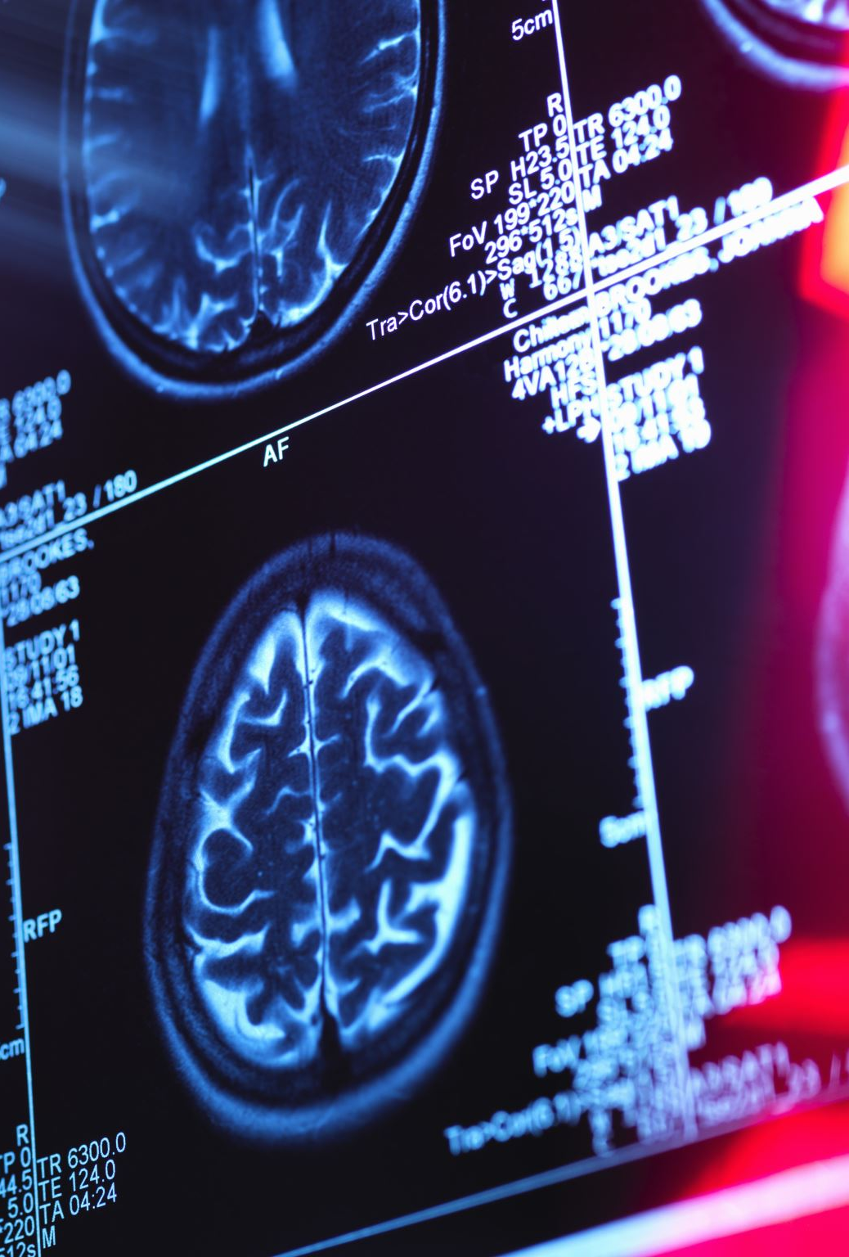

The scientific study of the structure, function, and pathology of the nervous system is known as neurology.

Slide 3
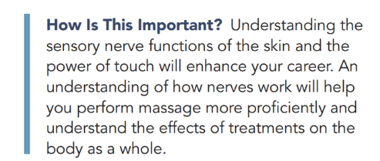

Slide 4
Nerve Cell Structure and Function
What are nerves ?
Nerves are whitish cords, made up of bundles of nerve fibers held together by connective tissue, through which impulses are trans-mitted. Nerves originate in the brain and spinal cord, and their branches extend to all parts of the body.

Slide 5
A Journey
Let’s See

Slide 6
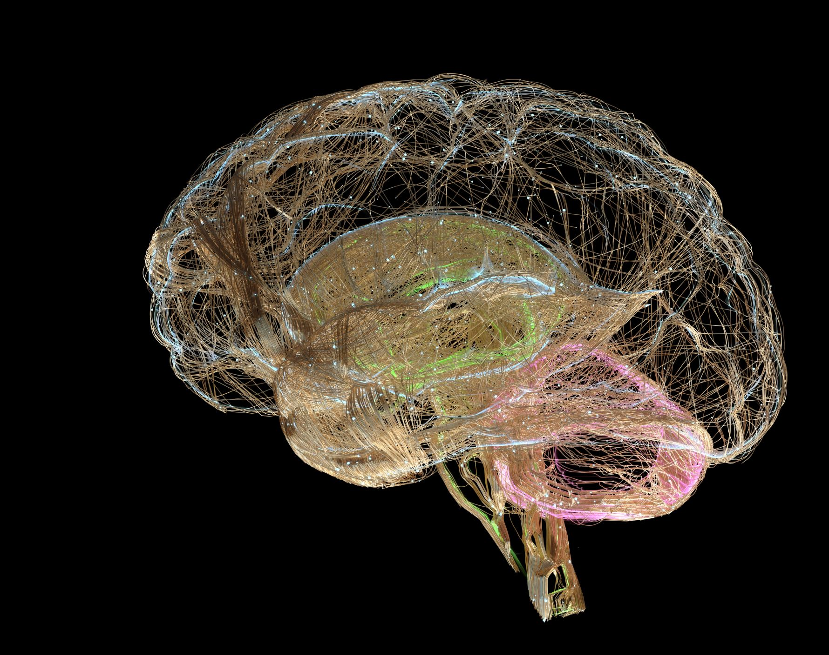
Nerves of the Head, Face, and Neck

Slide 7
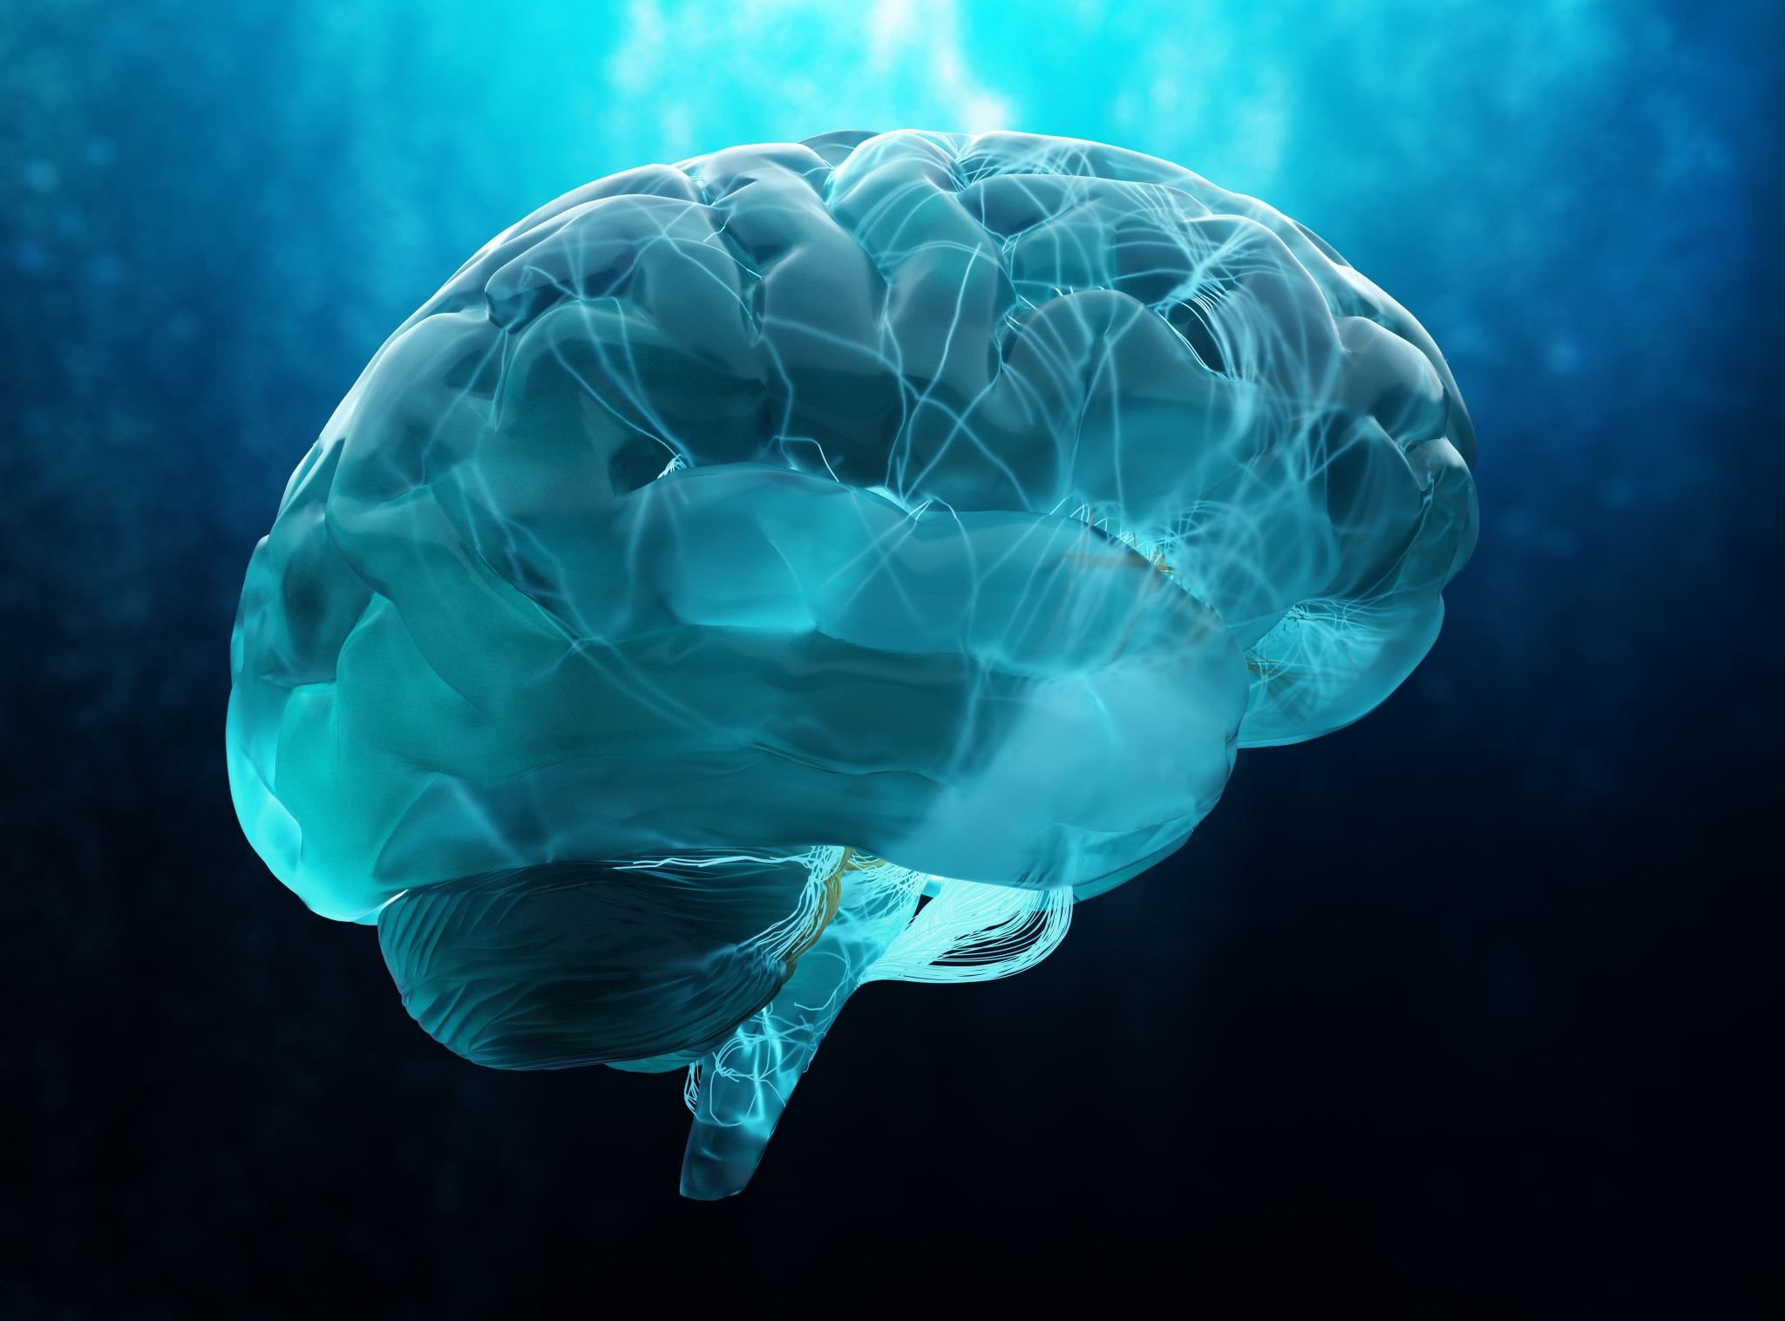
There are 12 pairs of cranial nerves arising at the base of the brain and the brain stem. The cranial nerves activate the muscles and sensory structure of the head and neck, including skin, membranes, eyes, and ears

Slide 8
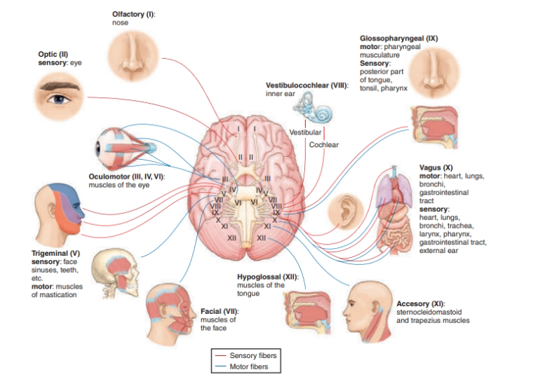

Slide 9
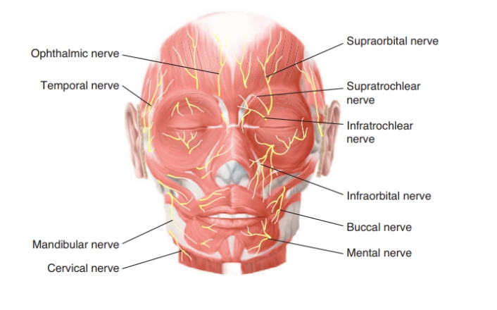
Estheticians are primarily concerned with nerves V, VII, and XI, and each one has several branches

Slide 10
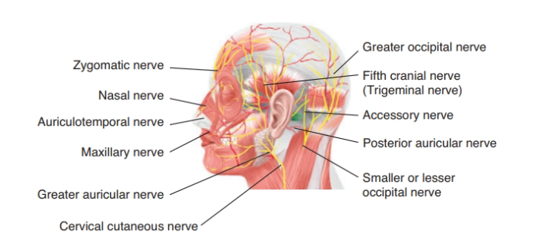

Slide 11

Nerves of the Arm and Hand
The principal nerves supplying the superficial parts of the arm and hand include:
The digital nerve is a sensory-motor nerve that, with its branches, supplies the fingers.
The radial nerve is a sensory-motor nerve that, with its branches, supplies the thumb side of the arm and back of the hand.

Slide 12
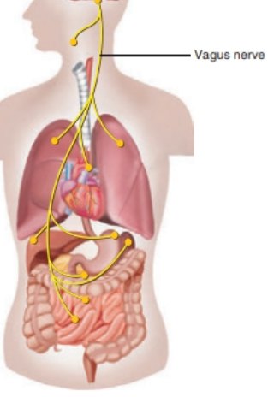
Vagus Nerve
The vagus nerve is located in the abdominal cavity, but its function can impact the esthetician in a surprising way, so knowledge of its function is important. The vagus nerve is a nerve of the autonomic nervous system. When it overreacts to a trigger, it can cause a sudden drop in blood pressure, and the result is fainting. It is the most common cause of fainting. Some triggers are standing up too quickly, the sight of blood, stress, pain, and even pressing on certain areas of the throat, sinus cavities, and eyes.

Slide 13



