Slide 1
MRAD 204:
Radiographic Technique 1
Outcome 1-5:
Positioning – Scapula & AC Joints
MRT Program
Anderson College

Slide 2
Affiliated Readings
Module 5
Bontrager
Pg: 205
Pgs: 207→209

Slide 3
Overview
Guidelines/Considerations
Protocol
Positioning
Evaluation Criteria

Slide 4
Guidelines/Considerations – AC & Scapula
Identify required anatomy
  Note: scapula images do not require entire clavicle
Gowning instructions/Artifact removal
  Same as shoulder imaging
Select appropriate equipment/technical factors
Breathing instructions
Use external landmarks
  Same as shoulder and clavicle imaging

Slide 5
Protocol – AC Joints
Routine:
AP without weights
AP with weights
Note: Both AC Joints must be imaged, however they are typically performed “one side at a time” using a 110cm SID

Slide 6
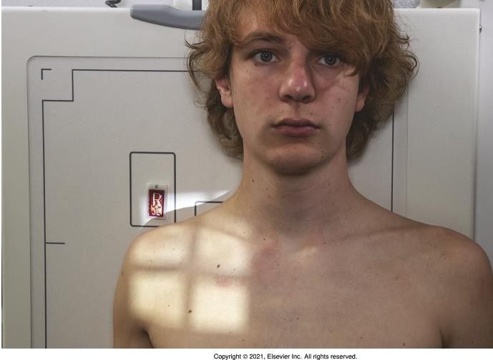
Positioning –AP AC Joints w/o weights
Shoulders Relaxed, with arm in
neutral rotation
Image one AC joint at a time – centering one joint over the middle of the IR for each image
Collimate tightly (as per yellow outline)
Bontrager pg. 206 Fig. 5.90
Note: suspend respiration

Slide 7
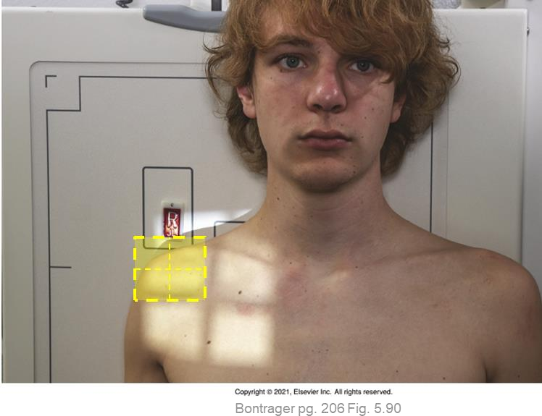
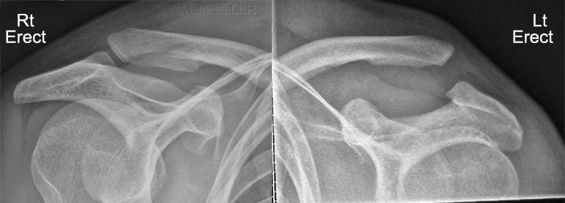

Evaluation criteria: “anatomy demonstrated”
Anatomical marker + w/o weight marker
One AC Joint per image
Acromion
Lateral End of Clavicle
Bontrager pg. 206 Fig. 5.90
w/o weight

Slide 8
Positioning – AP AC Joints w/ weights
Same position as AP w/o weights, except:
Place a weight on the patients wrist, keeping their shoulder relaxed
  *Tell patient to drop weights when
done
Image each AC joint separately
Collimate tightly (as per yellow outline)
Note: suspend respiration

Slide 9

Evaluation criteria: “anatomy demonstrated”
Anatomical marker + w/ weight marker
One AC Joint per image
Acromion
Lateral End of Clavicle
w/ weight
Bontrager pg. 205 Fig. 5.88
w/ weight

Slide 10
Protocol - Scapula
Routine:
AP
Lateral

Slide 11
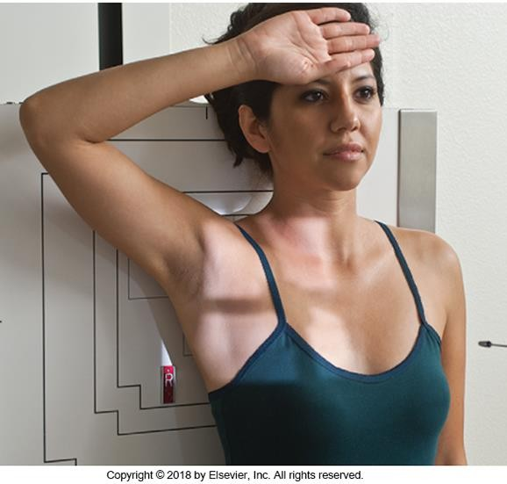
Positioning – AP Scapula
Abduct arm to 90º and extend
above head
Position top of collimated light
field 1” above top of the shoulder
CR to midscapular region
Place an anatomical marker (using
Anderson Marker Rules)
Bontrager pg. 207 Fig. 5.95
Note: suspend respiration

Slide 12
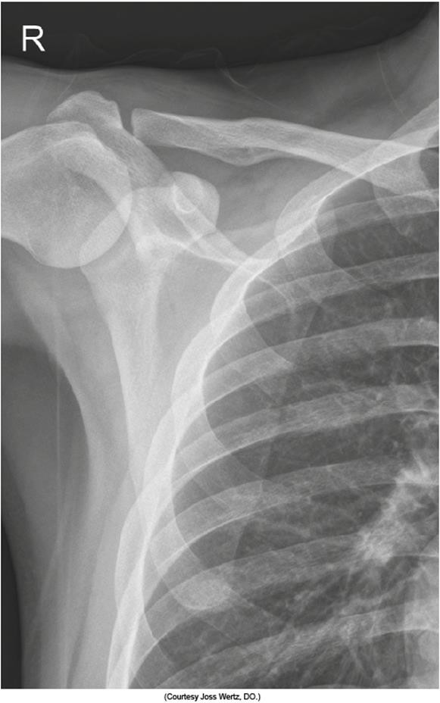
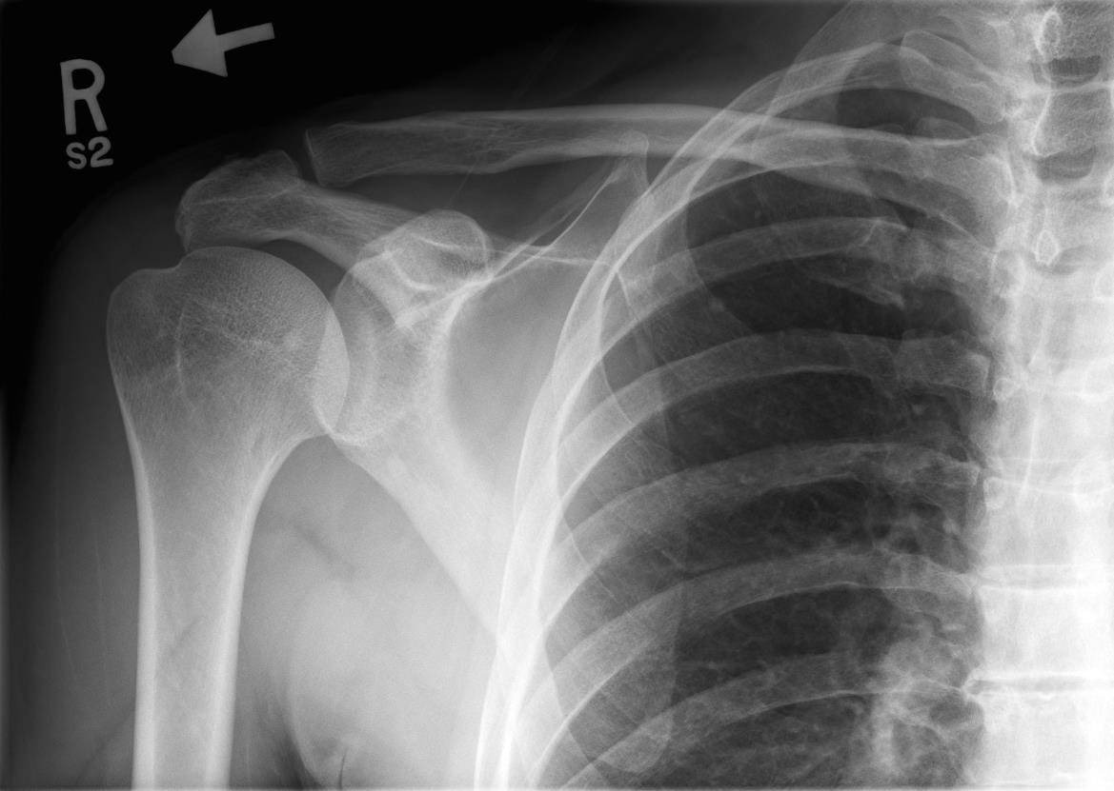
Evaluation criteria: “anatomy demonstrated”
Scapula
Entire Scapula
AC Joint
~½ the Clavicle
Shoulder
Bontrager pg. 207 Fig. 5.97
SAIT image library

Slide 13
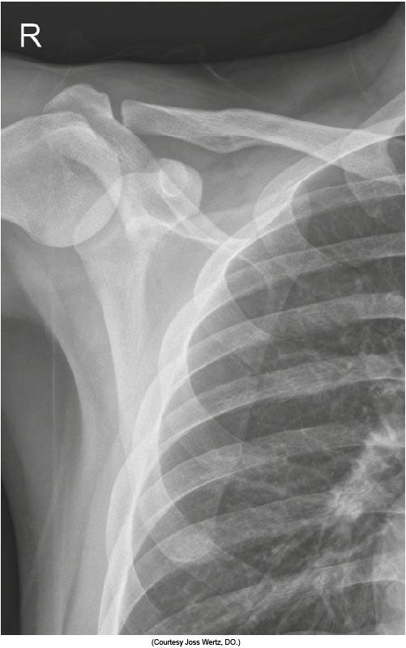
Evaluation Criteria: “Position”
Lateral portion of scapula free of superimposition (from the ribs)
Optimal density and contrast
Bontrager pg. 207 Fig. 5.97

Slide 14
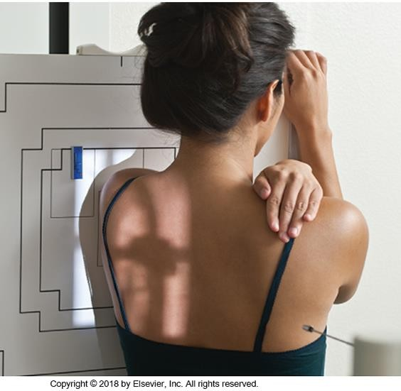
Positioning – Lateral Scapula
Have patient reach across chest
and hold opposite shoulder
Same rotation as PA Scap Y
Place an anatomical marker (using Anderson Marker Rules), and make final adjustments
Note: suspend respiration
Bontrager pg. 208 Fig. 5.99

Slide 15

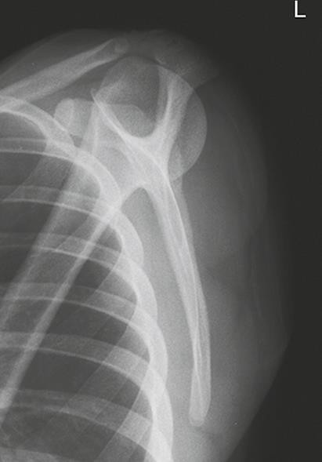
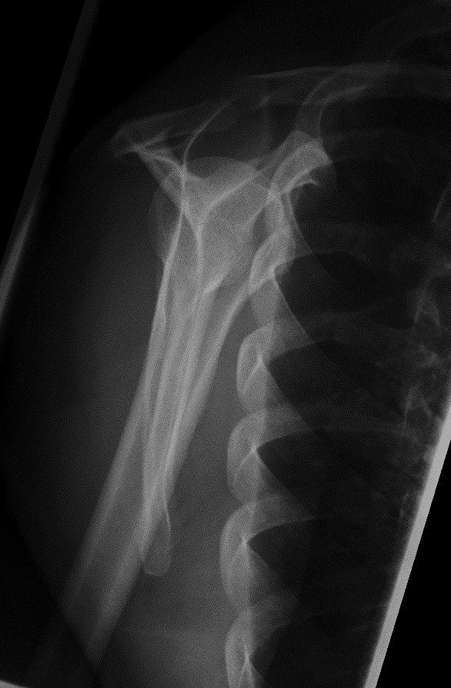


Evaluation criteria: “anatomy demonstrated”
Shoulder
VS.
Bontrager pg. 208 Fig. 5.100
SAIT image library

Slide 16
Evaluation Criteria: “Position”
As much as possible, the humerus should not superimpose the scapula
Optimal density and contrast
Bontrager pg. 208 Fig. 5.100

