Slide 1


LDR Phyto-Effervescents

Slide 2
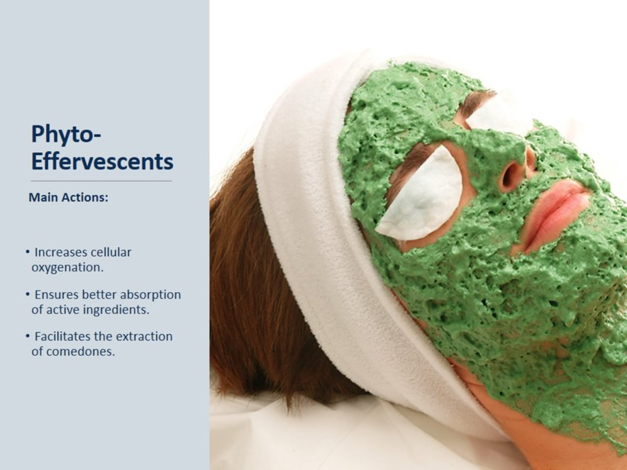

Slide 3
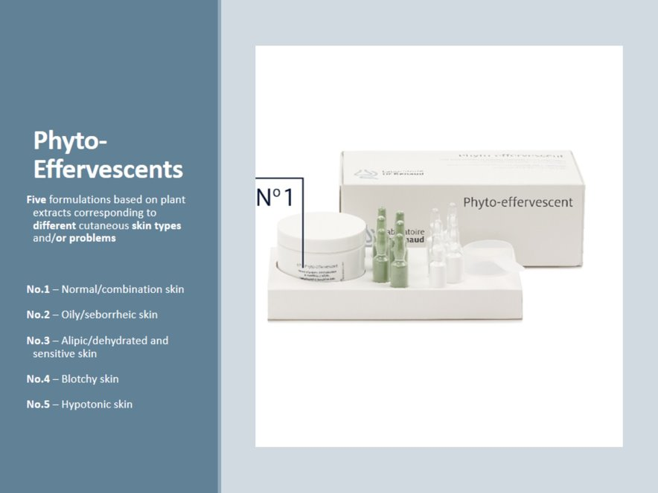

Slide 4
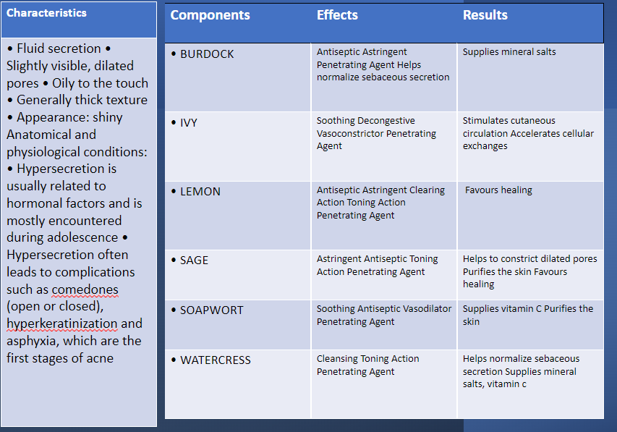

Oily and Seborrheic Skin: Phyto-effervescent no. 2

Slide 5
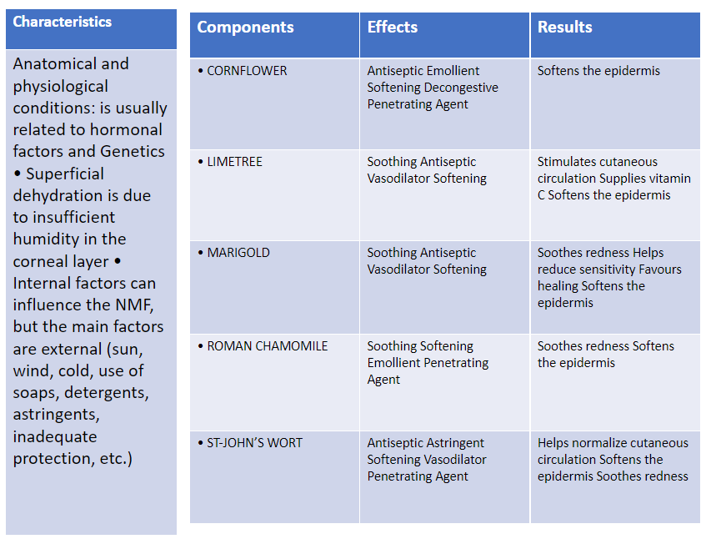
Alipidic and dehydrated skin: Phyto-effervescent no. 3

Slide 6
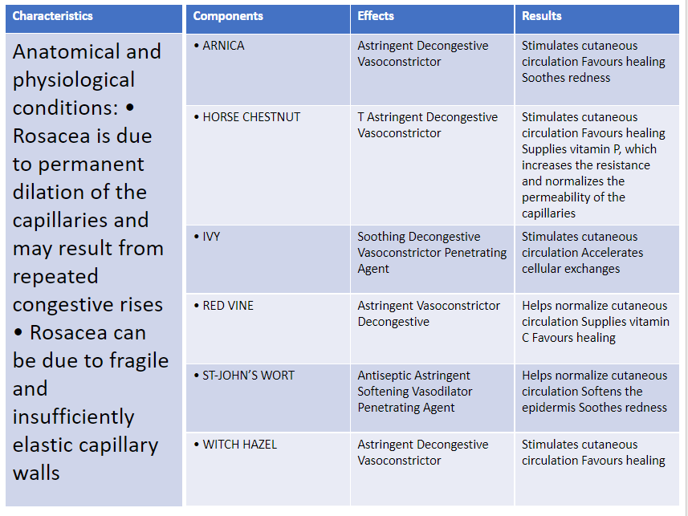
Sensitive and Blotchy Skin: Phyto-effervescent no. 4

Slide 7
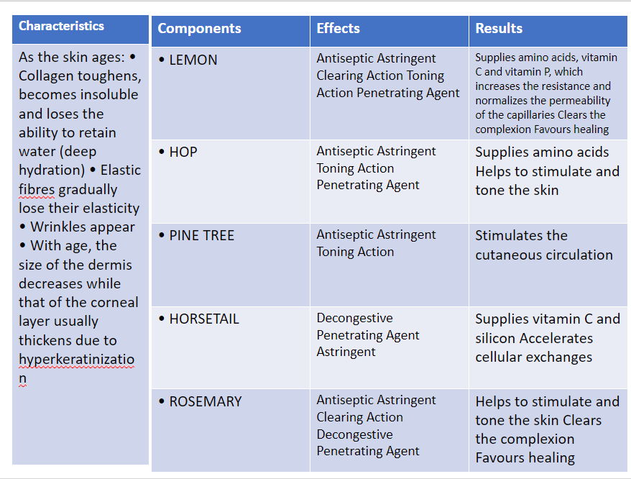
Hypotonic Skin: Phyto-effervescent no. 5

Slide 8

QUESTIONS?

