Slide 1
MRAD 256
Radiographic Technique 2
Positioning of the SI joints, Sacrum
and Coccyx

Slide 2
Routine protocol for SI Joints
35° AP Axial Projection
25-30° AP Obliques (Bilateral)

Slide 3
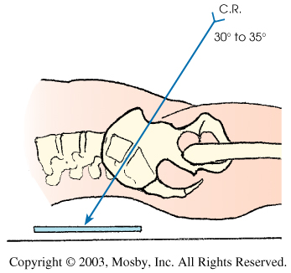
When positioning for AP axial SI joints the CR is angled to pass through the L5/S1 joint as follows:
30 degrees for male
35 degrees for female

Slide 4
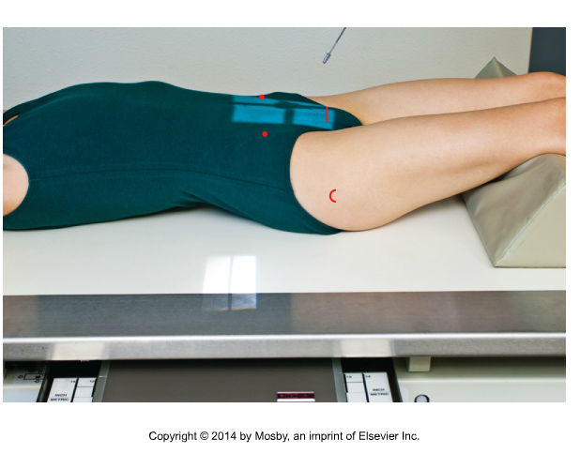
AP Axial Projection
  Angle 30 -35 ̊ cephalad to open the L5/S1 joint space
  CR 5 cm inferior to ASIS (compensates for steep tube angle)
  Collimate crosswise to include the SI joints
  On the patient:
    The inferior light border is at the level of the symphysis pubis (greater trochanter for palpating)
    The superior light border should be around ASIS, such that the diverging ray will be slightly above iliac crest
  Suspend respiration
Bontrager 9-76
Be careful that you do not clip the SI joints as they are near the edge of the light field

Slide 5
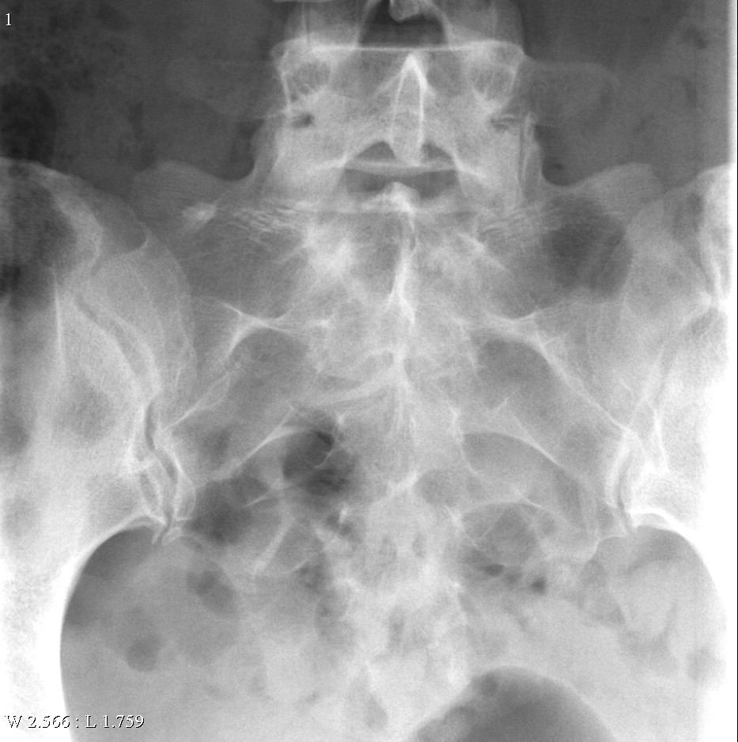
Evaluation criteria
SI joints and L5/S1
No rotation or tilt
Spinous processes centered
Symmetric sacral alae
Note: The symphysis pubis will superimpose the sacrum, as it is thrown superiorly by the 35° cephalad angle

Slide 6
PA Axial Projection
CR is directed 30- 35˚ caudad to pass 5 cm inferior to the ASIS

Slide 7
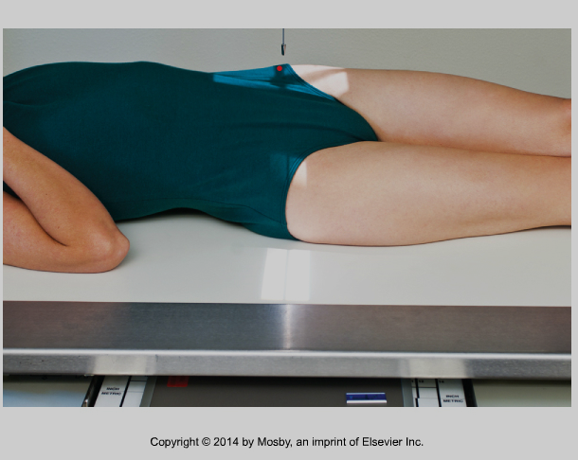
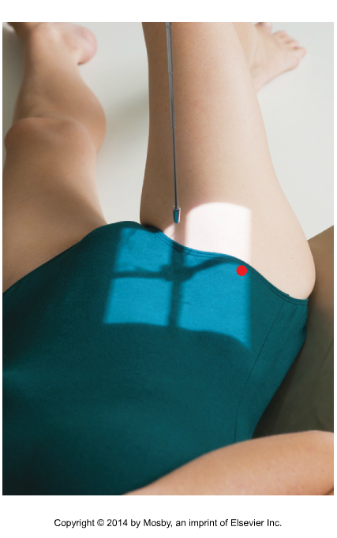
AP Bilateral Obliques
  Midcoronal plane rotated 25 to 30˚
  CR 1 inch or 2.5 cm medial to upside ASIS
  Collimate to upside SI joint
  Marker on lateral edge of upside
  Suspend respiration
Remember! SI joints sit in the same orientation as the crests, so you will see the upside in the RPO and LPO positions
Bontrager 9-79 and 9-80

Slide 8
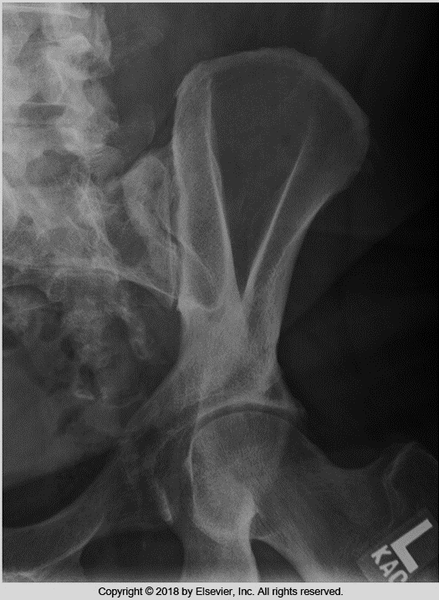
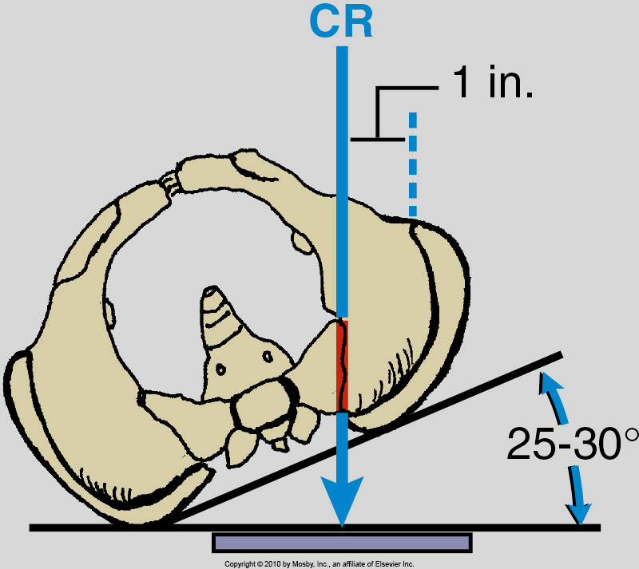
Evaluation criteria
Open SI joint
Bontrager 9-81 and 9-82

Slide 9
PA Oblique
Rotate MCP 25 to 30º
CR 1” medial to the downside ASIS(@ the PSIS)
Collimate to the downside SI joint
Suspend respiration

Slide 10
Routine Protocol Sacrum and Coccyx
15º AP axial sacrum (post evacuation)
10º AP axial coccyx (post evacuation)
Lateral sacrum and coccyx

Slide 11
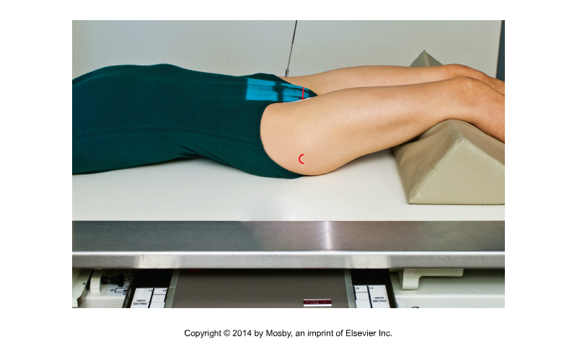
AP Axial Sacrum
ASIS
  Angle 15˚cephalad to place CR perpendicular to sacrum
  CR 2” (5 cm) superior to symphysis pubis
  Collimate medially to include SI joints, and lengthwise to include entire sacrum
  The inferior margin of the diverging rays will be at level of greater trochanter)
  The superior margin of the diverging rays will be at or just above crest
  Suspend respiration
Bontrager 9-64

Slide 12
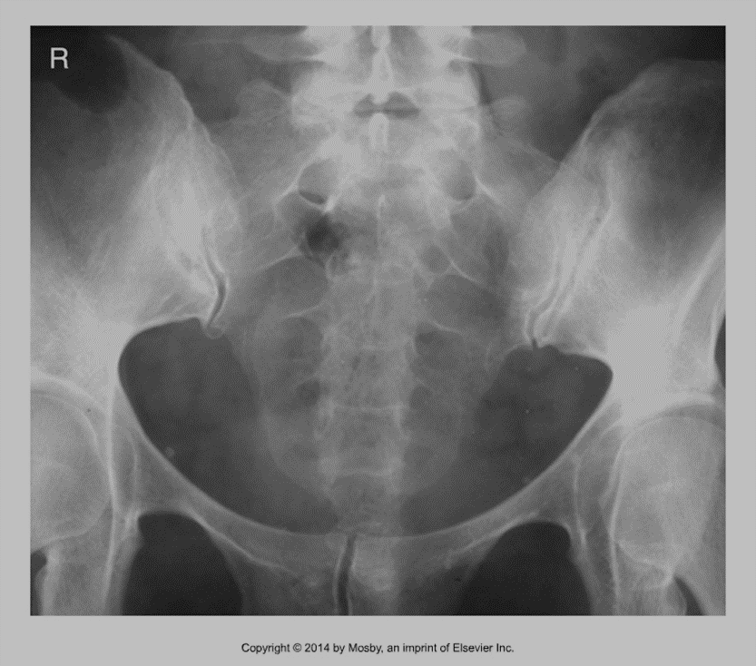
Evaluation Criteria - Sacrum
  Sacrum without distortion
  Closed SI and L5/S1 joints
  Pubic bones free of the sacrum
  No rotation
Bontrager 9-65

Slide 13
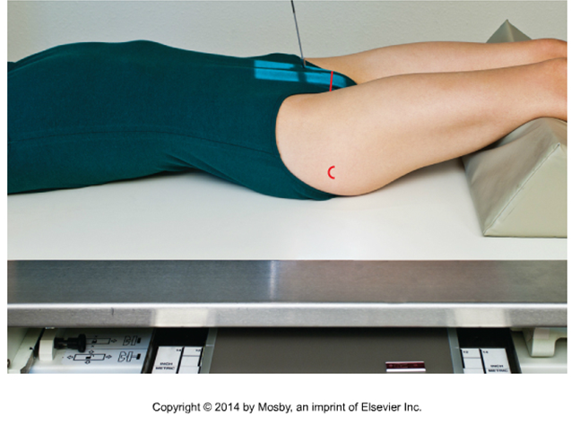
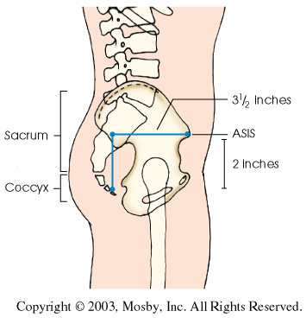
AP Axial Coccyx
  CR 10° caudad
  CR 2” or 5cm superior to symphysis pubis
  Collimate to include coccyx, on patient the light field will be small, as the coccyx sits posteriorly
  Suspend respiration
Bontrager 9-67

Slide 14
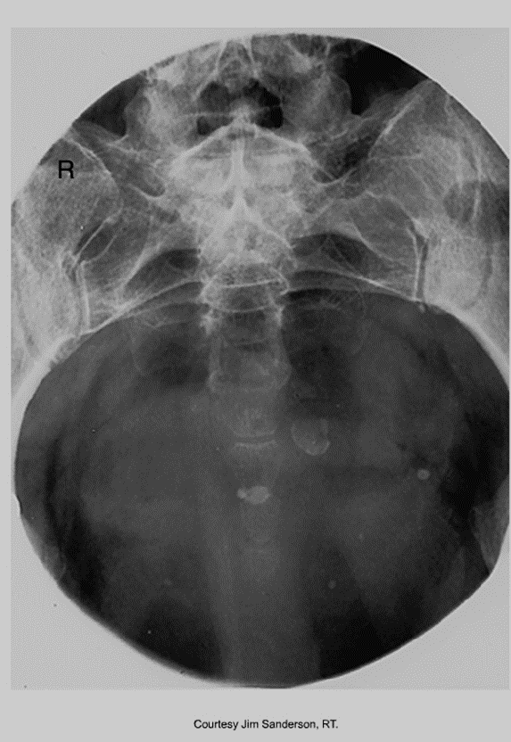
Evaluation Criteria - Coccyx
  Coccyx centered and free of superimposition
  Tight collimation
  No rotation
Bontrager 9-68

Slide 15
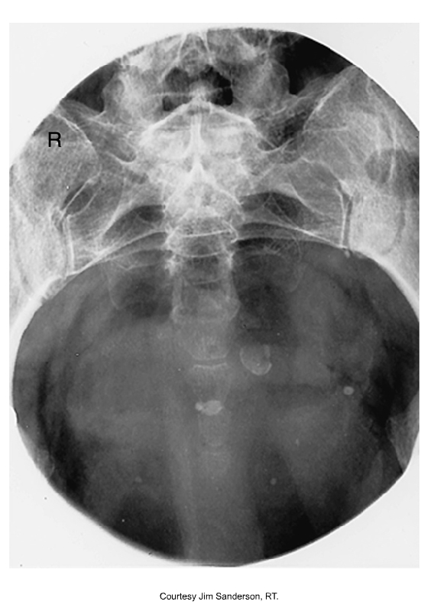
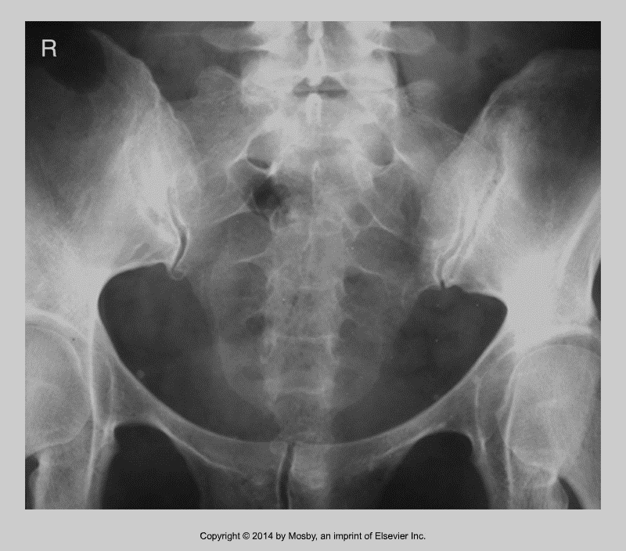
Compare the two…
Bontrager 9-65 and 9-68

Slide 16
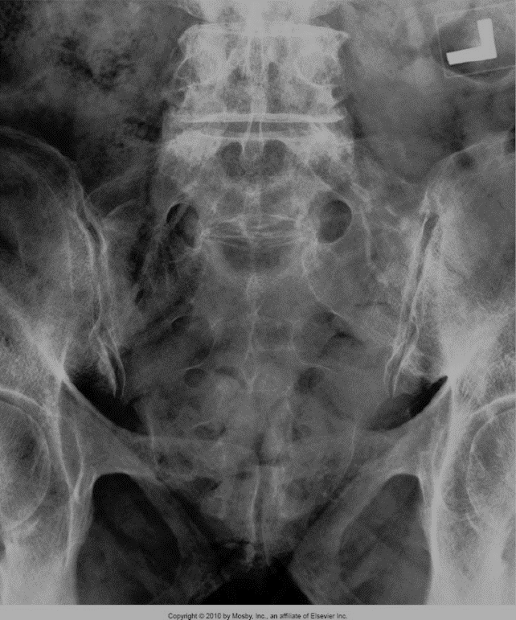

Know the differences between these two images
Axial SI Joints (L5/S1 upshot)
AP axial sacrum
Bontrager 9-65 and 9-77

Slide 17
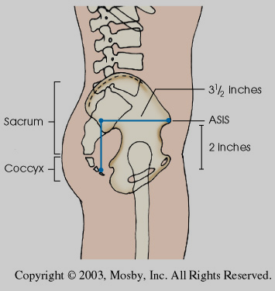
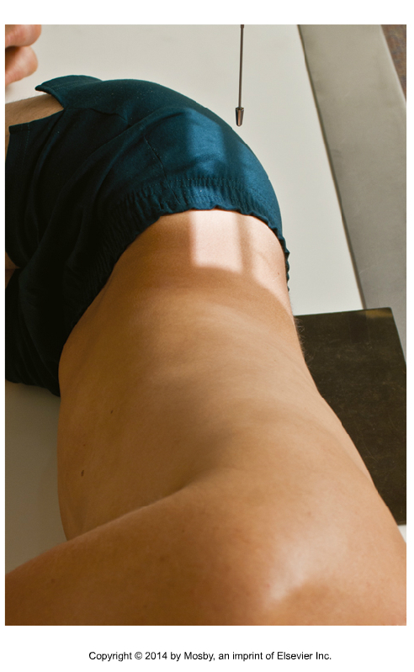
Sacrum and Coccyx - R or L - Lateral
  Center 8-10 cm posterior to ASIS, collimate to include sacrum and coccyx
  Center posterior than for L5-S1 spot, so entire sacrum can be included
  The inferior border of the diverging rays is at the level of greater trochanter
  The superior border of the diverging rays is at the level of the iliac crest
  Suspend respiration
Remember L5/S1 is the most superior required anatomy, and the coccyx is at the level of the greater trochanter
Bontrager 9-70

Slide 18
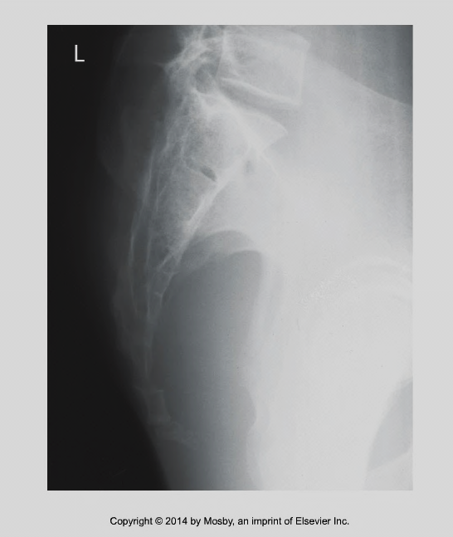
Evaluation Criteria
Entire sacrum, coccyx, and L5S1 joint
No rotation indicated by superimposed greater sciatic notches and femoral heads
Bontrager 9-71

Slide 19
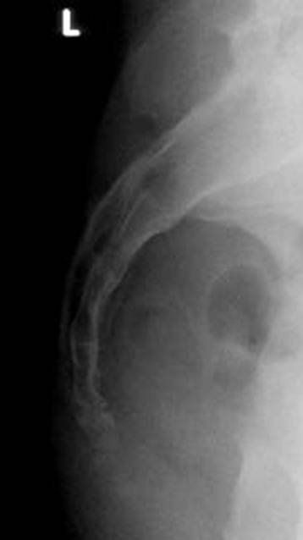
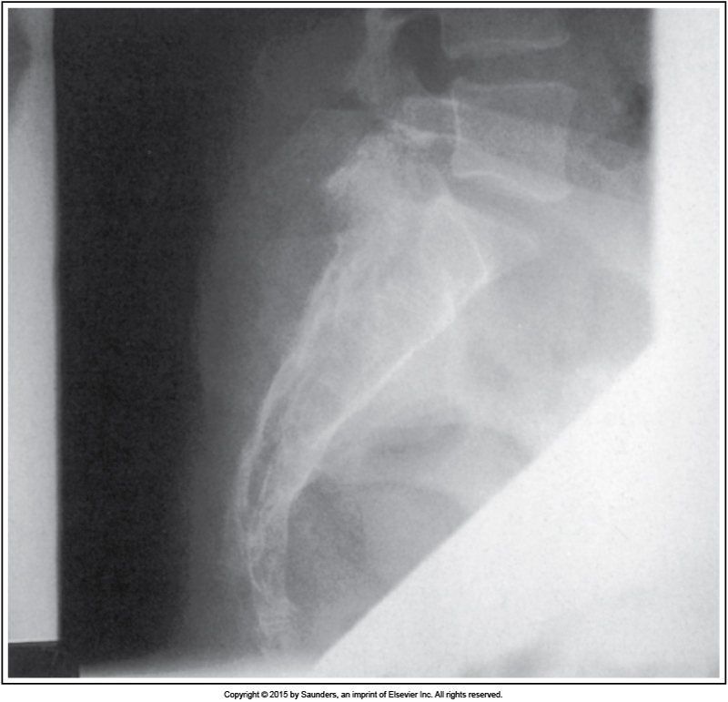

Slide 20
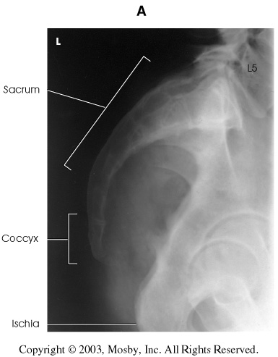
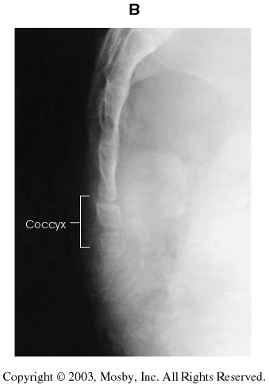
If the coccyx is over-exposed, it will need to be imaged separately.

