Slide 1
MRAD 256: Radiographic Technique 2
Rib Sternum Critique

Slide 2
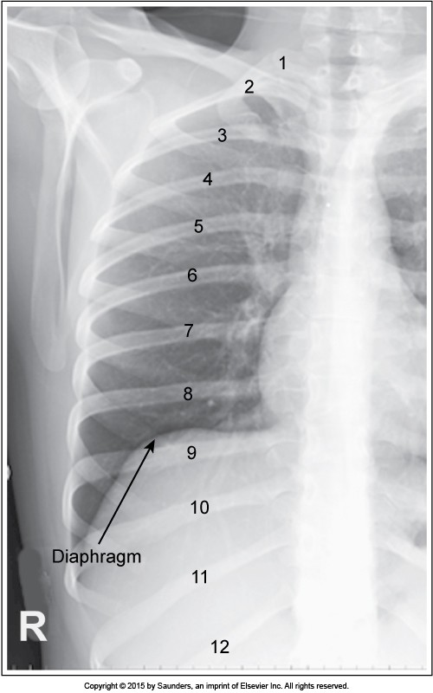
Appropriate collimation and positioning for upper ribs
© 2016, Southern Alberta Institute of Technology

Slide 3
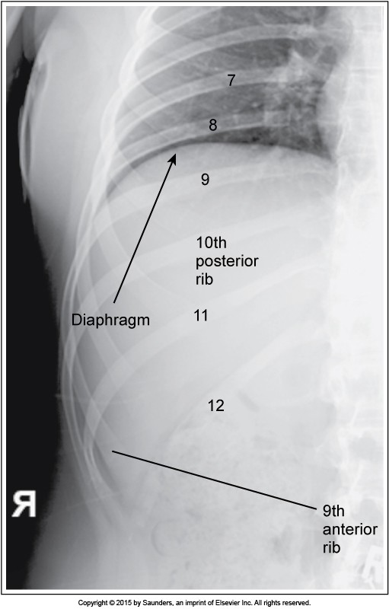
Appropriate collimation and positioning for lower ribs (note scapula is still on thorax, but soft tissue of arm is moved away)
© 2016, Southern Alberta Institute of Technology

Slide 4
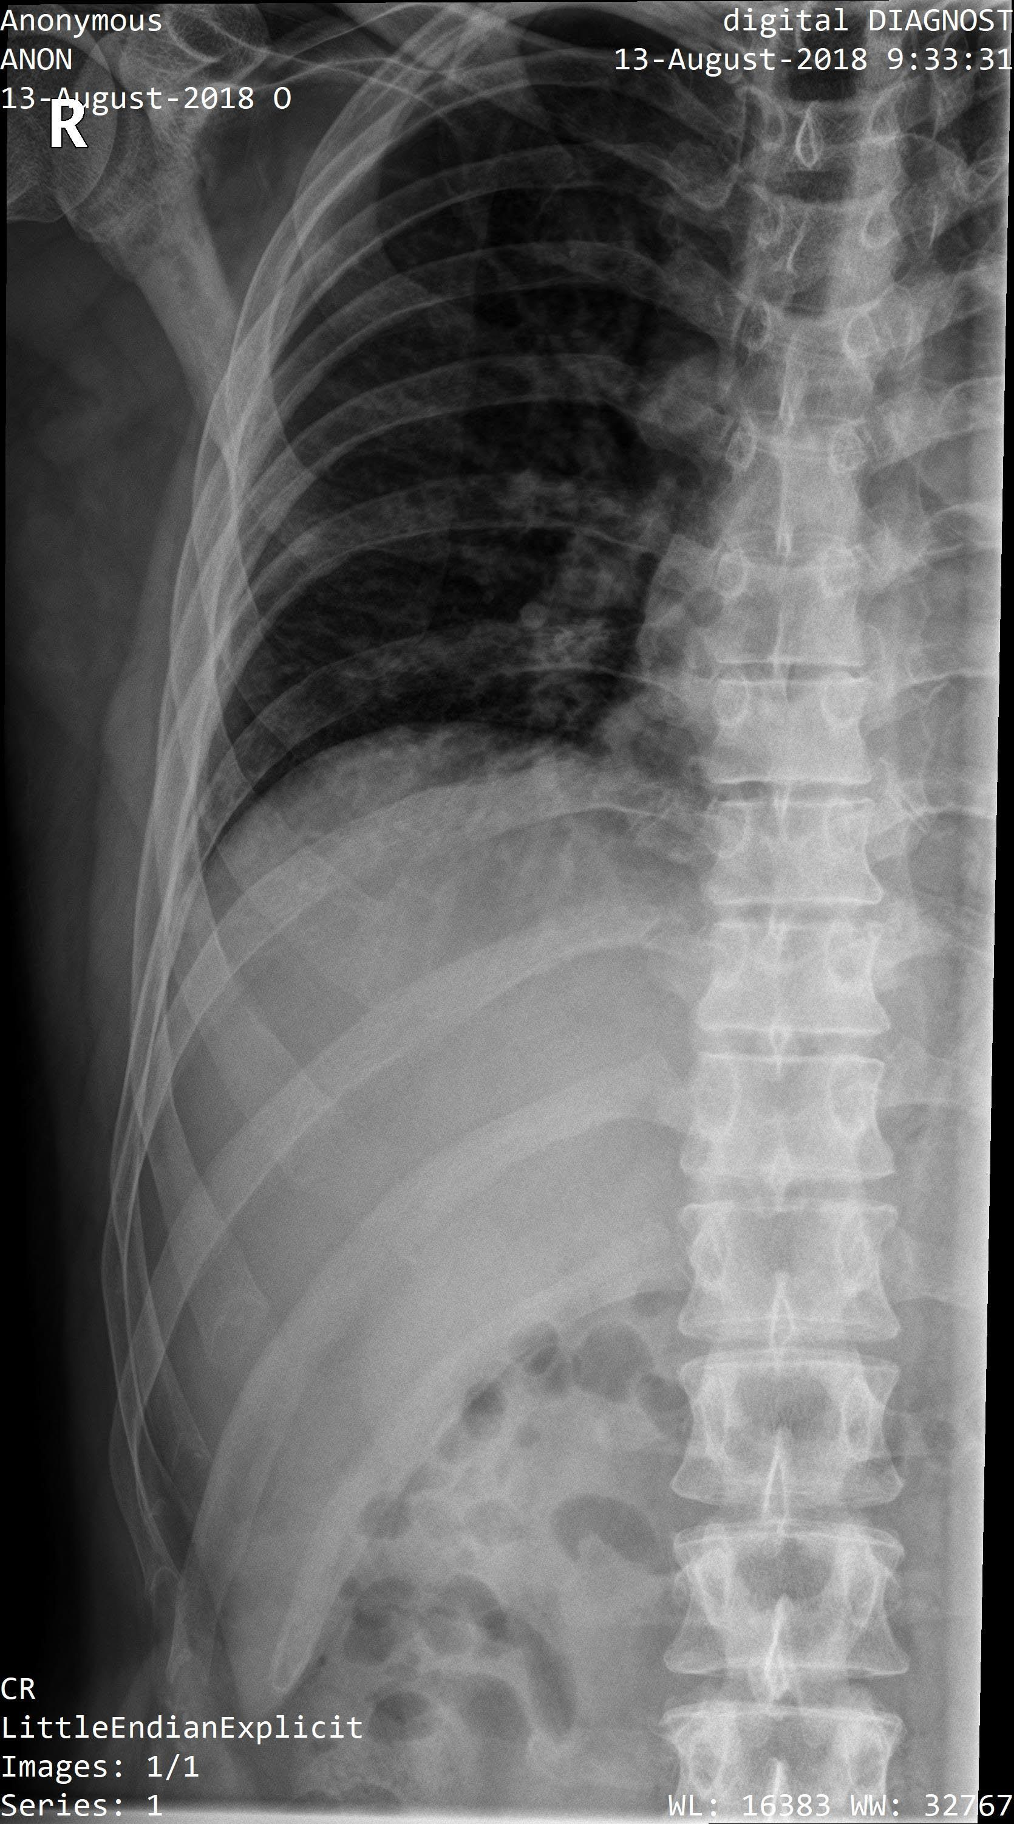
1
© 2016, Southern Alberta Institute of Technology

Slide 5
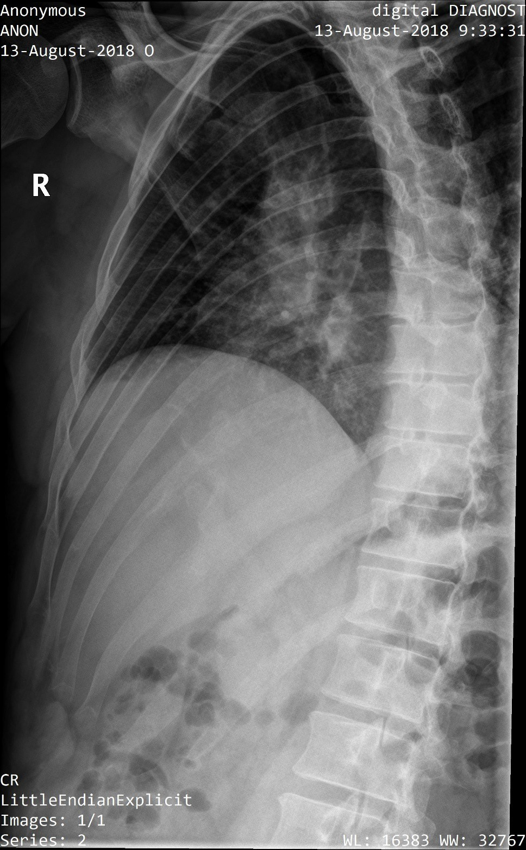
2
© 2016, Southern Alberta Institute of Technology

Slide 6
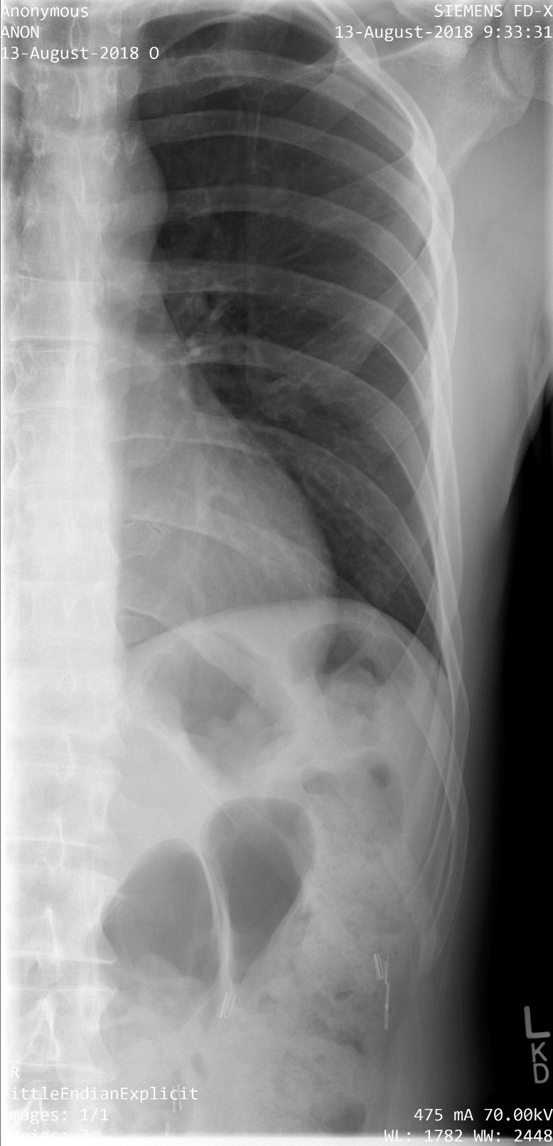
3
© 2016, Southern Alberta Institute of Technology

Slide 7
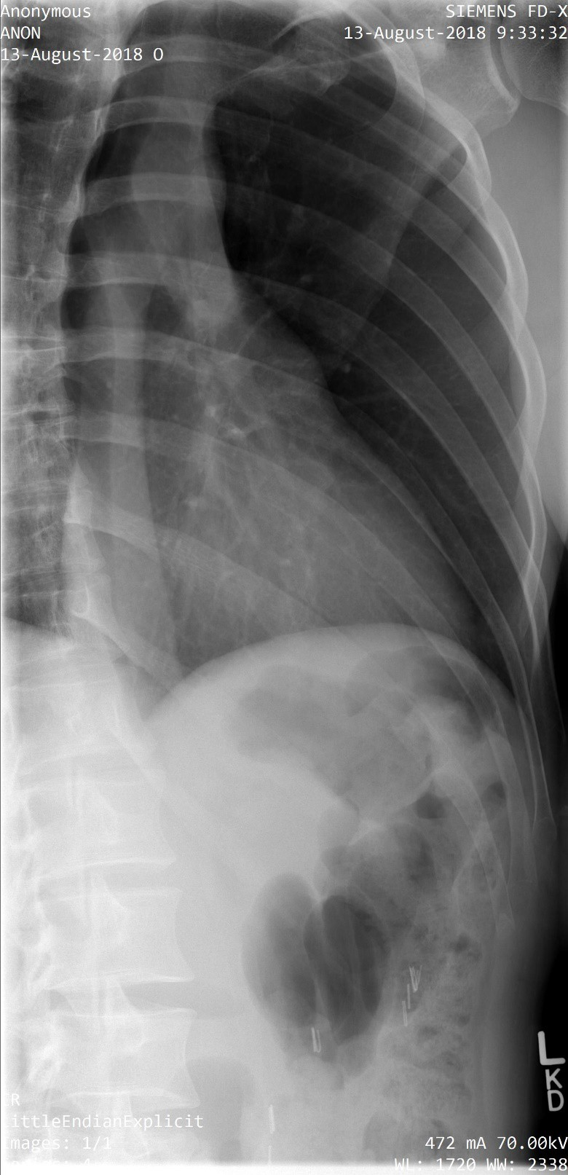
4
© 2016, Southern Alberta Institute of Technology

Slide 8
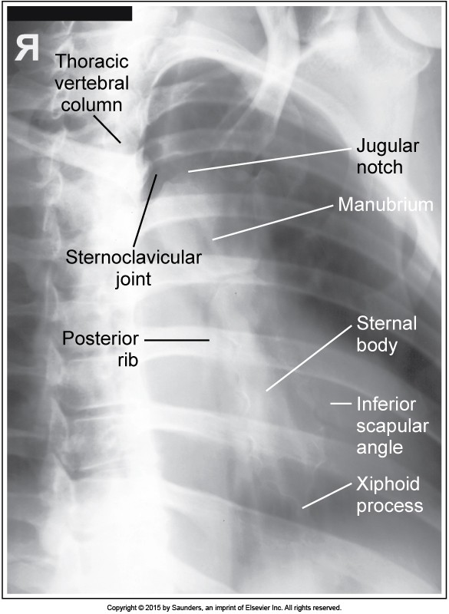
© 2016, Southern Alberta Institute of Technology

Slide 9
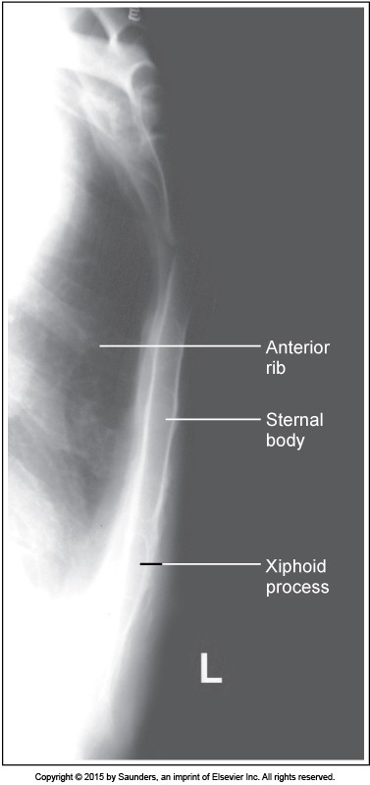
© 2016, Southern Alberta Institute of Technology

Slide 10
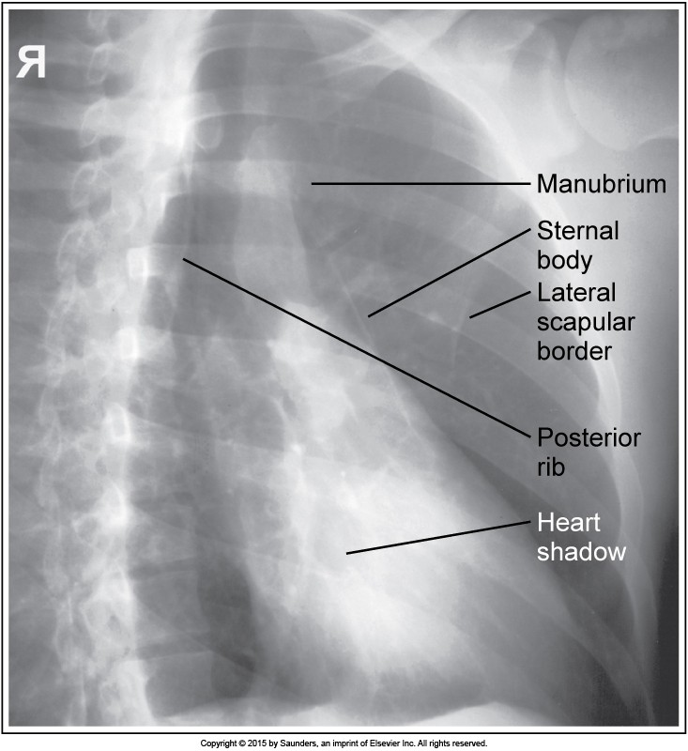
5
© 2016, Southern Alberta Institute of Technology

Slide 11
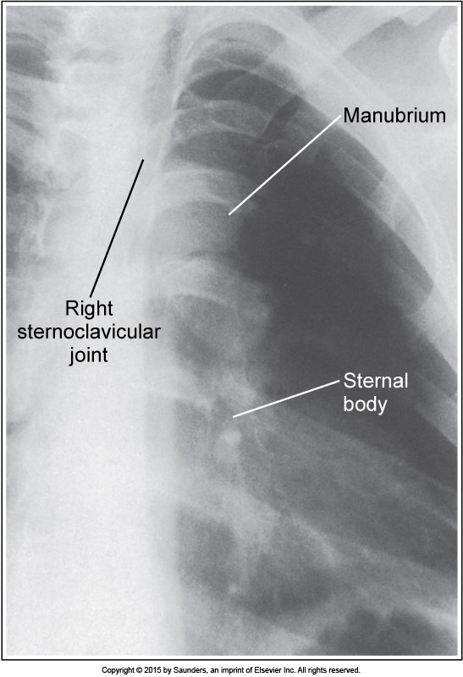
6
© 2016, Southern Alberta Institute of Technology

Slide 12
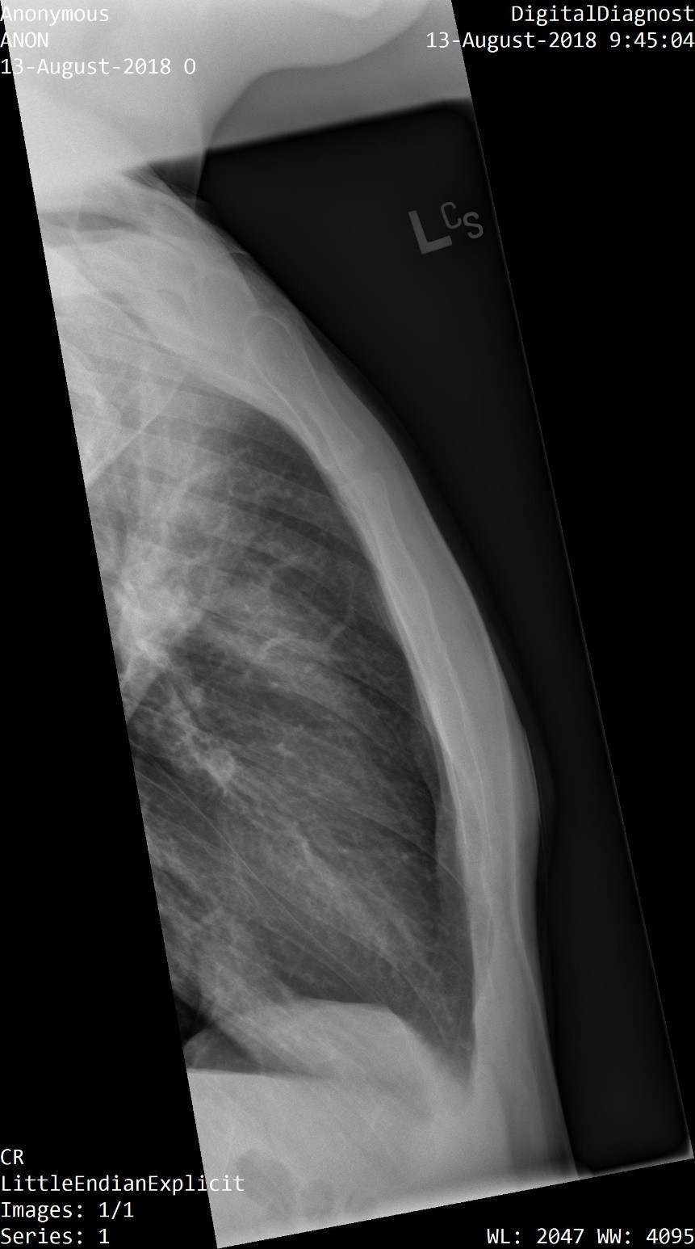
7
© 2016, Southern Alberta Institute of Technology

Slide 13
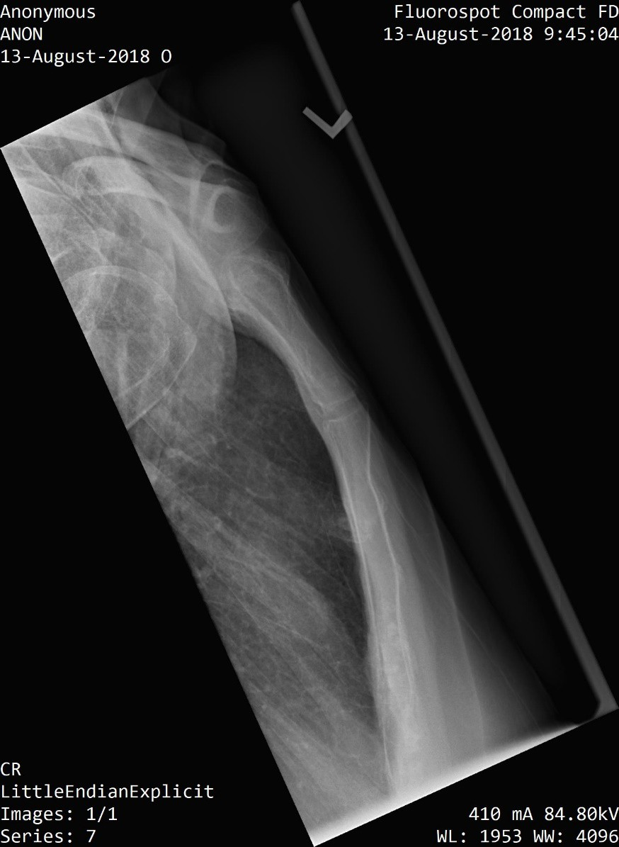
8
© 2016, Southern Alberta Institute of Technology

