Slide 1


Business Operations
Unit 9

Slide 2
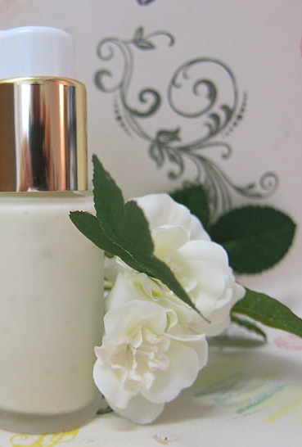
The line (s) you will carry
One of the most important components on the Spa business is the Skin Care line
Will you develop your own brand?
Will you carry someone’s brand?
Will you carry 1 or 2 lines?
What are the options?
What type of business will you be operating?

Slide 3
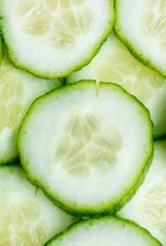
Developing your skin care brand
Developing your brand might be time consuming and take a hit on your investment budget, but it can be extremely rewarding and make you more competitive and exclusive
Several companies offer the lab and the premises to develop your chemical mixes
Several companies provide with packaging and branding

Slide 4

Carrying an established brand
When carrying an established brand there are a few factors to consider:
The type of services you will be providing
The price point
The ability to sell the product in the specific demographic areas

Slide 5

Case Scenario
Bethany will open a Medical Spa located at a new neighborhood development
He monthly expenses will be 50 thousand
The demographic is of 30 to 60 years of age
The % of kids in the neighborhood is 1 per household between 1 month to 12 years old
The ethnicity of the neighborhood is of a mixed background
What type of skin care line price point you think she will be able to sale ?
Moisturizer $25- $40
Moisturizer $60 - $70
c. Moisturizer $90- 125

Slide 6

If you said a & c
YOU ARE CORRECT!

Slide 7
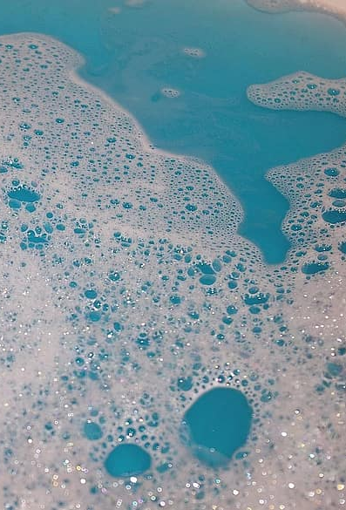
BUT WHY?
By the demographics in Bethany’s area, you can deduct there will be a lot of younger generations with kids
This will impact their buying power
But there is also some older mix who have more buying power
You will want to cater to both
In this case scenario you would carry a few luxury items with 80% of your retail being targeted to your main demographic area

Slide 8


Retail , Retail Retail
Retail will bring a lot of cash to your business
A good menu with the right services is key to your business but retail is the real cash maker
Let’s review why:

Slide 9

Case Scenarios
What day you think was more productive and why?
Trish closed the day with $2000 positive balance
Her overall head cost on services for the day was $1000
She was booked all day with services from 9 am to 5 pm.
On Day 2 Trish closed the day with a balance of $5000
Her overall head cost for the day was $850
She only performed 2 facial services at 120 each. She sold products worth 4700 for which only half is profit. Overall she made 1,740 for the day,

Slide 10
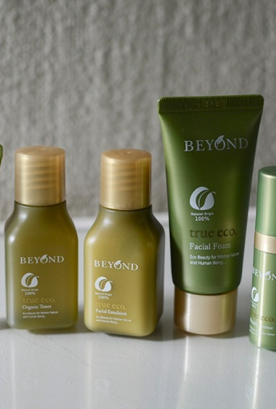

The importance of selling retail
The 3 R's of Why

Slide 11

Revenue
Retention
Reputation

Slide 12
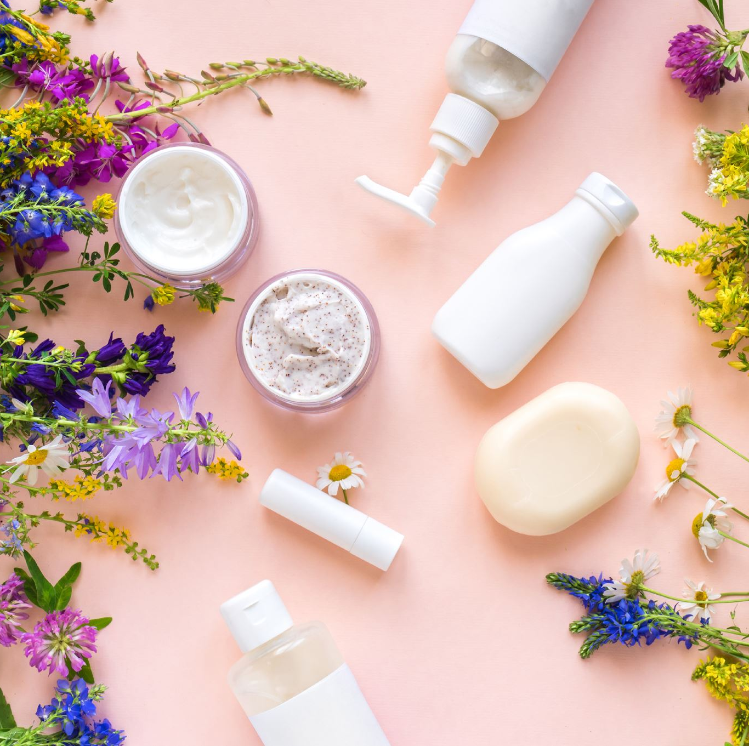
Revenue
A Spa can make close to three times more than what’s possible on most services. While some services can be priced high, the margins on retail are that much higher. So, when it comes to selling retail, it really is a no-brainer. You’ve already created the market for products, why not be the one to sell them? Not only is it the best for your customer and their but it also helps keep your clients happy and coming back for more.

Slide 13

Wich brings us to the next R
Retention !
If you have a new client and you sell them retail during their first appointment, the numbers will tell you that they are three times more likely to return a second time. Also, if you sell a regular customer retail, regularly, they tend to stay your client three times longer. It took years of observation and number-crunching to realize what was happening, and there naturally was some room for fluctuation, but the numbers and the return rates of clients do not lie.

Slide 14
Reputation
Gaining client loyalty is the real way to build up reputation
Reputation that is built in trust and client satisfaction is a great marketing tool

Slide 15
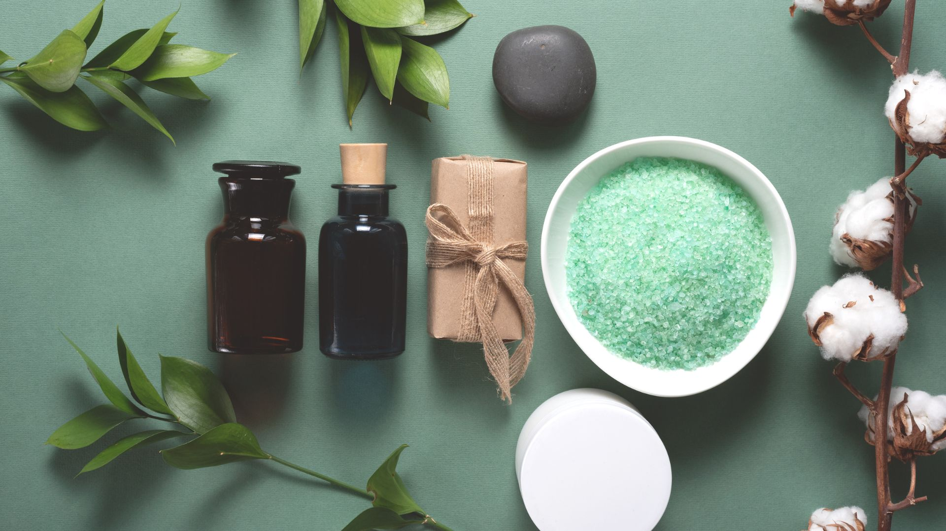
Deciding what to carry
Once you have researched the skin care lines you will need to decide what to carry in the cabin and at the retail space.

Slide 16
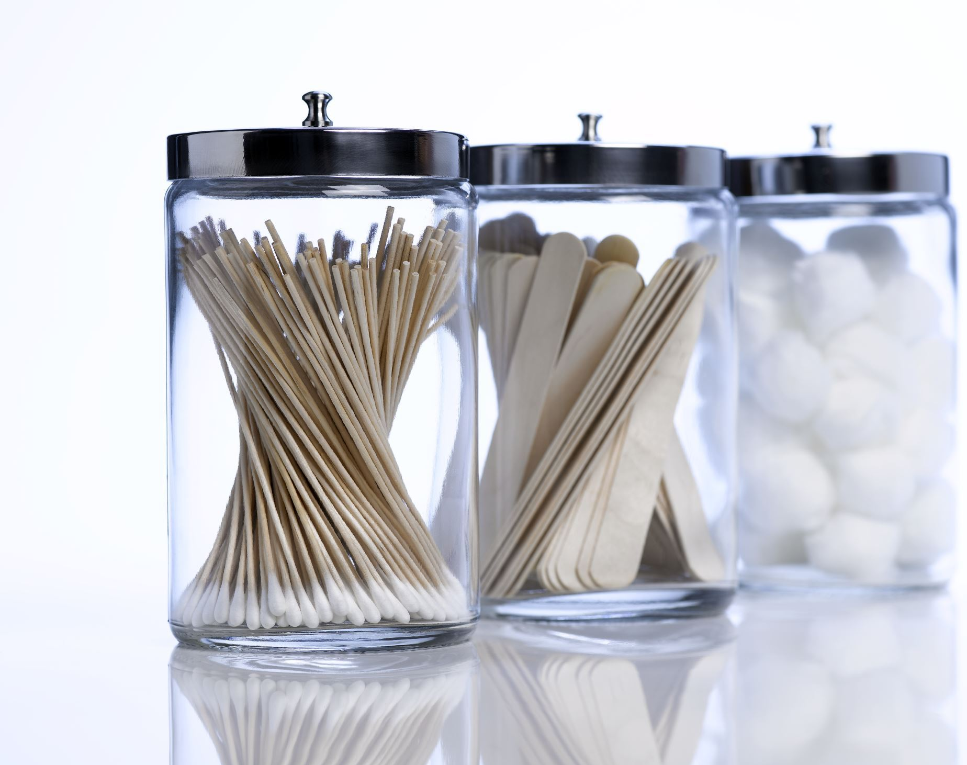
Cabin Products
You cabin products should reflect your service menu.

Slide 17
Let's Get to Work!
Time Allotment : 30 minutes
Design Shortly a service menu
What type of services will you offer?

Slide 18
Now that you have mapped out your services, you will have a clear vision when choosing products

Slide 19
Retail Products
-Your Skin Care Retail should reflect the line you use in the cabin
-The retail product allows the client to maintain the results of the treatment or to provide the healing or remodeling process of the treatment
- You should carry a basic line with different products to cover all skin types
- You should also have the option for a luxury line for clients who want to invest in a more advanced options.

Slide 20

QUESTIONS?

