Slide 1

BOTOX in Cosmetic Dermatology

Slide 2
History of Treatment
Botulinum toxin type A has been used safely
and effectively for more than 15 years to treat
many disorders, including strabismus, blepharospasm,and myotonic dystrophies.
1980-natural purified protein of botulinum
toxin was used in the treatment of strabismus.

Slide 3
1991- era of the use of botulinum toxin for reduction of skin lines began when Dr. Jean Carruthers observed a smoothing effect on the glabellar brow furrows in patients injected with toxin for blepharospasm.

Slide 4
PHARMACOLOGY
Botulinum neurotoxins are currently categorized into 7 distinct serotypes: A, B, C1, D, E, F, and G.
commercially available, serotypes A and B, are derived from different strains of Clostridium botulinum.

Slide 5
Mechanism of Action
Type A toxin cleaves SNAP-25 (synaptosome-associated protein of 25 kd), whereas type B cleaves VAMP (vesicle-associated membrane protein), also called synaptobrevin

Slide 6
Botulinum Toxin Type A
Botox Medical
longest commercial history, having been approved by the FDA in 1989 for the treatment of strabismus and blepharospasm.
December 2000 for the treatment of cervical dystonia.
For hyperhidrosis, poststroke spasticity, back spasm, and headache.

Slide 7
Botox Cosmetic
approved by the FDA in April 2002 for the temporary improvement in the appearance of moderate to severe glabellar lines in men and women 65 years of age or younger.
vertical lines between the eyebrows, crow’s feet, horizontalforehead lines, neck lines, melolabial folds, and other hyperkinetic facial lines.

Slide 8
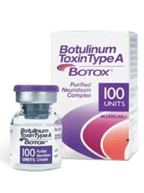

Slide 9
Dysport
another brand of botulinum toxin type A.
available in the United Kingdom since the early 1990s.
different medical indications, including blepharospasm, hemifacial spasm, and spasmodic torticollis

Slide 10
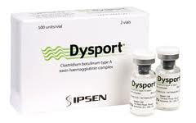
Dysport 300 units/ vial

Slide 11
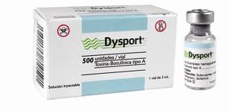
Dysport 500 units/ vial

Slide 12
Botulinum Toxin Type B
Myobloc contains botulinum toxin type B.
It was licensed by the FDA in January 2001 for
treatment of cervical dystonia.
off-label use for cosmetic purposes.
effective treatment for glabellar wrinkles, forehead wrinkles, and crow’s feet.

Slide 13
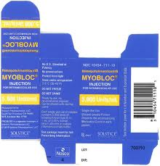
Myobloc 2,500- 11,000 Units

Slide 14
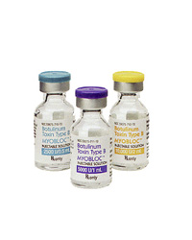

Slide 15
Pretreatment Considerations
Because of the potential for bleeding, patients
should avoid using:
(1) anticoagulants, including warfarin, aspirin, or nonsteroidal anti-inflammatory drugs (NSAIDs);
(2) nutritional supplements such as Ginkgo biloba, garlic, or vitamin E
(3) alcohol.

Slide 16
Managing Patient Expectations
Cosmetic denervation with botulinum toxin is
suitable for all skin types.
It provides relaxation of dynamic rhytids giving patients a more youthful appearance.
Deep furrows or rhytids may require higher doses and/or more yearly treatments.
Overall, doses will vary from person to person

Slide 17
Important for patients to understand that they are not being paralyzed; rather, hyperkinetic muscles are being relaxed.
cosmetic denervation will not improve loose or sagging skin and does not serve the same function as a facelift.

Slide 18
To optimize a treatment program, many options are available to use botulinum toxin in combination therapy, including injectable fillers and microimplants.

Slide 19
Contraindications
Botulinum injections are contraindicated in patients with a history of neurological disorders such as myasthenia gravis, amyotrophic lateral sclerosis, Eaton-Lambert syndrome, and Myopathies.
They are also contraindicated for individuals :
Pregnant or lactating women
Psychological or medical contraindications
Allergy to aminoglycoside antibiotics
Infection at the proposed injection sites

Slide 20
Postinjection Considerations
Patients may apply makeup.
Avoid physical activity or exercise for the remainder of the day.
Bruising- immediately apply cold compresses to the injected area.

Slide 21
Treatment and Clinical Management
It is important to note that the definition of a
unit of activity varies among Botox, Dysport,
and Myobloc.
In clinical use, Botox appears three to four times stronger (in mouse units) than Dysport, and the dose must be adjusted accordingly.
Determining an equivalent unit of Myobloc is more complicated due to differences in such details as the vehicle, dilution scheme, and laboratory protocols for various assays.

Slide 22
Botulinum Toxin Type A
Botox Cosmetic is supplied in 100-U vials, must be kept between 2°C and 8°C until used.
Additionally, the sterile vacuum vial contains
albumin and sodium chloride but does not contain a preservative.
The 100-U vial is reconstituted with 2.5 ml of normal saline (0.9% NaCl), resulting in a final concentration of 4 U/0.1cc of Botox Cosmetic.

Slide 23
Due to the absence of a preservative, Botox Cosmetic should be stored in a refrigerator and used within 4 h.
Small quantities are injected directly into the
muscles to be treated using a 30- to 32-gauge needle and a calibrated syringe.

Slide 24
Dysport
Each 500 Unit vial of Dysport is to be reconstituted with 1 mL of 0.9% Sodium Chloride Injection USP (without preservative) to yield a solution of 500 Units per mL.
Each 300 Unit vial of Dysport is to be reconstituted with 0.6 mL of 0.9% Sodium Chloride Injection USP (without preservative) to yield a solution equivalent to 250 Units per 0.5 mL.

Slide 25
Using an appropriately sized sterile syringe, needle and aseptic technique, draw up 1.0 mL or 0.6 mL of sterile, 0.9% Sodium Chloride Injection USP (without preservative) for 500 and 300 Unit vials, respectively. Insert the needle into the Dysport vial.

Slide 26
The partial vacuum will begin to pull the saline into the vial. Any remaining required saline should be expressed into the vial manually. Do not use the vial if no vacuum is observed.
Swirly gently to dissolve.

Slide 27
Parenteral drug products should be inspected visually for particulate matter and discoloration prior to administration.
Reconstituted Dysport should be a clear, colorless solution, free of particulate matter, otherwise it should not be injected.

Slide 28
Expel any air bubbles in the syringe barrel. Remove the needle used to reconstitute the product and attach an appropriately sized new sterile needle.
Once reconstituted, Dysport should be stored in a refrigerator at 2–8°C (36–46°F) protected from light and used within four hours. Do not freeze reconstituted Dysport. Discard the vial and needle in accordance with local regulations.

Slide 29
Indication
Treatment of dynamic expression lines in the upper third of the face (the glabellar brow furrow, horizontal frontalis forehead lines, periocular rhytides or crow's-feet) and for the treatment of axillary hyperhidrosis.

Slide 30
Less common and therapeutically more challenging indications are platysmal banding in the neck, perioral rhytides, marionette lines at the corners of the mouth from the action of the depressor anguli oris, postsurgical synkinesis (nerve trauma) in the lower face, and palmar/plantar and forehead/scalp hyperhidrosis.

Slide 31
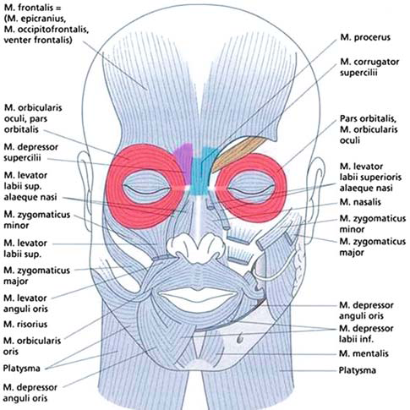

Slide 32
Glabellar Brow Furrows
Anatomic considerations: upper face
Muscle Function
Frontalis Raises the eyebrows and produces transverse wrinkles of the forehead
Corrugator Brings the eyebrows toward each other
Procerus Pulls the glabellar skin in an inferior direction and causes a transverse rhytid

Slide 33
Depressor supercilii Depresses the eyebrow
Orbicularis oculi Functions as the sphincter of the eye

Slide 34
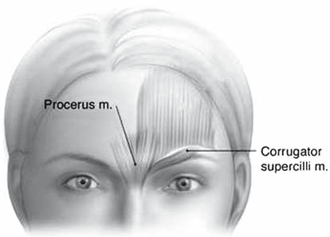

Slide 35
25 to 35 units of Botox may be placed in five separate injection points to treat the corrugators and procerus muscle in the average brow.
The dose of Dysport is a total of 50 Units given intramuscularly in five equal aliquots of 10 Units each to achieve clinical effect.

Slide 36
Each 300 Unit vial of Dysport is to be reconstituted with 2.5 mL of 0.9% Sodium Chloride Injection USP (without preservative) prior to injection.
The concentration of the resulting solution will be 10 Units per 0.08 mL to be delivered in five equally divided aliquots of 0.08 mL each.

Slide 37
Dysport may also be reconstituted with 1.5 mL of 0.9% Sodium Chloride Injection USP (without preservative) for a solution of 10 Units per 0.05 mL to be delivered in five equally divided aliquots of 0.05 mL each.

Slide 38
A 30-gauge, 31-gauge, or even 32-gauge needle and a tuberculin or diabetic syringe are used to minimize the trauma of the intramuscular injections.

Slide 39
The corrugator injections are placed just at or above the medial brow and in or just lateral to the mid-pupillary line, 1 cm above the bony orbital rim.
The fifth injection is placed in the procerus at the midline at a point just above the horizontal creases created in the glabella at the bridge of the nose.

Slide 40
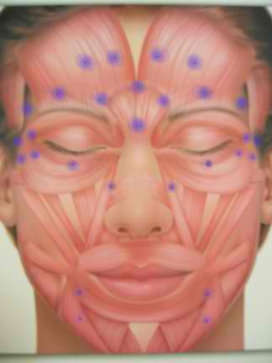

Slide 41
Patients are instructed to remain upright for 2 to 3 hours to limit the incidence of eyelid ptosis, which occurs with diffusion of the toxin down into the levator muscles of the lid.
Temporary stimulation of Müller's muscle in the lid can be achieved with 0.5 percent apraclonidine or 2.5 percent phenylephrine eyedrops every 4 hours for 2 to 3 weeks.

Slide 42
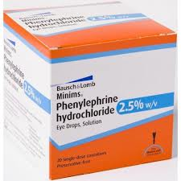
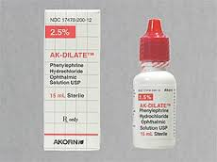

Slide 43
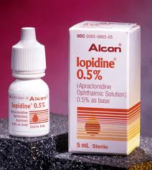
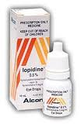

Slide 44
Raise 2 to 3 mm of elevation of the lash margin until the distant diffusion effect of the botulinum toxin on the levator muscle disappears after 2 to 3 weeks.

Slide 45
Horizontal Forehead Lines
Frontalis is treated at the horizontal equator of the forehead or above to avoid inactivation of the lower third of the frontalis muscle
responsible for suspension and movement of the eyebrows

Slide 46
12 to 20 units of botulinum toxin are placed in four or five divided doses equidistantly along the forehead equator.
Large doses or too low injection site produce brow ptosis and loss of brow arch.
No comparable adrenergic agent available to reverse brow ptosis.

Slide 47
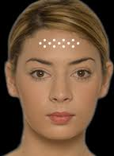
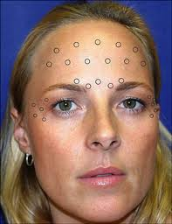

Slide 48
Crow's-Feet
Rhytides at the corners of the eye respond favorably to injections of toxin.
Toxin is usually placed at one to three injection points approximately 1 cm lateral to the lateral canthus with 10 to 18 units.

Slide 49
Placing toxin at or below the malar eminence “smile lines” in an attempt to weaken these lines may lead to paralysis of the zygomaticus muscles.
Drooping corner of the mouth that cannot spontaneously be raised acquiring a post-stroke appearance.

Slide 50
The patient should have good lower eyelid tarsal tone to avoid the appearance of senile ectropion from too much laxity of the lower eyelid.

Slide 51
Pre-treatment of the crow's-feet area is very useful as an adjunctive technique before laser resurfacing.
It prevents the problem of rhytides being readily re-formed by repeated squinting during the postoperative healing period.

Slide 52
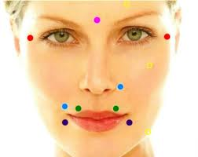

Slide 53
Combination Therapy
A synergy exists between soft-tissue fillers and neurotoxins.
The ability to control both muscles of expression and their secondary lines and folds, and to repair age-related volume changes in subcutaneous tissue has revolutionized minimally invasive cosmetic techniques

Slide 54
Toxin: upper third of the face (glabellar frown lines, horizontal forehead lines, and crow's-feet)
Filler: volume restoration of the lower and middle face (lip enhancement, filling of nasolabial fold and marionette lines, chin and cheek augmentation)

Slide 55
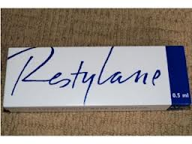
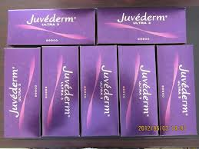
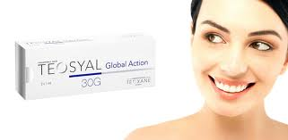

Slide 56


Hyperhidrosis

Slide 57
Hyperhidrosis
Minor's starch-iodine test to map out the extent of surface area in the axillary vault that is affected
Doses of 2.5 to 4.0 units of botulinum toxin are placed every 1 to 2 cm as intradermal injections in axillary skin.

Slide 58
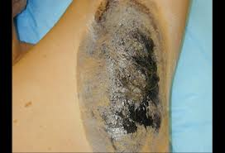

Slide 59
Reliable anhidrosis is produced within 72 hours and will last for 8 to 12 months with doses of 50 units per axilla.
The duration of effect appears to be dose related.
doses of up to 200 units (Dysport) per axilla have been reported to produce dryness for up to 29 months

Slide 60
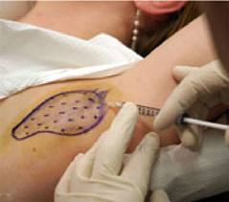

Slide 61
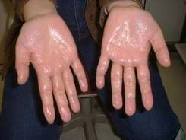

Slide 62
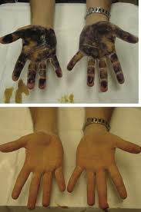

Slide 63
Palmar hyperhidrosis is more challenging to treat.
1) the more limited diffusion of the toxin in palmar skin
(2) the pain on injection
(3) the generally predictable incidence of temporary weakness in the hand

Slide 64
Anesthesia is achieved with regional wrist blocks of the median, ulnar, and radial nerves using lidocaine 1 percent to 2 percent without epinephrine.
Approximately 100 to 150 units of botulinum toxin are needed to treat a single palm, divided into 50 to 60 intradermal injections of 2 to 3 units each.

Slide 65
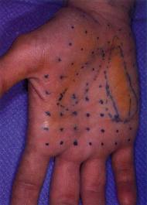

Slide 66
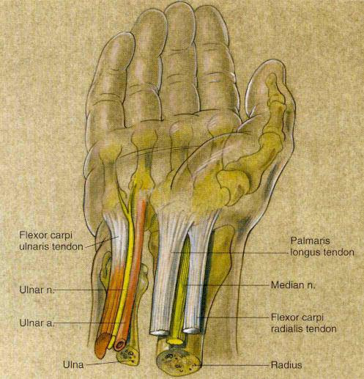

Slide 67
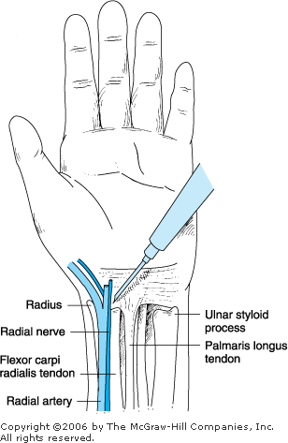
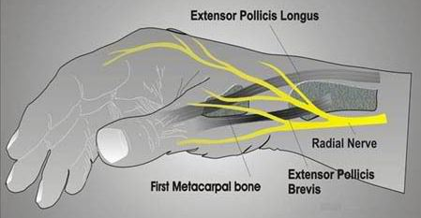

Slide 68
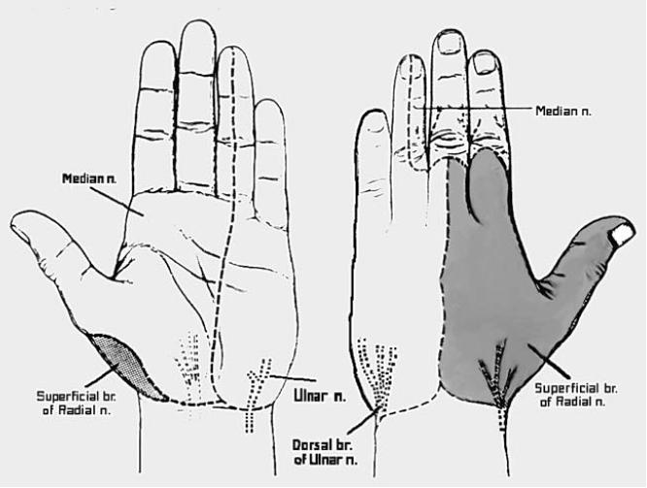

Slide 69
Onset of anhidrosis peaks in 5 to 7 days
minor weakness of the intrinsic muscles of the hand, which makes tasks requiring strength and stability (e.g., pushing a button through a buttonhole) subsides within 3 weeks.

Slide 70
wider variation in response to palmar treatment vs axillary treatment, with anhidrosis lasting from 4 to 12 months.
Due to technical difficulties in achieving even dispersion of the toxin through the palmar skin.

Slide 71
Treatments and injection sites
Region Type of correction Injection site Additional Information
Facial asymmetry Hemiparesis: Contralateral muscles
naturally occurring or consequence
of medical conditions such
as Bell’s palsy
Upper face Glabellar creases Corrugator/supercilli/ Orbicularis oculi; procerus
Pretreatment snap testand Schirmer documented tear secretion
Forehead lines Frontalis
Forehead and brow shaping Frontalis, depressor supercilii,
lateral orbicularis oculi
Periorbital rhytids or crow’s feet Inferior ciliary margin of
the orbicularis oculi
Eye shaping to increase the
palpebral aperture

Slide 72
Thank you for you
Attention

Slide 73
Midface [32] Nasalar radix (bunny lines), Levator alaeque nasi Causes upper lip ptosis
nasolabial folds Levator labii superioris
Nasal flare
Gummy/canine smile
Lower face [32] Marionette lines or mouth Depressor anguli oris Potential side effect
frown includes asymmetric
relaxation of the oral
commissure
Perioral rhytids and mouth Orbicularis oris
shaping
Peau d’orange (pebbly chin) Depressor labii inferioris
Mentalis muscle
Neck [32] Horizontal neck creases Intradermal along the Possibility of dysphagia
transverse neckline
Platysmal bands Platysma
Below the neck Décolleté creases [33] Subcutaneous muscle
fibers running over the
third intercostal spaces
and over the presternal
area [33]
Breast lifts

