Slide 1


Nonsurgical Skin Tightening

Slide 2
Summary and Key Features
• Nonsurgical skin tightening is a popular concept, with novel devices continually entering the market.
• The main types of nonsurgical skin-tightening technologies include radiofrequency, infrared light, ultrasound, micro-needling with radiofrequency, and subdermal minimally-invasive radiofrequency.
• All skin-tightening devices work by the introduction of energy to create heat within the skin or underlying structures.
• Patient selection is key for best results and overall patient satisfaction.
• Ideal candidates for non-ablative approaches include those patients concerned with risks and recovery of more invasive procedures
• Noninvasive and minimally invasive skin-tightening devices can improve both skin laxity and facial contours with limitations
• Skin-tightening procedures can be performed along with fillers, neurotoxins, or other laser- or light-based devices to address multiple issues and achieve a more global improvement: synergy amongst these modalities leads to enhanced patient satisfaction.
• Very rarely patients may experience side effects related to overly-aggressive treatment, such as burns, indentations, scars, or changes in pigmentation.

Slide 3
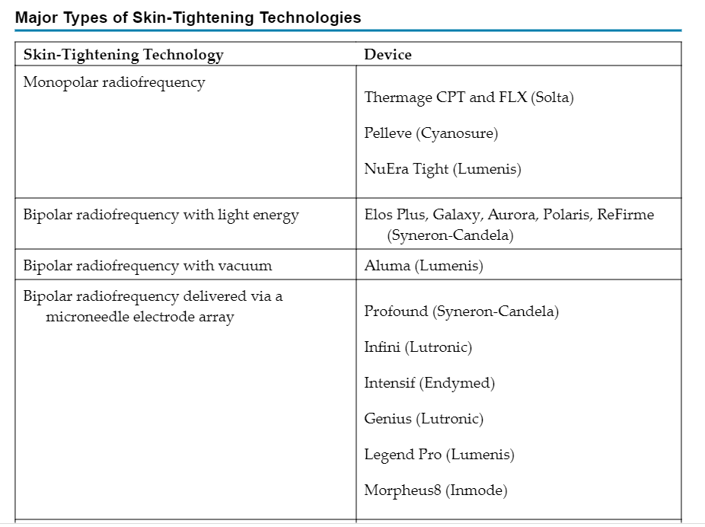

Slide 4
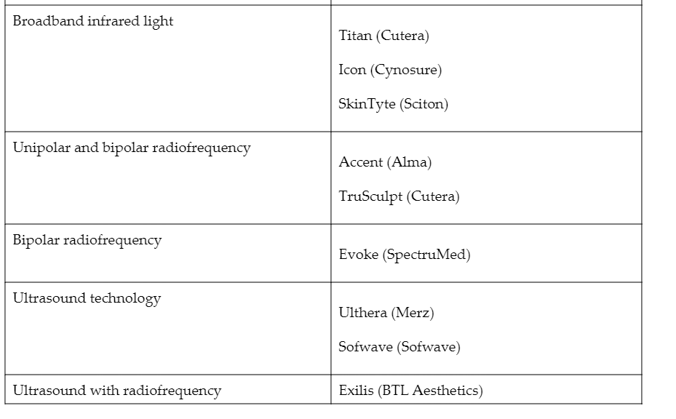

Slide 5
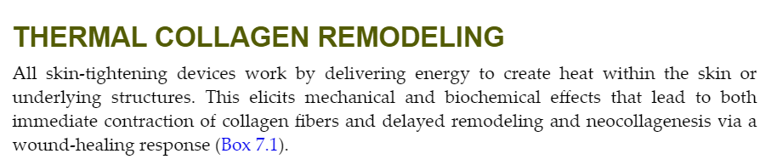
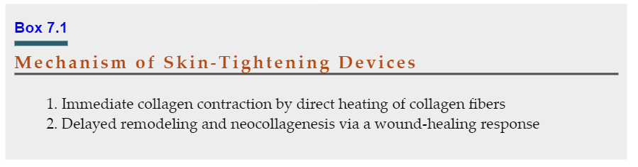

Slide 6
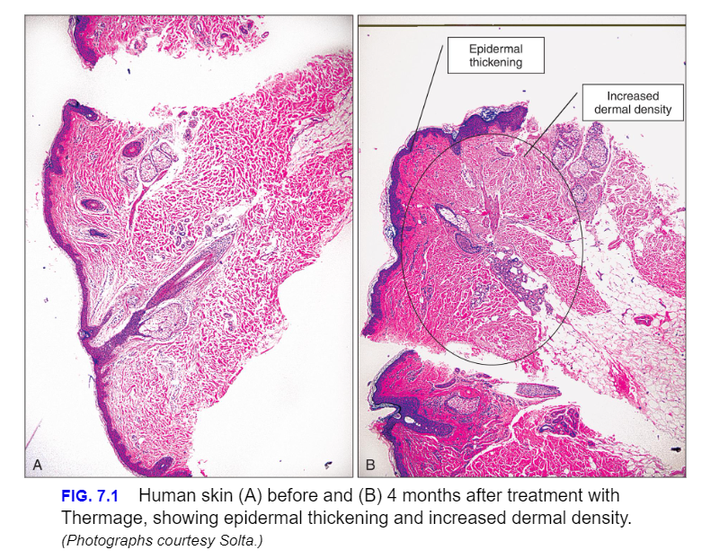

Slide 7
Problems arise if too much heat is delivered, as collagen fibrils denature completely above a critical heat threshold, leading to cell death, and scar formation.
If too little heat is delivered, there can be an inadequate tissue response,
The optimal shrinkage temperature of collagen has been cited as 58°C–65°C, with initial onset of fibril shrinkage at 58°C
The main transition to denaturation occurring at approximately 65°C;
Contraction is, in actuality, determined by a combination of temperature and exposure time.
For every 5°C decrease in temperature, a tenfold increase in exposure time is required to achieve an equivalent amount of collagen contraction.
Studies demonstrate with exposure times in the millisecond domain, the shrinkage temperature is greater than 85°C, whereas for exposure times over several seconds, the shrinkage temperature is at the lower range of 60°C–65°C.
In conclusion, both temperature and exposure time must be considered.

Slide 8
Radiofrequency Devices
Radiofrequency (RF) devices are indispensable for hemostasis, electrocoagulation, and endovenous closure in medical dermatology.
In the esthetic arena, the technology has been used for skin resurfacing and noninvasive tissue tightening.
Radiofrequency is energy in the electromagnetic spectrum, ranging from 300 MHz to 3 kHz.
Unlike most lasers, which target specific absorption bands of chromophores, heat is generated from the natural resistance of tissue to the movement of electrons within the radiofrequency field
This resistance, called impedance, generates heat relative to the amount of current and time by converting electrical current to thermal energy.
Consequently, energy is dispersed to three-dimensional tissue volumes at targeted and controlled depths.

Slide 9
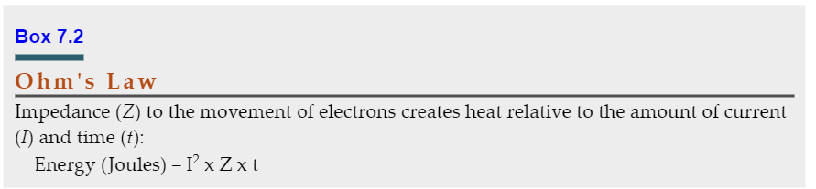

Slide 10
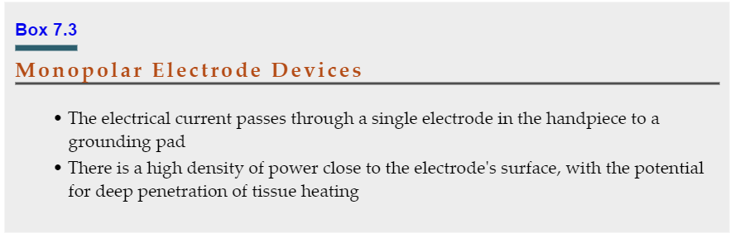
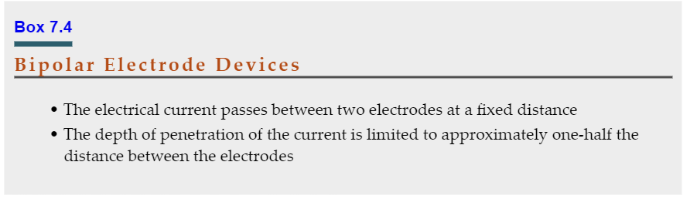

Slide 11
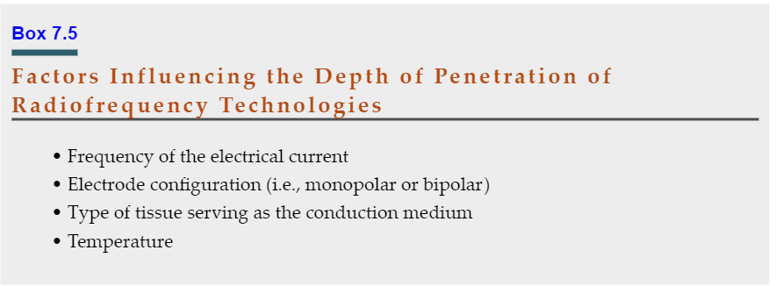

Slide 12
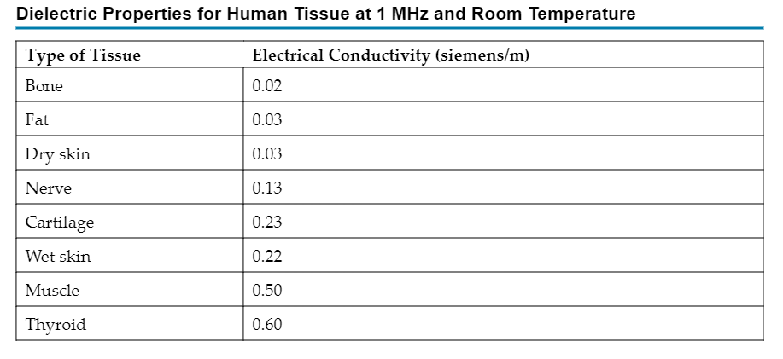

Slide 13
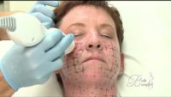

Slide 14
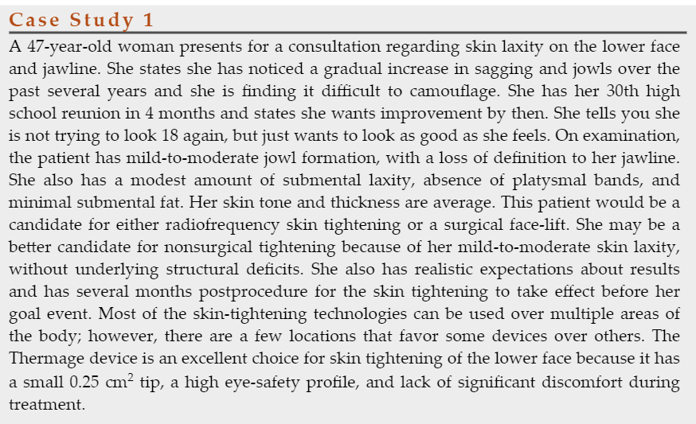

Slide 15
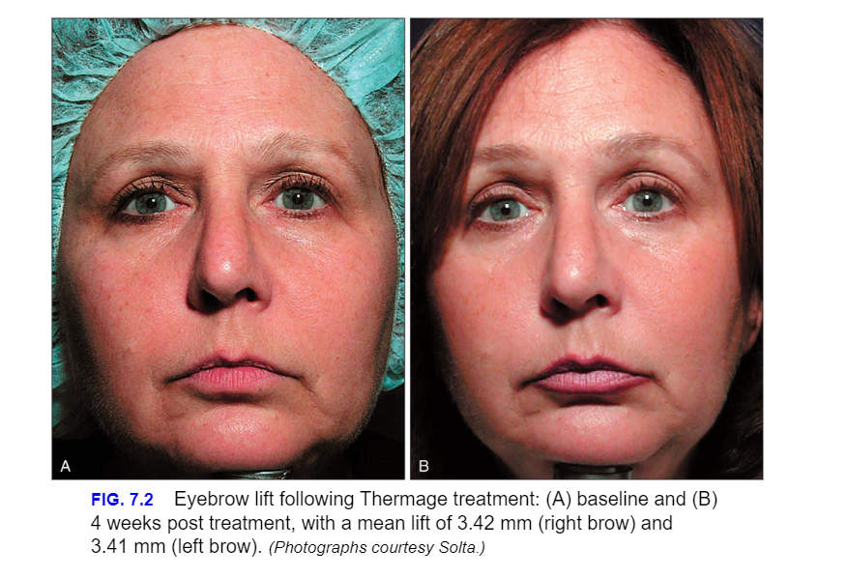

Slide 16
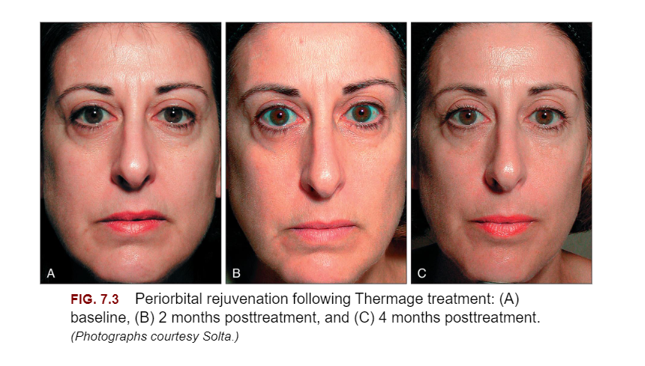

Slide 17
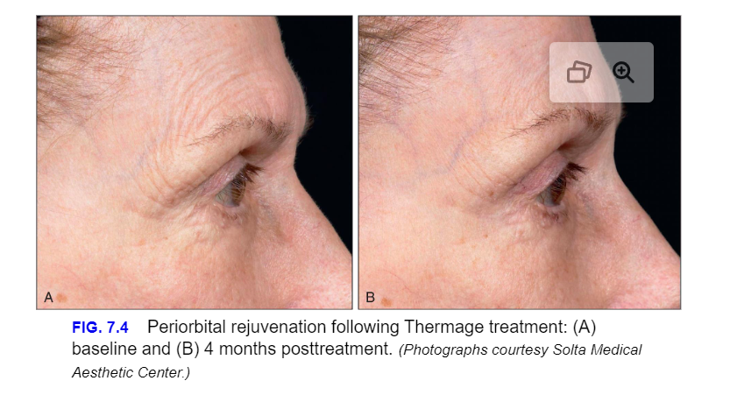

Slide 18
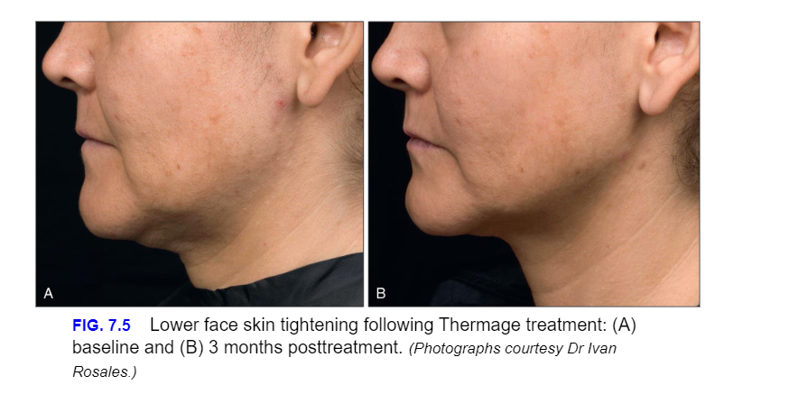

Slide 19
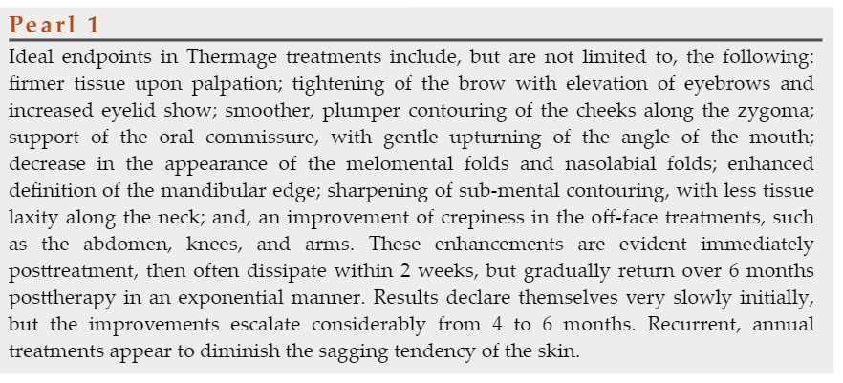

Slide 20
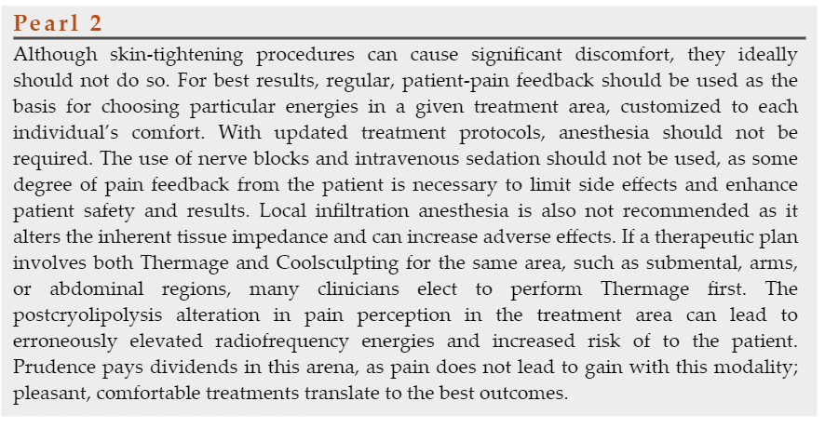

Slide 21
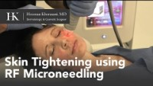
Fractional Minimally Invasive Bipolar Radiofrequency

Slide 22
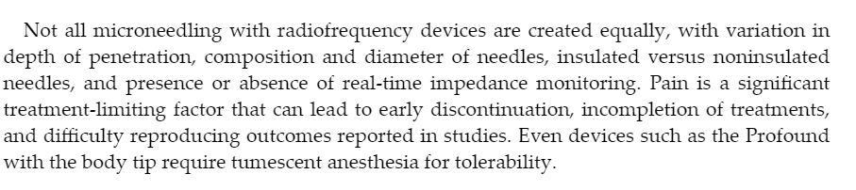

Slide 23
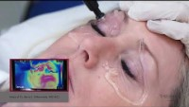
Subdermal Minimally Invasive Radiofrequency

Slide 24
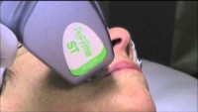
Combined Electrical and Optical Energy

Slide 25
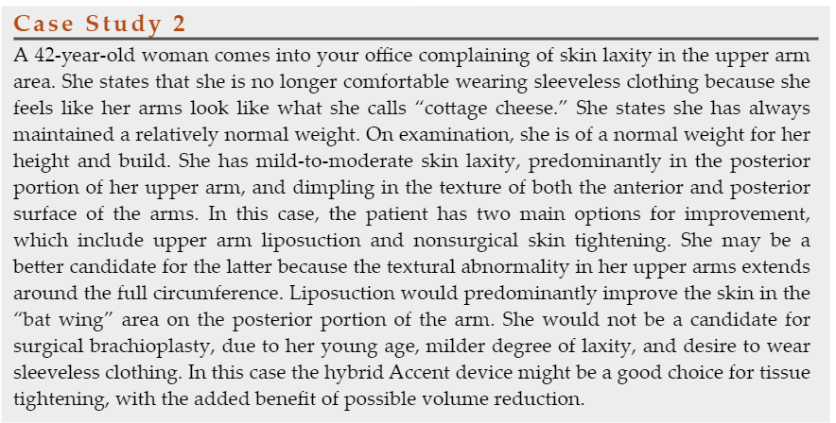

Slide 26
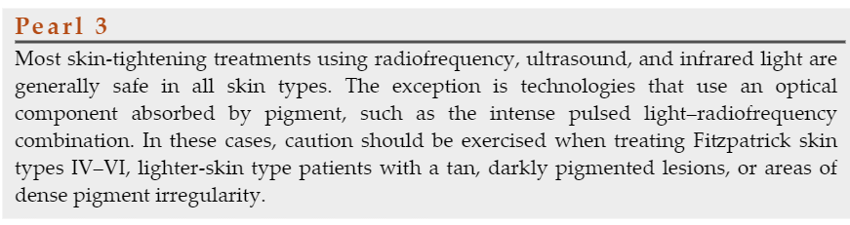

Slide 27
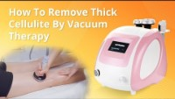
Vacuum-Assisted Bipolar Radiofrequency

Slide 28
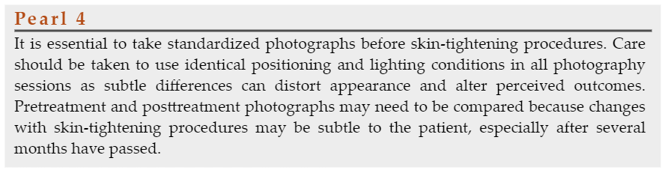

Slide 29
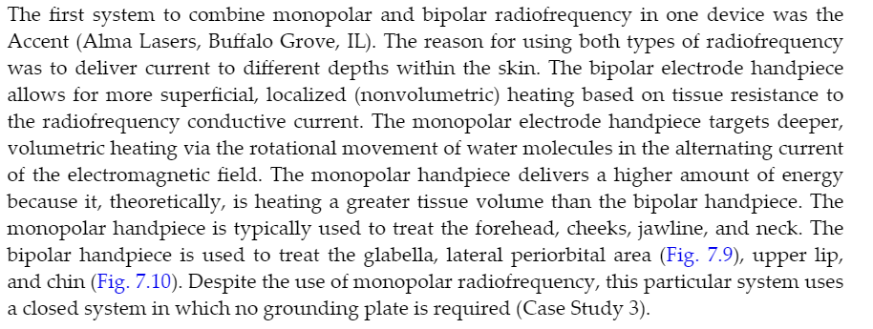
Hybrid Monopolar and Bipolar Radiofrequency

Slide 30
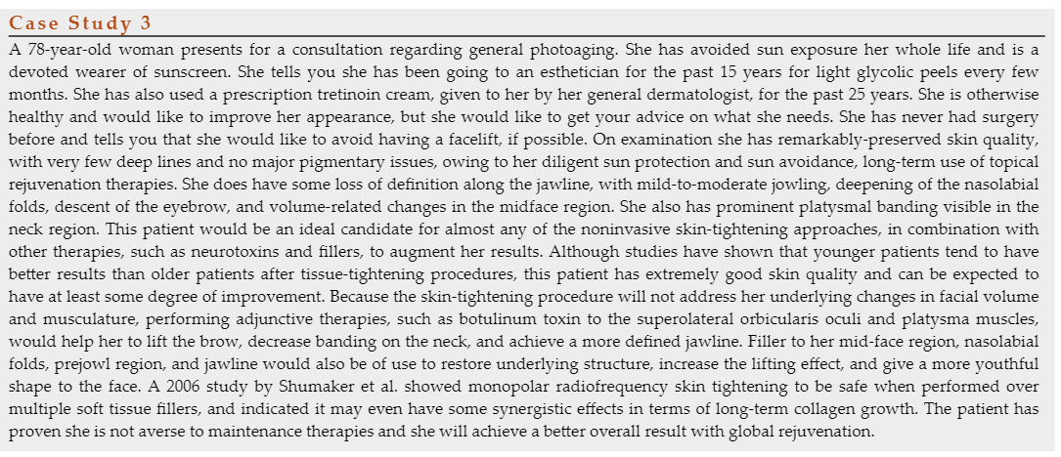

Slide 31
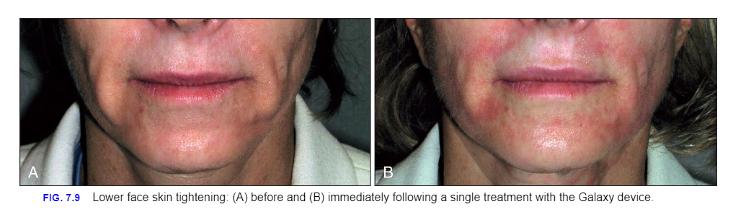

Slide 32
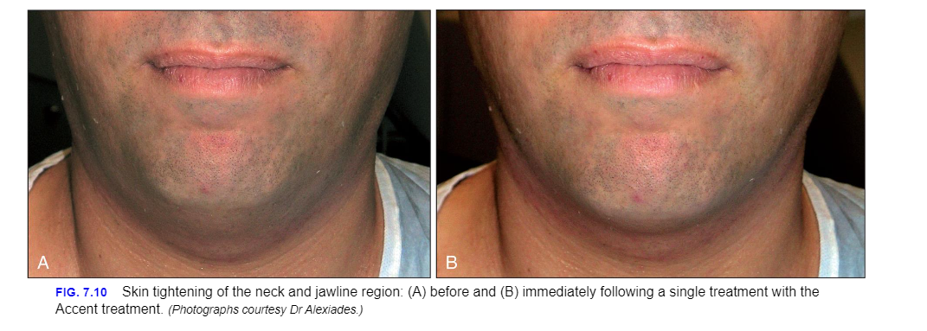

Slide 33
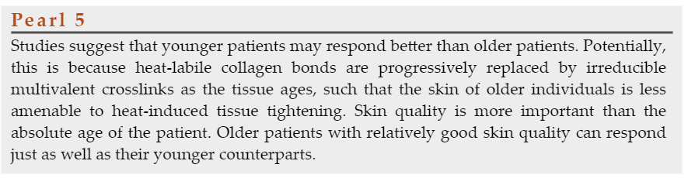

Slide 34

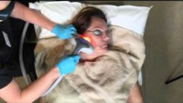

Slide 35
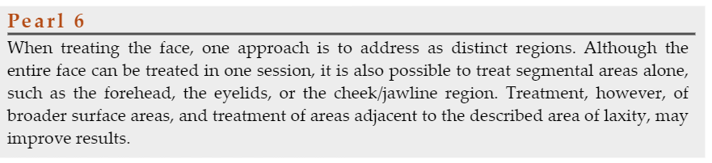

Slide 36
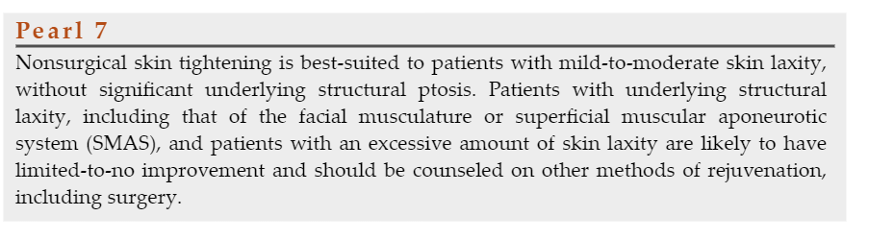

Slide 37
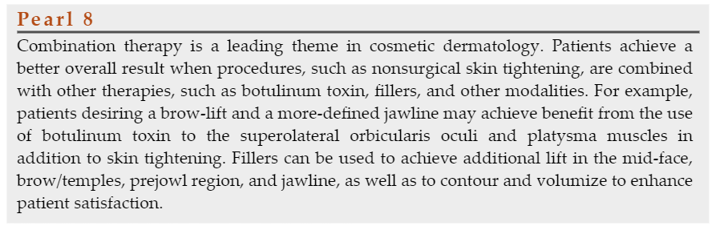

Slide 38

Ultrasound Devices

Slide 39
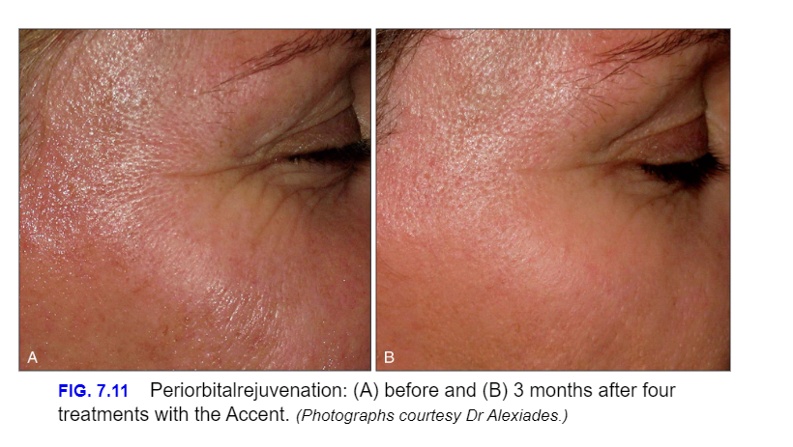

Slide 40
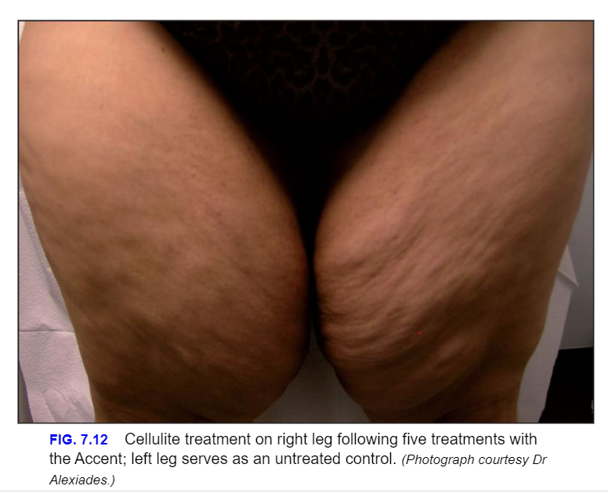

Slide 41
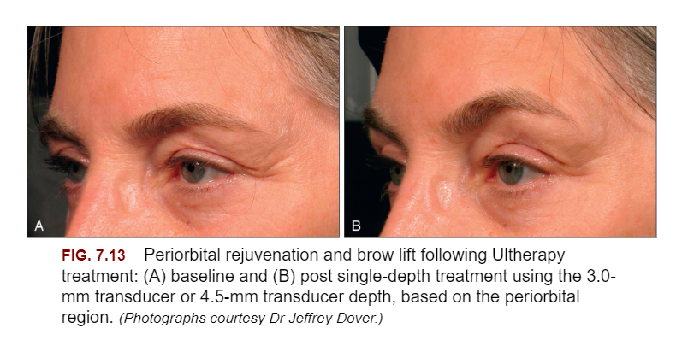

Slide 42
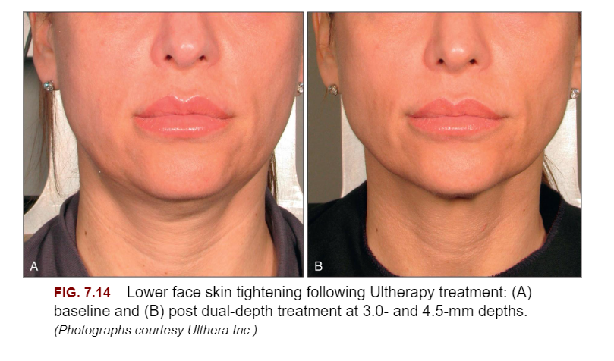

Slide 43
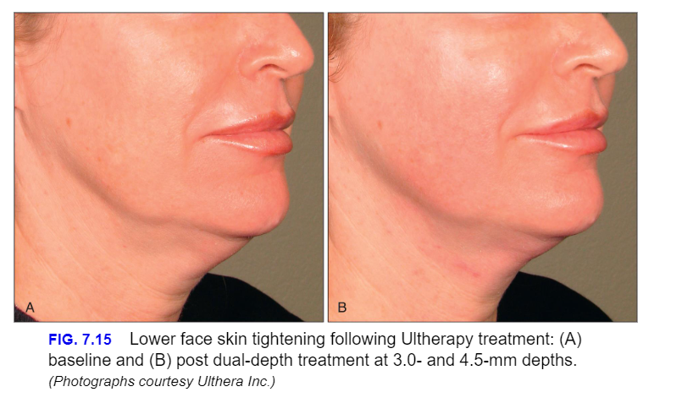

Slide 44
Tips for Maximizing Patent Satisfaction
Patient selection is of utmost importance
Results are slow gradual and occur over a period of 3–6 months.
Despite several clinical studies reporting significant improvement in the appearance of lax skin, most patients show only mild-to-moderate improvement.
Patients who are younger at the first sign of skin descent, with a lesser degree of skin laxity, may yield the most promising clinical outcomes
Very old adults, with severe sagging and wrinkles, are generally sub-optimal candidates for the degree of improvement expected with noninvasive tightening devices.
Interestingly, when these elderly patients, who are often not remotely surgical candidates, do choose to proceed with noninvasive skin-tightening procedures, they are often content with the mild improvements.
Many patients report that when skin-tightening procedures are performed at regular 1 to 2-year intervals, the progression of sagging and laxity appears to slow significantly over time.

Slide 45
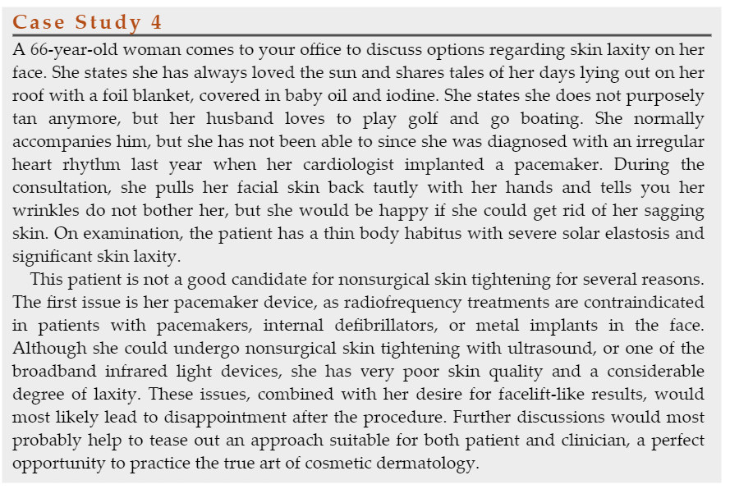

Slide 46
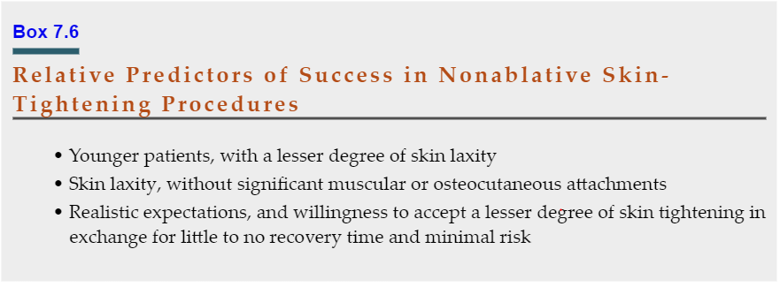

Slide 47
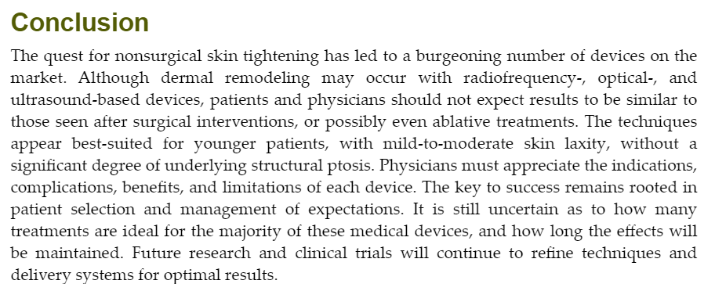

Slide 48

QUESTIONS?

