Slide 1
MRAD 256: Radiographic Technique 2
Introduction to Cranial Anatomy

Slide 2
Skull Readings
Bontrager:
Chapter 11
  pages: 375-384: Anatomy of the skull

Slide 3
Skull
Rests on superior end of vertebral column
Divided into two main sets of bones
  8 Cranial Bones, form a protective housing for the brain
  14 Facial Bones, provide structure, shape and support for the face as well as protect the upper portions of the respiratory and digestive tracts

Slide 4
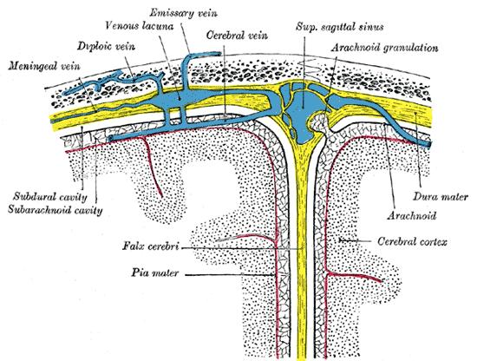
Skull
The bones of the cranial vault are composed of 2 plates of compact tissue separated by an inner layer of spongy tissue called dipl
The bones of the cranium and face are joined by fibrous joints called sutures

Slide 5
Cranium
Calvaria, Skull cap or Vault
  Frontal
  Right Parietal
  Left Parietal
  Occipital
Floor
  Right Temporal
  Left Temporal
  Sphenoid
  Ethmoid

Slide 6
Bones of the Cranium
STEP OF
Sphenoid
Temporal
Ethmoid
Parietal
Occipital
Frontal

Slide 7
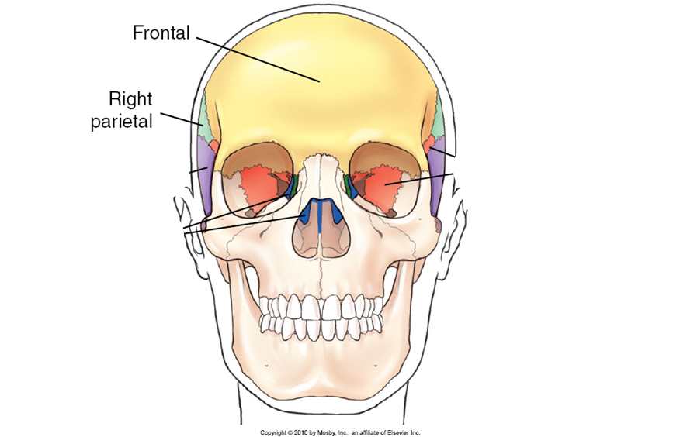
Skullcap

Slide 8
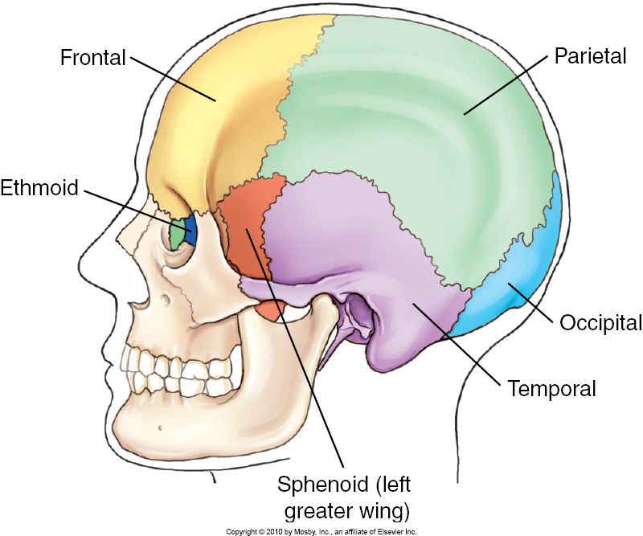
Skullcap

Slide 9
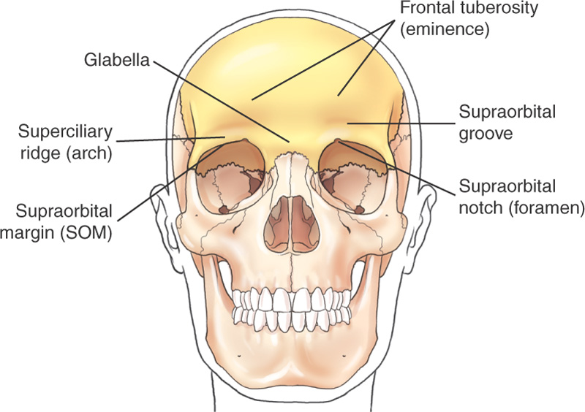
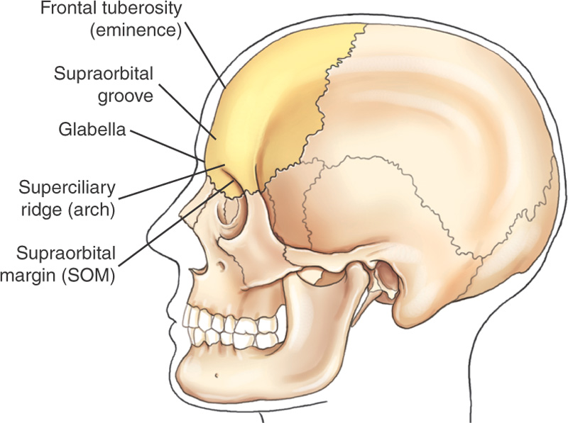
Frontal Bone

Slide 10


Slide 11


Slide 12
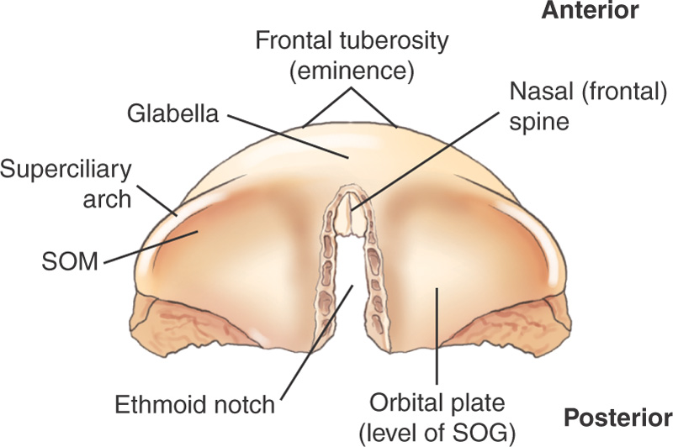
Orbital (Horizontal) Portion of Frontal Bone (Inferior View)

Slide 13
Frontal Bone Articulations
Articulates with 4 cranial bones
Left and right parietals
Sphenoid
Ethmoid
Also articulates with 8 facial bones

Slide 14
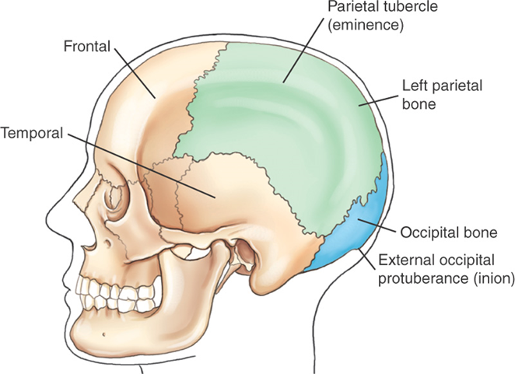
Parietal Bones

Slide 15
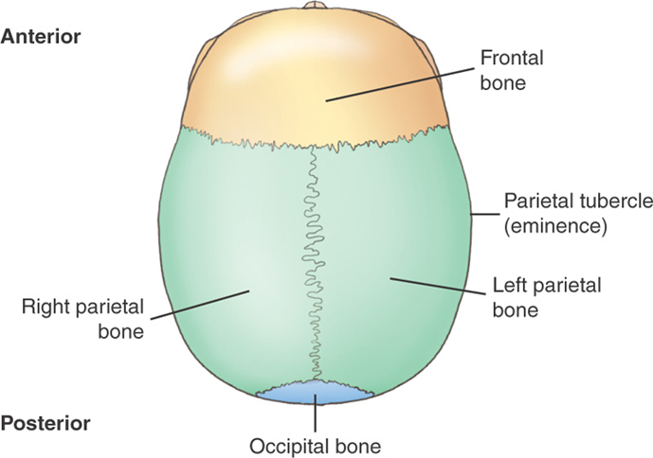

Slide 16
Parietal Bones
The widest portion of the entire skull is located between the parietal tubercles or eminences
Articulates with 5 cranial bones
  Frontal
  Occipital
  Temporal
  Sphenoid
  Opposite parietal

Slide 17
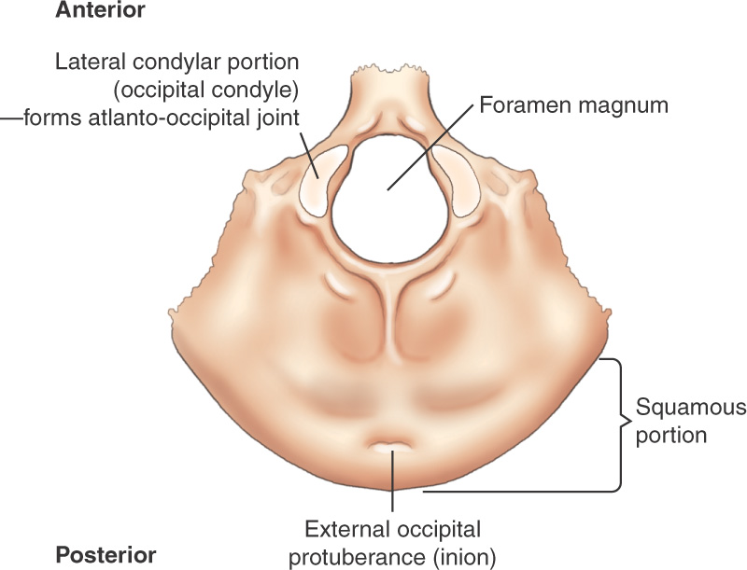
Occipital Bone Inferior View

Slide 18
Occipital Bone
External surface presents a rounded part called the squamous portion
Squamous portion forms the back of the head that is superior to the external occipital tuberance or inion, which is the prominent bump on the inferoposterior portion of the skull
Large opening in base called foramen magnum, through which the spinal cord passes
Occipital condyles on each side of foramen magnum articulate with the atlas (C1) forming the atlanto-occipital joint

Slide 19
Occipital Bone Articulations
Articulates with 6 bones
  2 parietals
  2 temporals
  Sphenoid
  Atlas (C1)

Slide 20
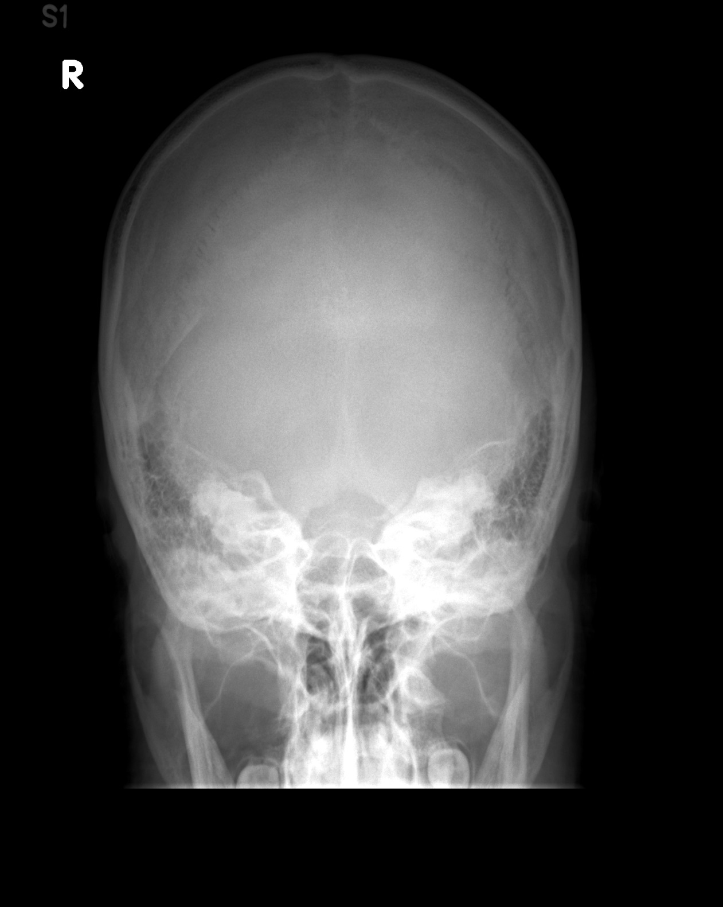

Slide 21
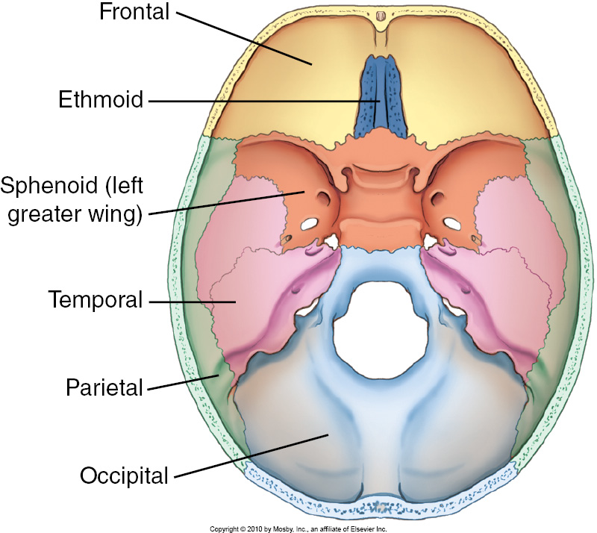
Floor
Notes:
Notice the occiput-forms the posterior wall

Slide 22
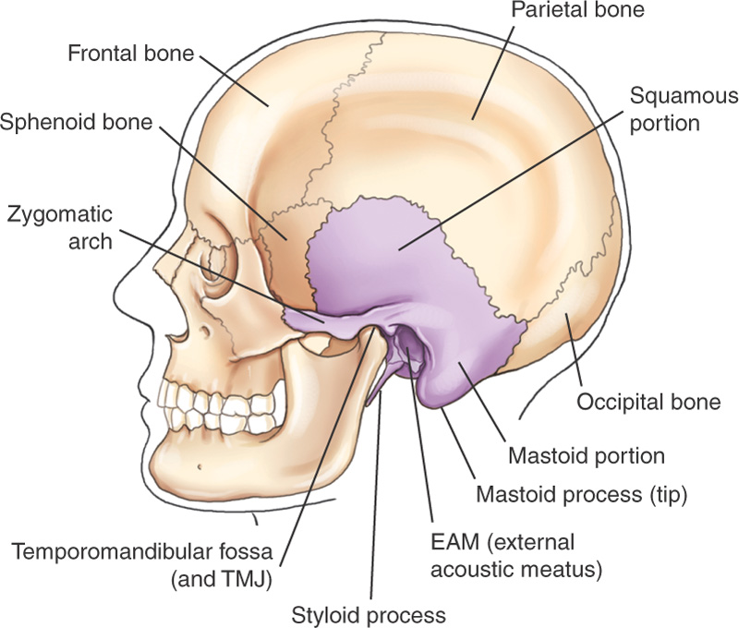
Temporal Bone Lateral View

Slide 23
Temporal Bones
Complex structures that house the organs of hearing and balance
Divided into 3 parts
  Squamous portion-thinnest, most vulnerable to fracture
  Mastoid portion, posterior to EAM, prominent mastoid process or tip
  Petrous portion or petrous pyramid or pars petrosal, upper border of petrous portion also called petrous ridge

Slide 24
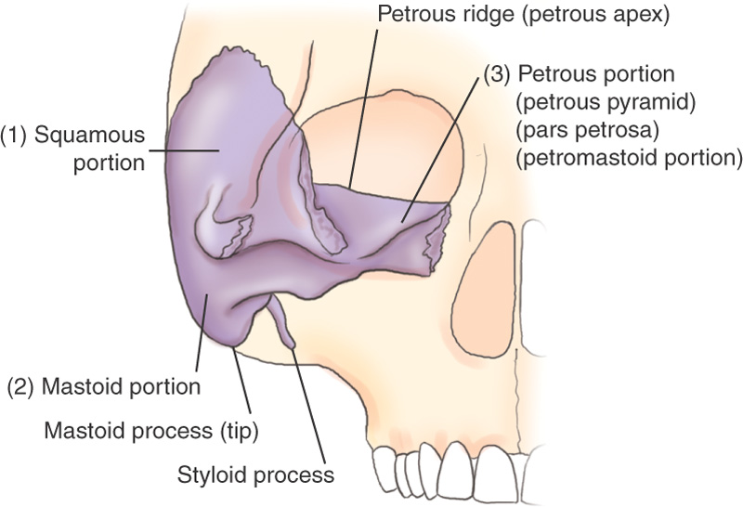
Temporal Bone (Front Cutaway View)

Slide 25
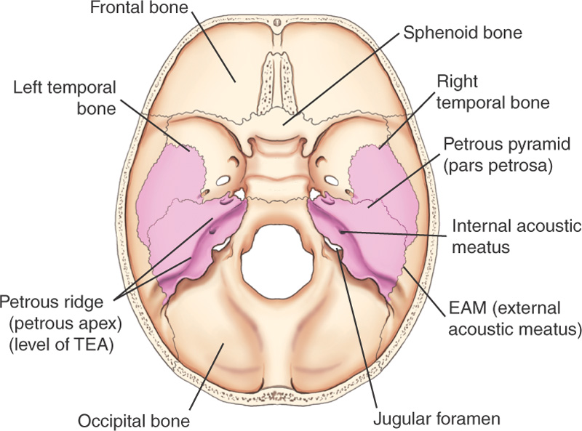
Temporal Bones (Superior View)

Slide 26
Temporal Bones Articulations
Articulates with 3 cranial bones:
  Parietal
  Occipital
  Sphenoid
  Also articulates with 2 facial bones

Slide 27
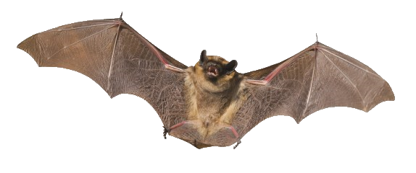
Sphenoid Bone

Slide 28
Sphenoid Bone
Centrally located, forms the anchor for all 8 cranial bones
Sella turcica (sella =saddle) is a central depression in the body of the sphenoid partially surrounds and protects the pituitary gland
Dorsum sellae is posterior to sella turcica (back of saddle)

Slide 29
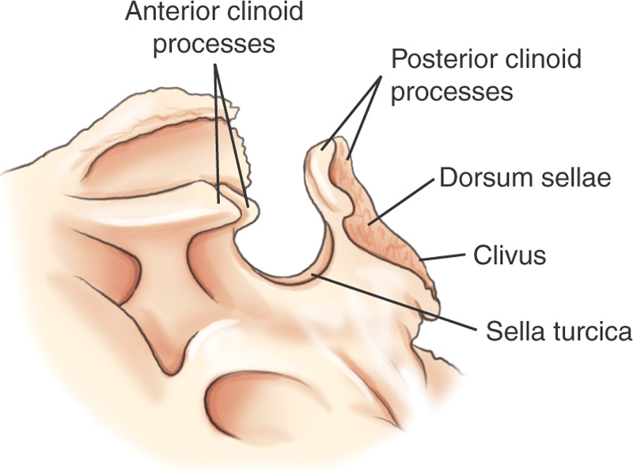
Sella Turcica (Lateral View)

Slide 30
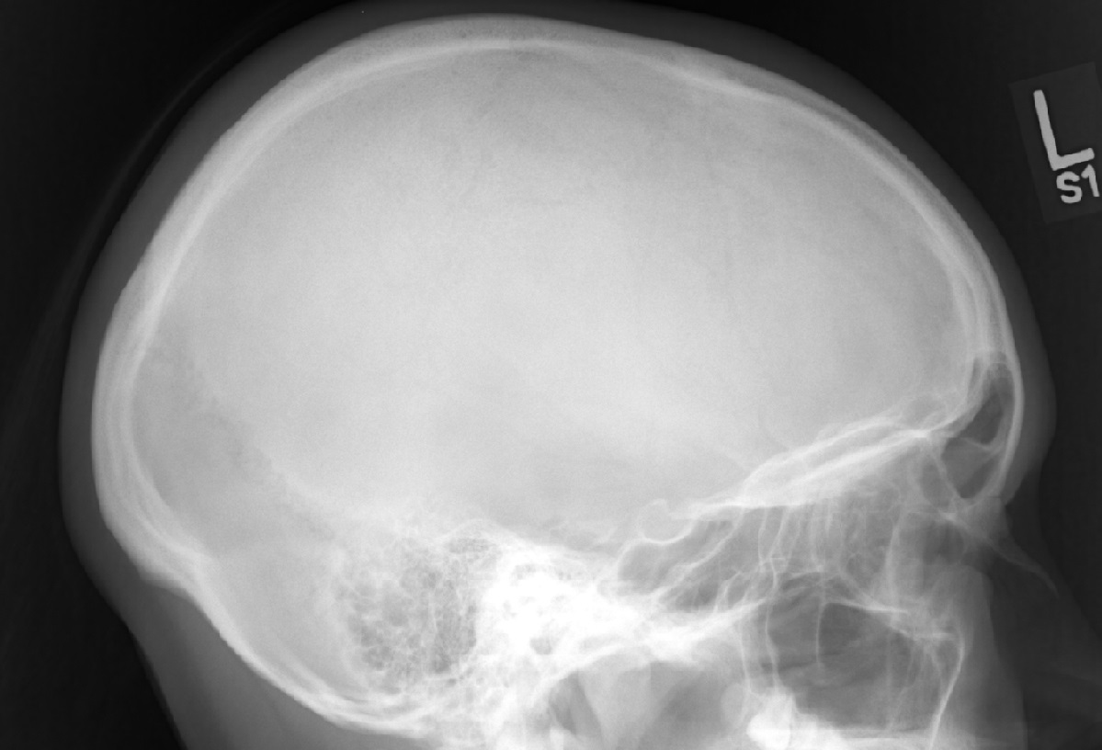

Slide 31
Sphenoid Bone
The clivus is a shallow depression that begins on the posteroinferior aspect of the dorsum sellae, extending to the foramen magnum
The clivus forms a base of support to the pons and the basilar artery
Extending laterally on both sides are 2 pairs of wings
  Lesser wings are triangular and nearly horizontal, ending medially in the 2 anterior clinoid processes
  Greater wings extend laterally from the sides and form a portion of the sides of a cranium. Three pairs of foramina are for passage of cranial nerves.

Slide 32
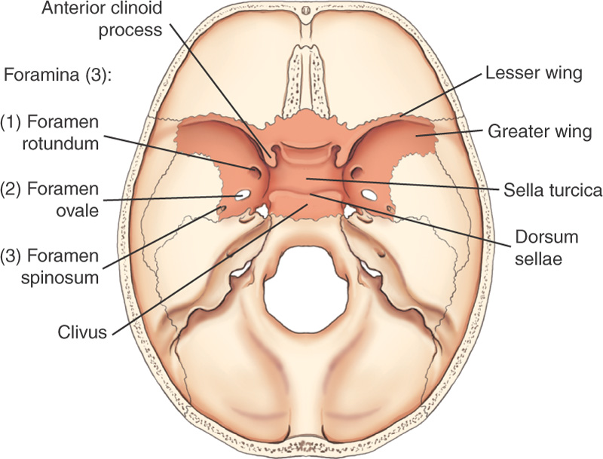
Sphenoid Bone Superior View

Slide 33
Sphenoid Bone
Foramen rotundum
Foramen ovale
Foramen spinosum
Chiasmatic or optic groove
Optic canal
Optic foramen

Slide 34
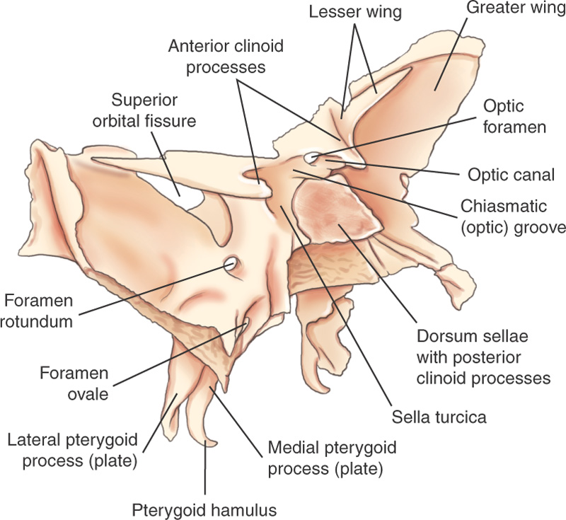
Sphenoid Bone Oblique View

Slide 35
Sphenoid Bone
Projecting downward are 4 processes:
  Lateral pterygoid processes (sometimes called plates)
  Medial pterygoid processes which end in small hook like processes, called the pterygoid hamuli
  Pterygoid processes form part of the lateral walls of the nasal cavities

Slide 36
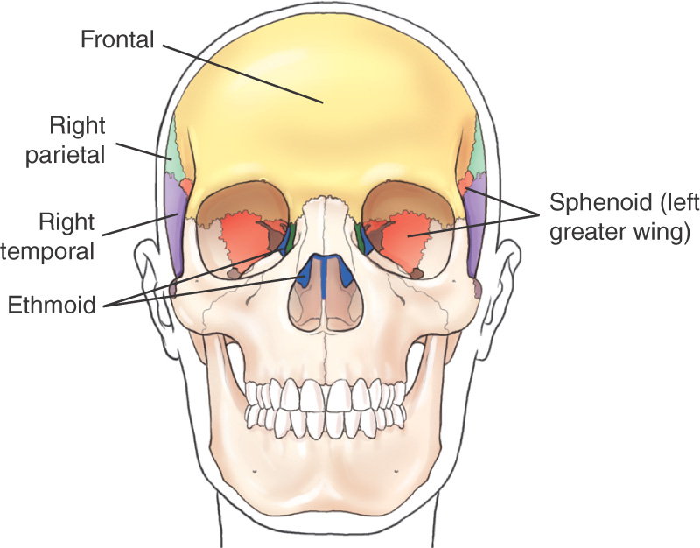
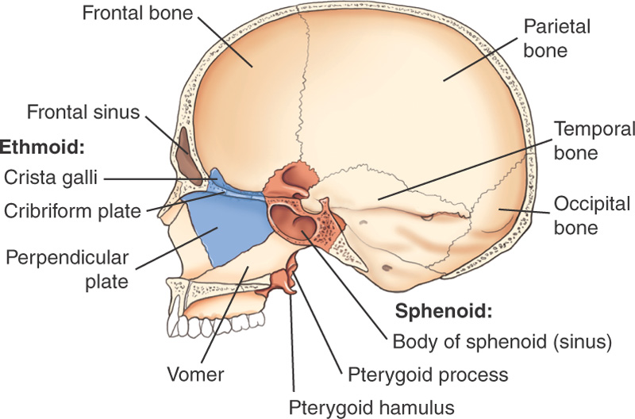
Sphenoid Frontal and Sagittal Views

Slide 37
Sphenoid Articulations
Articulates with all 7 of the other cranial bones
Articulates with 5 facial bones

Slide 38
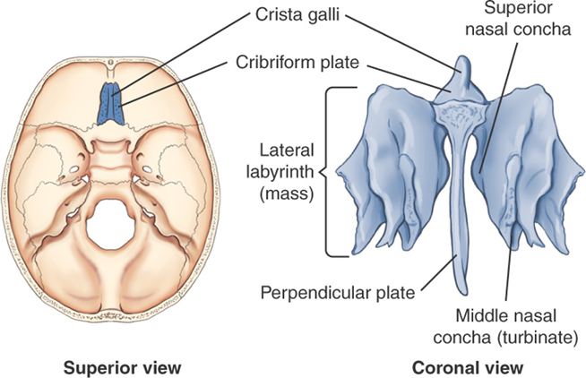

Slide 39
Ethmoid Bone
Lies below the floor of the cranium, the top shows on a superior view situated in the ethmoid notch of the frontal bone
Cribriform plate contains numerous foramina for segmental branches of the olfactory nerve
Crista galli (derived from “rooster’s comb”) projects superiorly from the cribriform plate

Slide 40
Ethmoid Bone
Projecting downward in the midline is the perpendicular plate, helps form the nasal septum
Lateral labyrinths (masses) on each side of the perpendicular plate are suspended from the underside
Lateral masses contain the ethmoid air cells or sinuses, and help to form the medial walls of the orbits and the lateral walls of the nasal cavity
Extending medially and downward from each labyrinth are superior and middle nasal conchae or turbinates

Slide 41
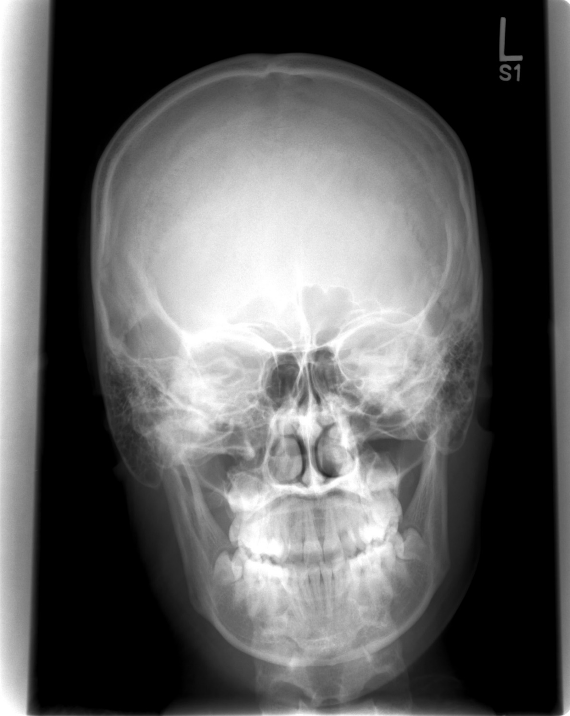

Slide 42
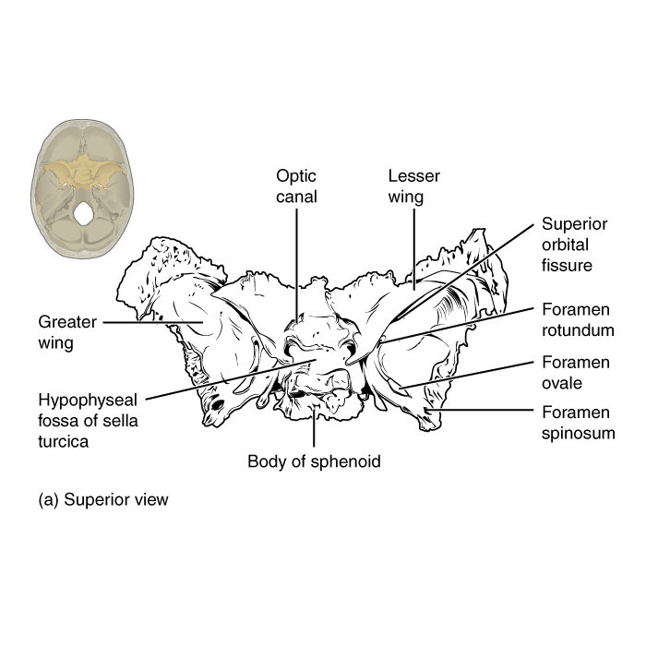
Case courtesy of OpenStax College, Radiopaedia.org, rID: 42758

Slide 43
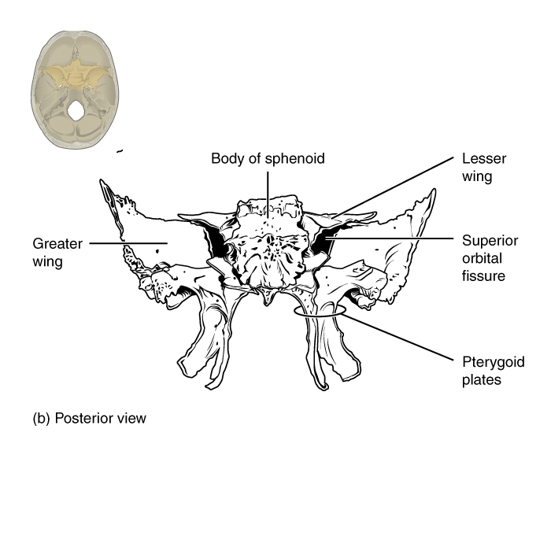
Case courtesy of OpenStax College, Radiopaedia.org, rID: 42758

Slide 44
Cranial Sutures
Articulations of cranium called sutures
Immoveable synarthrodial joints
Suture lines have a serrated appearance
Wormian Bones sometimes develop in the sutures of adults
Most often found in lambdoidal suture

Slide 45
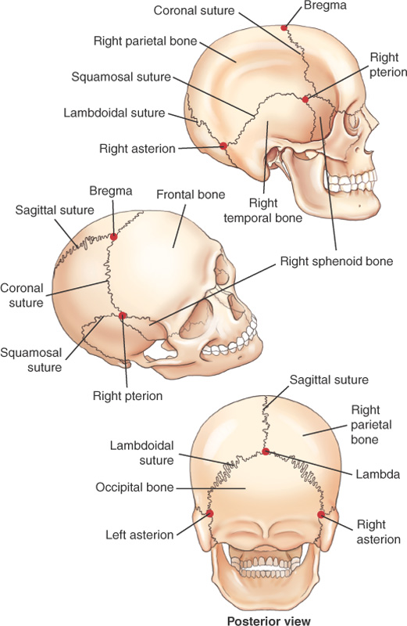
Cranial Sutures and Junction Points
Cranial sutures
  Coronal
  Lambdoidal
  Squamosal
  Sagittal
Junction points
  Asterion
  Bregma
  Lambda
  Pterion

Slide 46
Major Sutures
Coronal
  Separates frontal bone from parietals
Sagittal
  Separates parietals midline
Squamosal or Squamous
  Separates parietals from temporals
Lambdoid
  Separates parietals from occipital

Slide 47
Sutural Junctions
Bregma
  Anterior end of Sagittal suture
Lambda
  Posterior end of Sagittal suture
Pterions – right and left
  Junction of parietals, temporals, and greater wings of sphenoid
Asterions – right and left
  Posterior to ear, where squamosal and lambdoidal sutures meet
Notes:
Each end of a

Slide 48
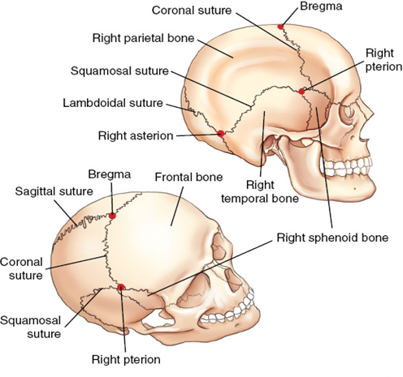
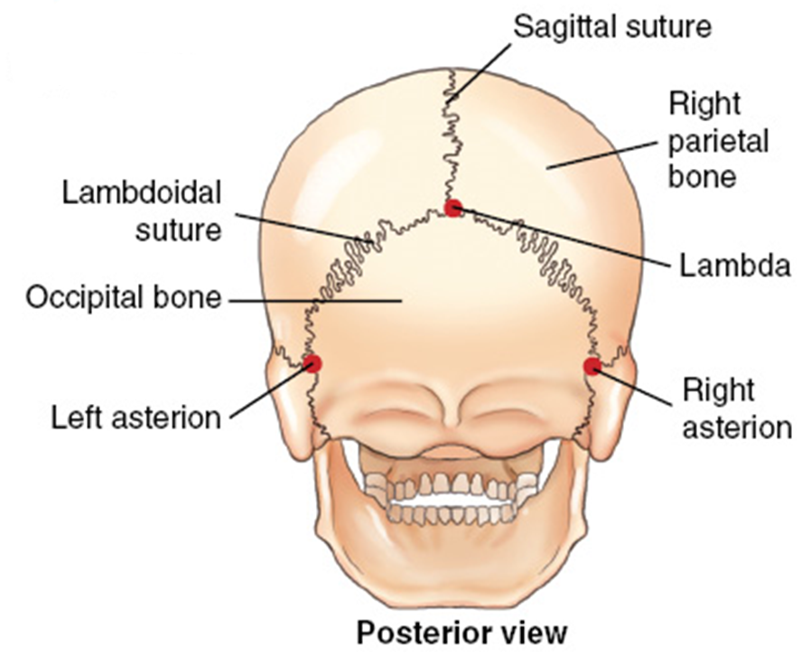
Cranial Sutures
Notes:
Adult Skull

Slide 49
Infant Cranium
Ossification of individual cranial bones is incomplete at birth
Sutures fill in after birth
Fontanels – sutures that join more slowly
  Do not completely close until age 12 or 13

Slide 50
Fontanels
Bregma and lambda are membrane-covered openings commonly referred to as “soft spots”
Soft spots are called anterior and posterior fontanels
Sphenoid and mastoid fontanels are seen on lateral aspects of the skull
Notes:
Anterior fontanel larger and doesn’t completely close until 18 months of age
Sphenoid fontanel becomes the pterion
Mastoid fontanel becomes the asterion

Slide 51
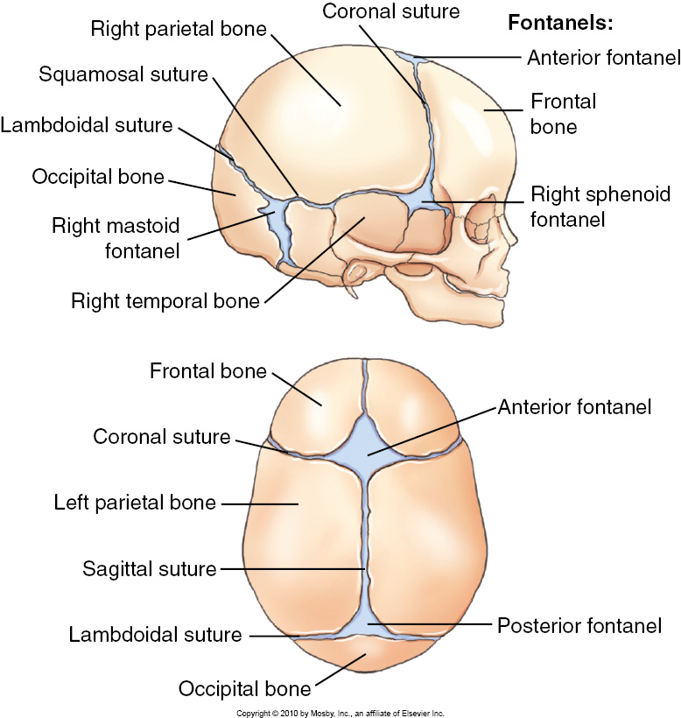
Infant Cranial Sutures & Frontanels

Slide 52

Infant Cranial Sutures & Frontanels

