Slide 1


IPL

Slide 2
IPL devices use filtered, high-intensity, pulsed, non-laser light of varying wavelengths to treat both esthetic and medical conditions.
Current IPL devices contain sophisticated, interchangeable light filters, which allow for versatility and a wide range of treatment options.
With appropriate patient selection and practitioner experience, IPL can be highly effective, providing excellent results, typically with little downtime.
Inappropriate patient selection, incorrect treatment parameters, or poor technique, however, can lead to significant adverse events.

Slide 3
• Intense pulsed light (IPL) devices are highly versatile and can be used for a wide range of esthetic and medical conditions.
• IPL platforms use high-output flash-lamps to produce polychromatic, noncollimated, incoherent (nonlaser) light, with wavelengths ranging from 500 to 1400 nm.
• Benign pigmented lesions, dyschromia, unwanted hair, telangiectasias, facial redness, flushing, Poikiloderma of Civatte, precancerous lesions, and acne can all be effectively treated with IPL.
• While treatment parameters can be adjusted to improve the safety profile of IPL in darker skin types (IV–VI), complications in this patient demographic are not uncommon. IPL should be used with extreme caution in darker skin types and in tanned skin.
• Not all IPL devices are created equally. Differences in the design and optics are significant, translating into huge ranges in efficacy. The device quality seems to correlate almost directly with the price point.
• With thorough understanding of light-tissue interactions and the wide selection of device parameters, experienced practitioners can take advantage of the considerable versatility of high-quality IPL devices.

Slide 4
Reflection
Approximately 4% to 7% of light is reflected off skin.2 The amount of light reflected increases with increasing angle of incidence with the least reflection occurring when the laser beam directed perpendicular to the tissue. If enough reflection occurs to create a high-intensity beam, damage to unintended targets could occur. For example, an errant 10,600-nm beam can cause damage to the cornea because of its water content whereas a reflected 595-nm pulsed dye laser beam can damage the retina because of its pigment content. Protective eye wear guards against reflected and direct exposure to laser light.

Slide 5

• Intense pulsed light: IPL is polychromatic, noncollimated, incoherent light, with wavelengths ranging from 500 to 1400 nm. This is in contrast to laser light, which is a single wavelength, highly-directional, and coherent in nature.
• Flash-lamp: Flash-lamps are pulsed sources of light, which consist of glass tubing with electrodes at either end. The glass tubing is filled with a gas, typically xenon or krypton.
• Selective photothermolysis: The target chromophores of IPL are primarily melanin, oxyhemoglobin, deoxyhemoglobin and methemoglobin ( all at the same time unlike LASESRS ) which have broad, overlapping absorption spectra; the polychromatic nature of IPL thus allows for the treatment of both vascular and pigmented lesions with a single light exposure.
Terminology

Slide 6
• Pulse duration: Pulse duration represents the length of time over which the light energy is delivered and the duration the tissue is exposed to the light beam.
• Multiple sequential pulsing and pulse delay: Depending on the IPL device, light can be delivered either as a single-pulse, or as a double- or triple-pulse, separated by short pulse delays in the millisecond range. “Multiple sequential pulsing” is the term used to describe the use of double- or triple-pulses. In theory, and practice, “multiple sequential pulsing” allows for a gentler treatment, given high fluences can be divided into multiple, shorter pulses of lower fluences. “Multiple sequential pulsing” also permits successive heating of large vessels, while still allowing adequate cooling of the epidermis. Some IPL devices also allow adjustment of the pulse duration of each individual pulse and the length of the pulse delay between the pulses. When more epidermal protection is needed, as in the case of tanned skin or darker skin, the pulse delay can be elongated to provide more time for enhanced protection through various means

Slide 7
Spectral shift: IPL devices experience a phenomenon known as spectral shift, in which a decrease in power causes a relative increase in the amount of energy density emitted at longer wavelengths. Specifically, for a set fluence, when coupled with a longer pulse duration and the accompanying decrease in power, the relative amount of energy density emitted in the longer wavelengths increases, with a relative decrease at the shorter wavelengths when compared to the same fluence at a shorter pulse duration. The spectral shift phenomenon enhances the effectiveness of IPL devices in treating deeper, darker, and larger vessels, which respond well to longer wavelengths.

Slide 8
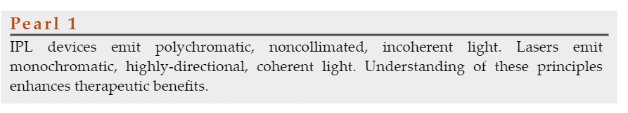

Slide 9
Equipment
Cut-off filters and absorption filters: Many IPL devices utilize interchangeable, optically-coated, quartz filters, called “cut-off filters.”
IPL hand-piece: Most IPL devices deliver light to the skin through a large, flat, rectangular, sapphire crystal. • Cooling mechanisms:
Epidermal cooling significantly decreases side effects and allows for the use of higher fluences.
BroadBand Light (BBL): BBL is a marketing term developed by the company Sciton (Palo Alto, CA) to describe their intense-pulsed light devices. The terms “BBL” and “IPL” are sometimes used interchangeably, and have similar meaning.

Slide 10
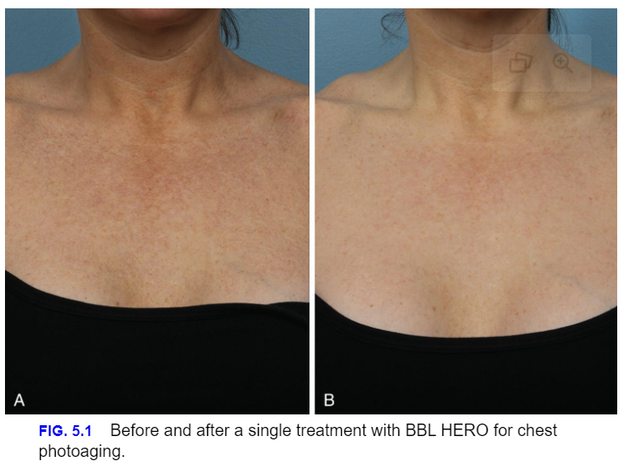

Slide 11
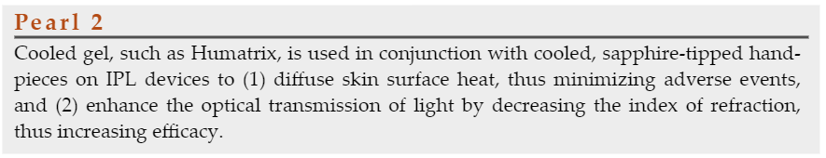

Slide 12
Patient Selection
Pigment lesions due to solar exposure and less then 1cm in size, never treat Melasma with IPL
Telangiectasias
Large Pores
Rosacea
Skin Texture
Skin types I to III only,
Skin Types V to VI is highly discouraged

Slide 13
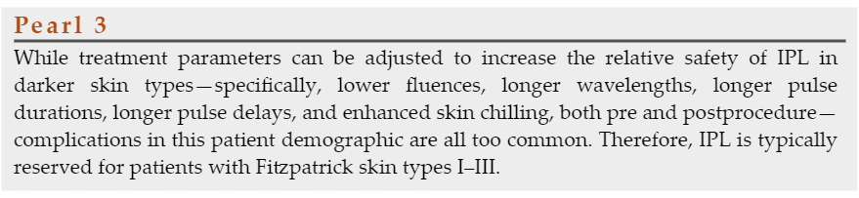

Slide 14
Treatment Protocol
Patient eligibility
Eye Protection
Clean skin
Given IPL often results in delayed tissue reactions, preforming a test spot on the same day of treatment can lead to a false sense of security. Red inflammatory burns can show a day after
A spot tests prior to treatment for novice technicians might be advice

Slide 15
Treatment Technique
Some prefer to perform multiple passes of a given treatment area, with each pass orientated in a different direction.
Those who overlap usually do so by about 20% between pulses
For skin types II–III patients, we increase the time between pulses, which allows for more time for cooling between pulses.
Determining which part of the face to treat and in what order is up to the individual clinician.
Regardless of the technique, it is crucial to frequently communicate with the patient; feedback is critical.
If the patient reports intense pain, treatment should be stopped, and the treatment area assessed and addressed accordingly, as this is an indication of incorrect treatment parameters. It is imperative that high vigilance be exercised throughout the treatment.

Slide 16
Appropriate endpoints include subtle darkening of lentigines, and constriction of the vessels or color conversion from bright red to blue/purple. If a vessel turns blue/purple, which represents a conversion of the intended target from oxyhemoglobin to deoxy- or methemoglobin, we often take advantage of this opportunity and perform a focal second pass with a slightly longer pulse duration, causing an intentional spectral shift to a longer wavelength for better absorption by the deoxy- or methemoglobin
Similarly, if there is an inadequate thermal response, and the vessel still blanches upon compression, implying persistent patency, a second pass focally with increased fluence and/or a shorter pulse duration is performed. Purpura can also be achieved as an endpoint, if so desired, although the esthetic patient population tends to prefer nonpurpuric treatments.

Slide 17
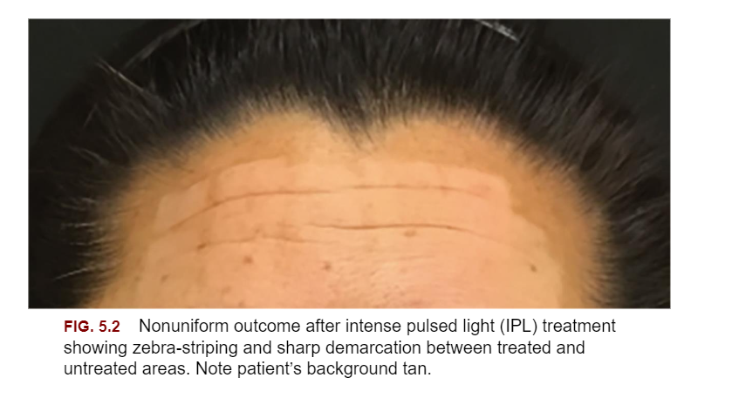

Slide 18
Additionally, given the rapid beam divergence of intense pulsed light, it is important to maintain the tip of the hand-piece in close and uniform contact with the cool gel on the skin surface. Nonuniform treatment can occur if a pulse is delivered when the treatment tip is either elevated off the skin with irregular contact with the gel and/or skin, or pressed too firmly into the skin, given beam divergence changes effective fluence. Close contact also ensures the cooled sapphire-crystal can provide adequate contact-cooling to the epidermis. For difficult to reach locations, such as the alar groove, applying a thicker layer of cool gel can help ensure adequate contact between the skin, gel and sapphire-crystal. Some of us also advocate for icing before, during and after the procedure. We often ice the treatment area, especially the alar region, immediately prior to treatment to alleviate discomfort and to minimize the potential for redness, swelling, and postinflammatory hyperpigmentation.

Slide 19

QUESTIONS?

